Slide 1


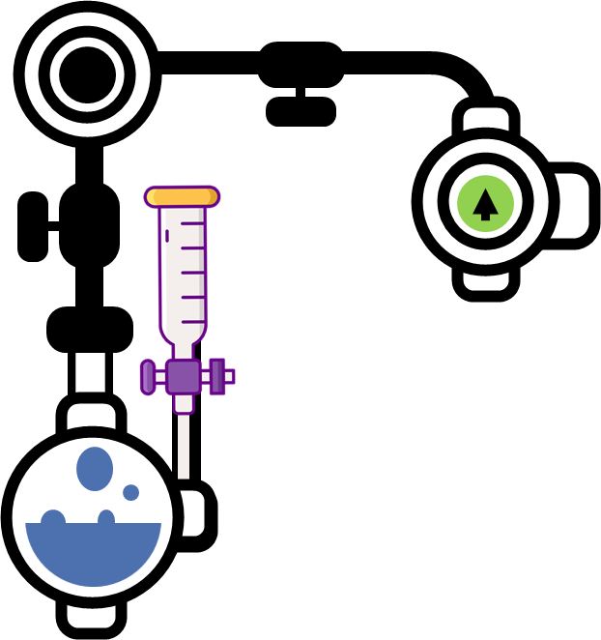
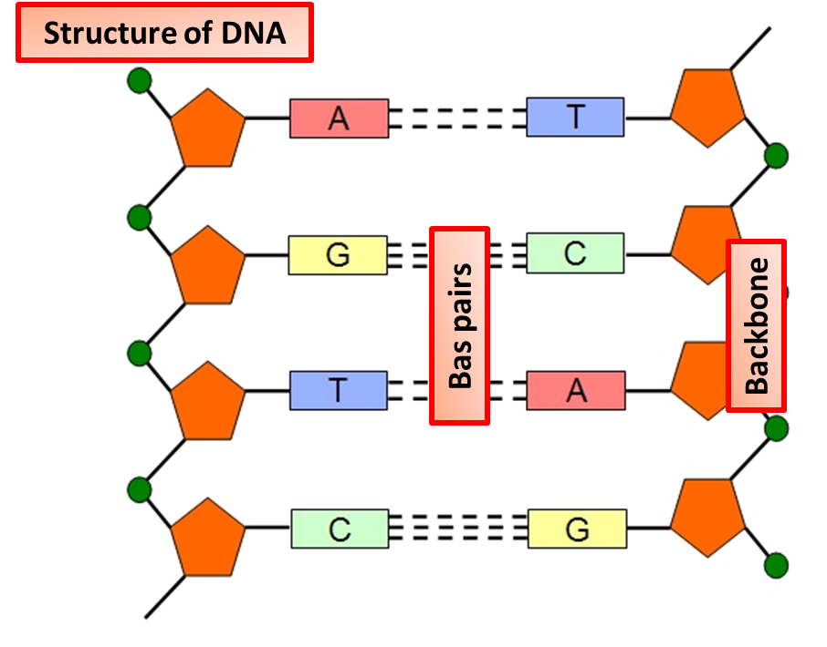
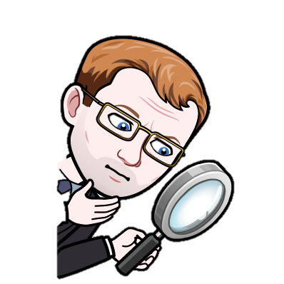
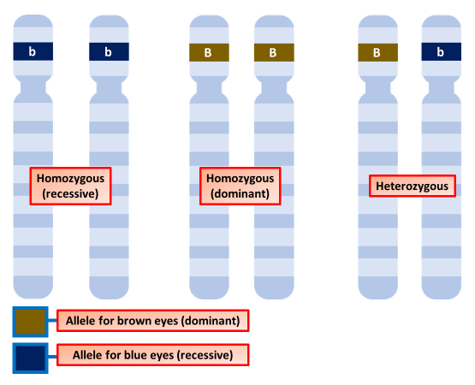
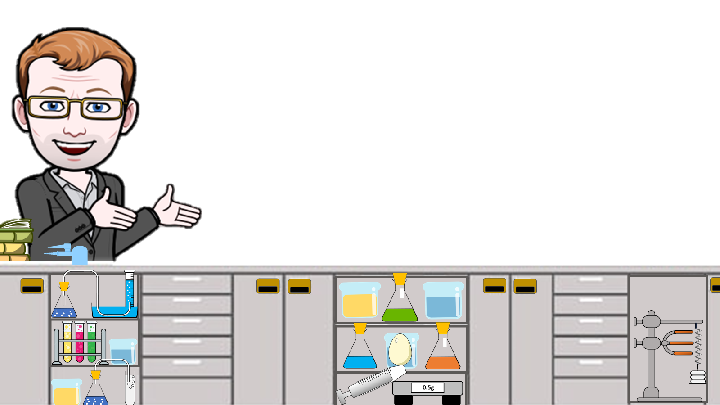
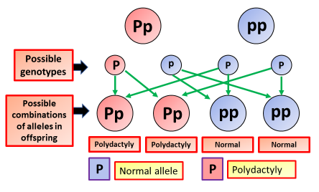
DNA & The Genome Notes
During sexual reproduction the two gametes join together in a fusion process known as fertilization, to create a zygote, which is the precursor to an embryo offspring, taking half of its DNA from each of its parents
Asexual reproduction is a type of reproduction by which offspring arise from a single organism, and inherit the genes of that parent only; it does not involve the fusion of gametes
DNA shown as a double twisted string with interlinking parts
Base pairs on a DNA molecule
Each strand of DNA is made of chemicals called bases. Do not confuse these with the bases you meet when you study acids and alkalis in chemistry. There are four different types of bases, shown as A, T, C and G in the diagram.
In DNA, two strands coil together to form a double helix. There are chemical cross-links between the two strands, formed by pairs of bases.
The chromosomes of a cell are in the cell nucleus.
They carry the genetic information.
Each chromosome contains many genes.
Chromosomes carry genetic information in a molecule called DNA.
Each human body cell contains 46 chromosomes.
These can be arranged into 23 pairs.
Each chromosome in a pair carries the same types of genes.
Chromosomes are important to this process to ensure the DNA is accurately replicated.
1 of each chromosome comes from each parent
A dominant allele is always expressed, even if one copy is present. Dominant alleles are represented by a capital letter, for example you could use a B. The allele for brown eyes, B, is dominant. You only need one copy of this allele to have brown eyes. Two copies will still give you brown eyes.
    A recessive allele is only expressed if the individual has two copies and does not have the dominant allele of that gene. Recessive alleles are represented by a lower case letter, for example, b. The allele for blue eyes, b, is recessive. You need two copies of this allele to have blue eyes.
A genetic disorder is a genetic problem caused by one or more abnormalities formed in the genome. Genetic disorders may be hereditary, meaning that they are passed down from the parents' genes. In other genetic disorders, defects may be caused by new mutations or changes to the DNA.

Slide 2

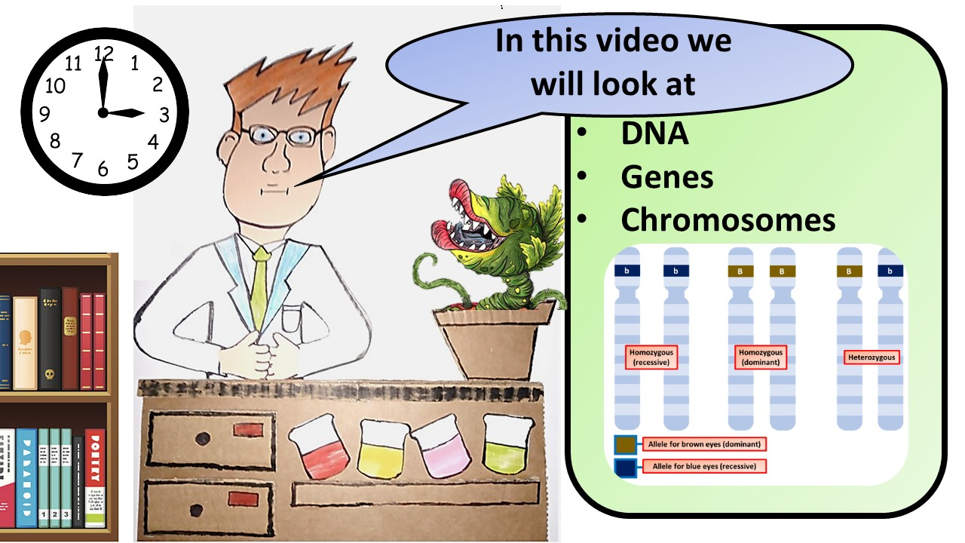


Click here to access my DNA youtube videos
Resources that this activity would work well with
Lesson on TES
Lesson on TPT
Follow me on social media to stay in touch
Keep up to date with my new content:

