Slide 1
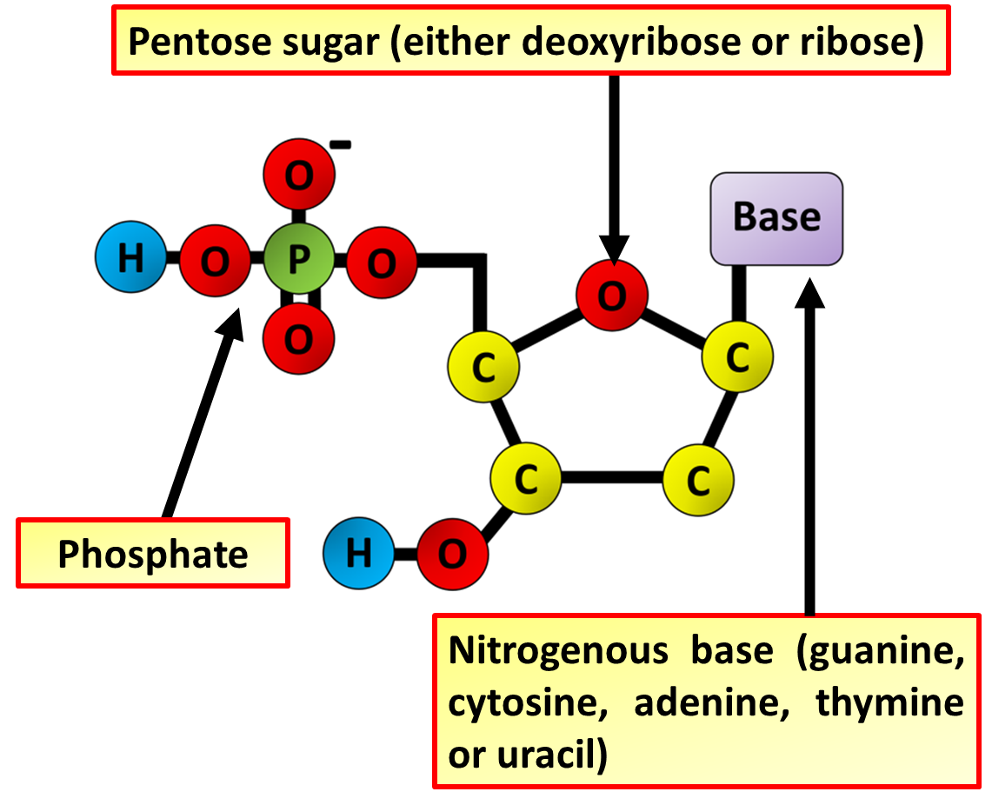
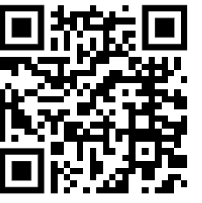
DNA Structure Question
The diagram below shows part of a DNA molecule.
Describe the structure of a nucleotide.
_____________________________________________________________________________________________________________________________________________________________________________________________________________________________________________________________________________________________________________________________________
Answer
Link to video

Slide 2
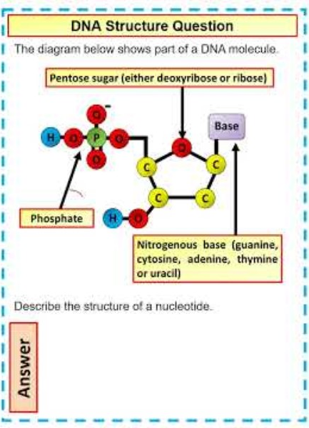
DNA Structure Question

Slide 3

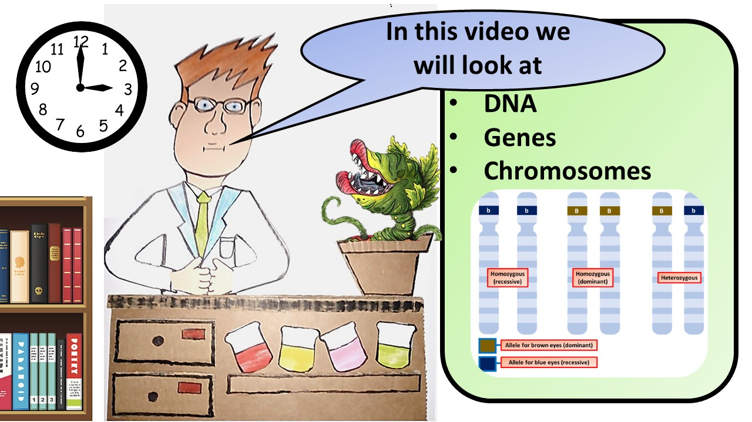


Click here to access my youtube videos
Resources that this activity would work well with
Lesson on TES
Lesson on TPT
Follow me on social media to stay in touch
Keep up to date with my new content:

