Slide 1
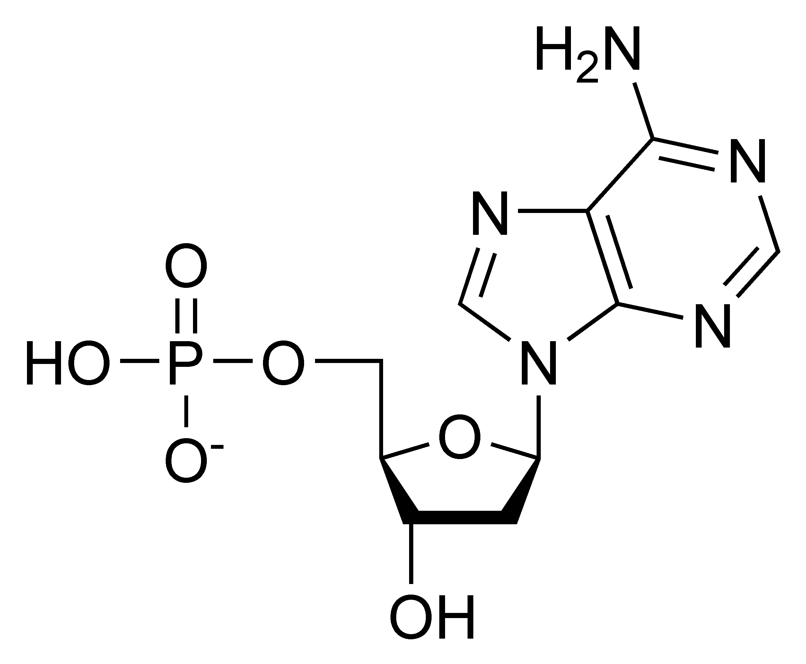
DNA Practice Question
Specification Link:
Biological Molecules
Highlight key words in the information below:
DNA is a nucleic acid. Nucleic acids are biological macromolecules containing oxygen, hydrogen, carbon, nitrogen and phosphorus. There are two types of nucleic acids: ribonucleic acid (RNA) and deoxyribonucleic acid (DNA). Nucleic acids are made up of basic units called nucleotides, which bind together with covalent bonds to form a polynucleotide or the nucleic acid.
The diagram shows the structure of a nucleotide. Identify the key features and describe it’s structure.
________________________________________________________________________________________________________________________________________________________________________________________________________________________________________________________________________________________________________________________________________________________________________________________________________________
When the nucleotides are linked together in a strand of DNA, the phosphate group attached to the 5′ (pronounced ‘five prime’) carbon of the deoxyribose sugar of one nucleotide becomes joined to the 3′ carbon on the sugar of an adjacent nucleotide. The strand in which the sugar alternates with phosphate is called a sugar-phosphate backbone. The backbone is not symmetrical. It has a definite orientation, with a free 3` hydroxyl group at one end and a free 5` phosphate group at the other end. The purine and pyrimidine bases stick out to one side of the sugar-phosphate backbone.
Summaries how nucleotides join together
__________________________________________________________________________________________________________________________________________________________________________________________________________________________________________________________
DNA Replication:
DNA has to be accurately copied during cell division to propagate the information to daughter cells
DNA replication occurs through a semiconservative mechanism, because each new molecule is made up of one old strand and one new strand.
DNA replication involves various enzymes
DNA helicase separates the strands to allow them to be copied. DNA polymerase synthesises new DNA from each strand
This occurs via two mechanisms: one strand is synthesised by leading strand synthesis which is continuous, and the other strand is made by lagging strand synthesis which requires discontinuous synthesis of smaller fragments
The gaps are filled in and the DNA is glued back together by DNA ligase
Why does DNA need to be replicated?
________________________________________________________________________________________
What enzymes are involved in DNA replication?
________________________________________________________________________________________
What mechanisms are used to replicate DNA
________________________________________________________________________________________
What enzyme sticks DNA together?
________________________________________________________________________________________
What enzyme separates DNA?
____________________________________________

Slide 2
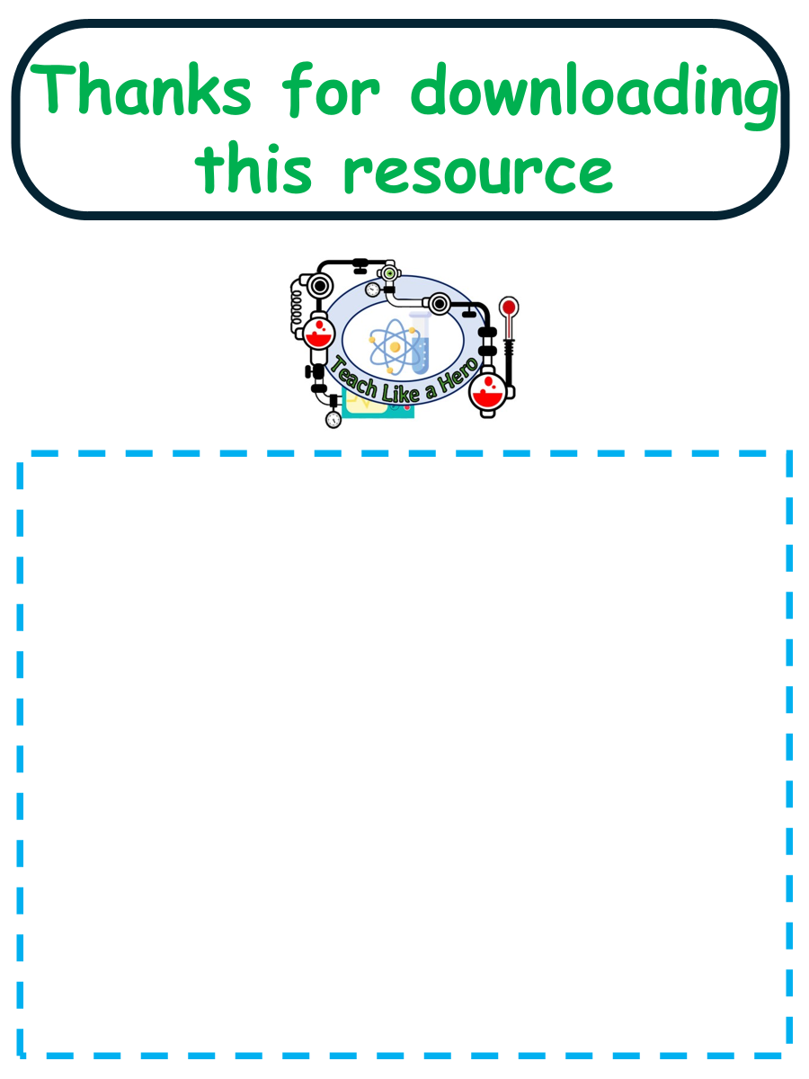
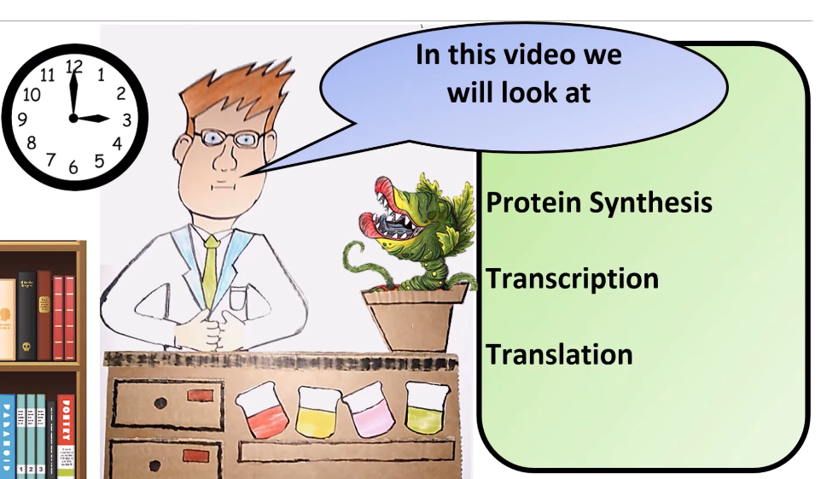


Click here to access my percentage composition youtube videos
Resources that this activity would work well with
Lesson on TES
Lesson on TPT
Follow me on social media to stay in touch
Keep up to date with my new content:

