Slide 1
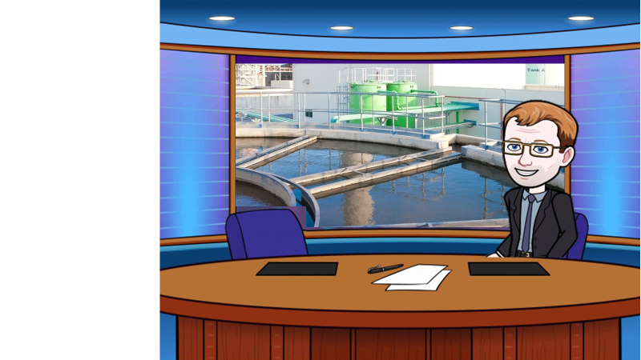
Many parts of the world have little fresh water, let’s have a look at how they can use sea water

Slide 2

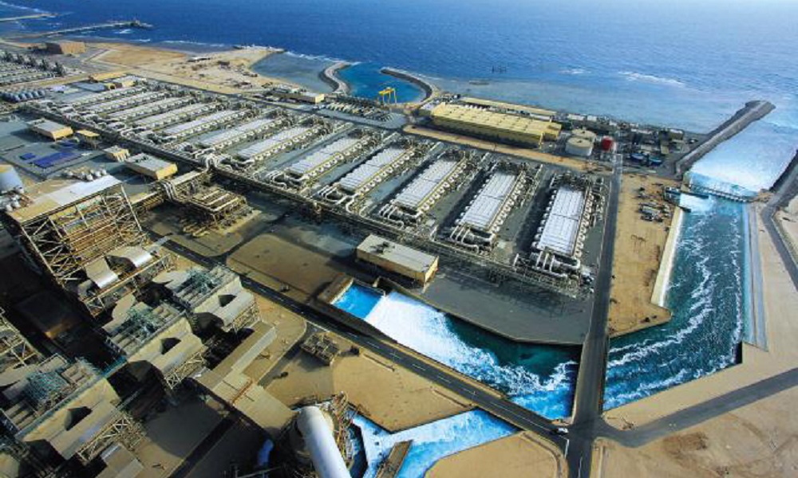

Water is allowed to flow in from the sea
Key questions
In what areas might this be used?
What might be dissolved in the sea water?
How can fish be kept out?

Slide 3
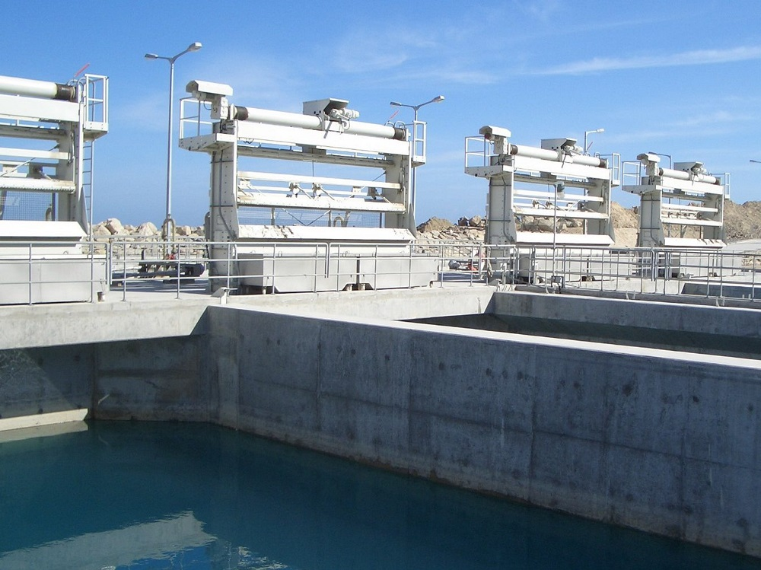
Seawater undergoes a 2 stage mechanical filtration process to remove coarse and fine particles
Key questions
Why is a rotating mesh used?
What might be removed from the sea water?

Slide 4

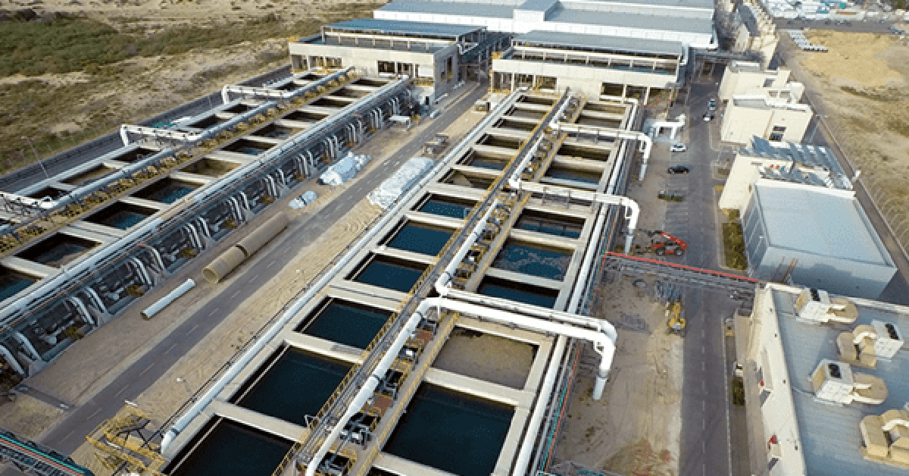
Chemicals are added to agglomerate impurities into bigger particles, and fine air bubbles are pumped into float these particles to the surface where they can be removed
Key questions
What chemicals do you know that cause small particles to clump together?
How can these impurities be removed?

Slide 5
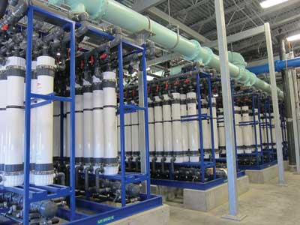

The clarified seawater passes through semi-permeable membranes to remove impurities, micro-organisms and bacteria
Key questions
What problems could be caused by micro organisms?
What does semi permeable mean?

Slide 6
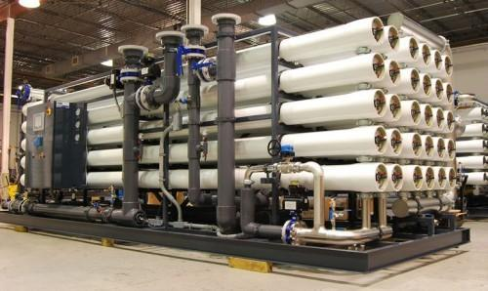

The pretreated seawater is pumped at high pressure through membranes with holes too small to allow salt particles to pass through
Key questions
What is osmosis?
What might reverse osmosis be?
Why is a high pressure needed?

Slide 7
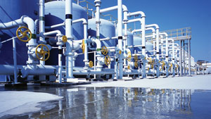

The water is made potable by adding chemicals such as chlorine and fluorine ensuring that the water remains safe to drink
Key questions
What chemicals are added?
What doe the chemicals doe to the water?
Why is it important not to add too much?

Slide 8
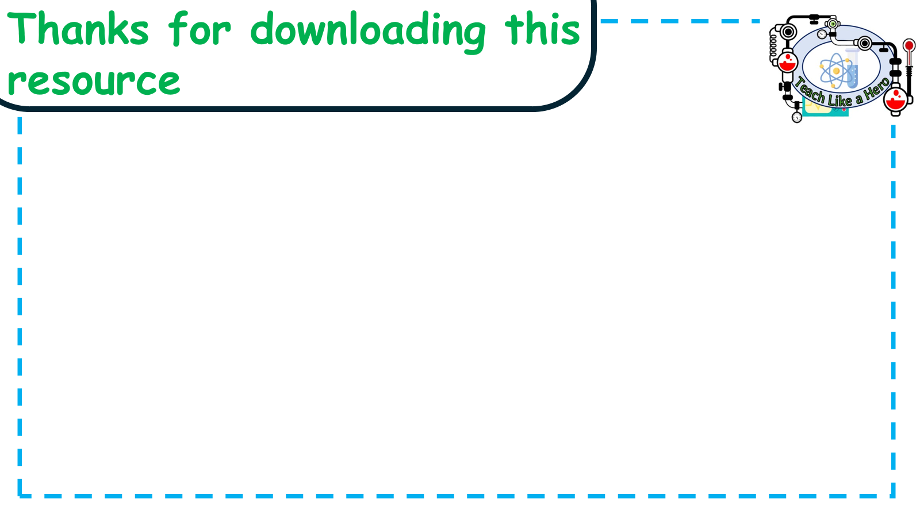
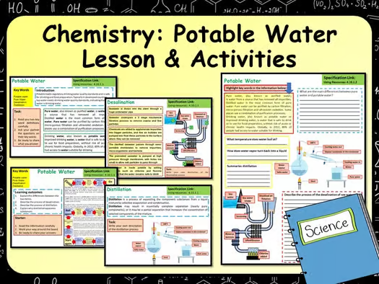
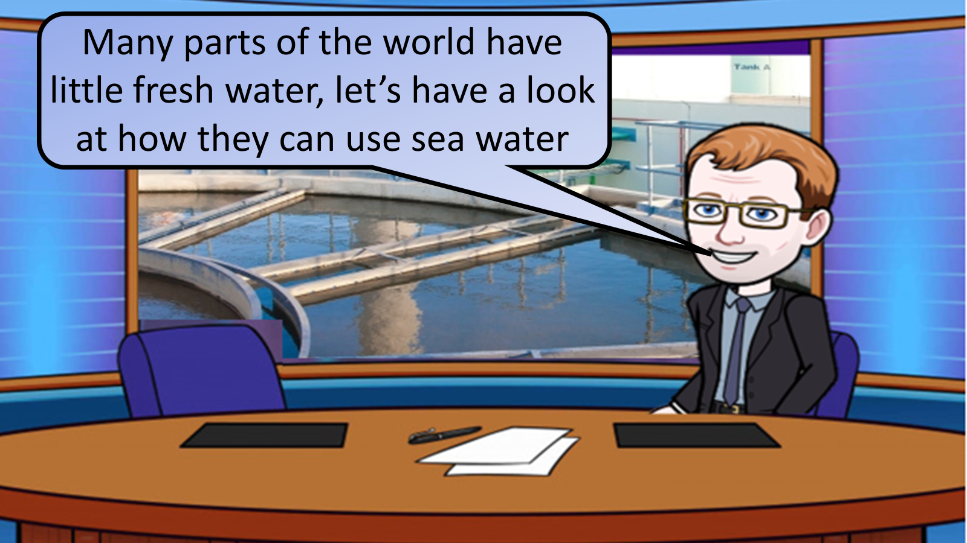


Click on the links below for lessons this resource can be used with
TPT lesson on potable water
TES lesson on potable water
Follow this link for a video running through this activity
Youtube video link
Follow me on social media to stay in touch
Keep up to date with my new content:

