Slide 1
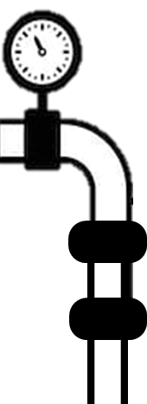

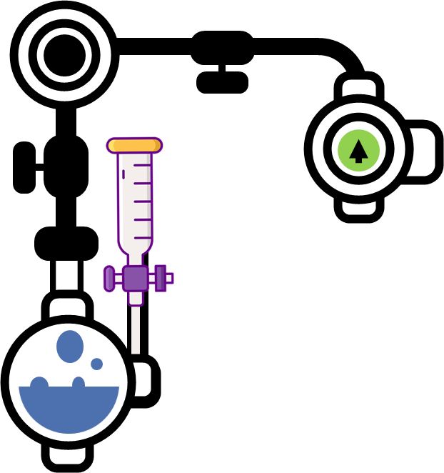
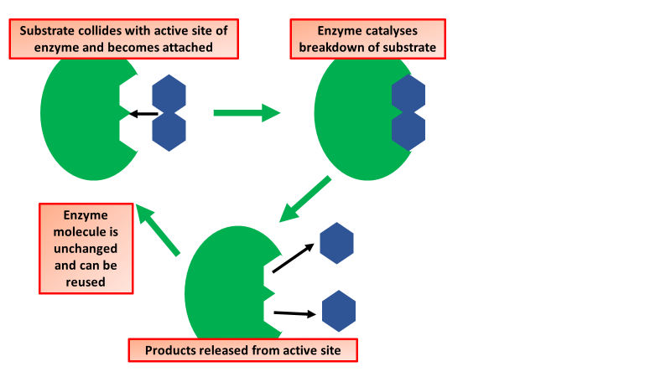
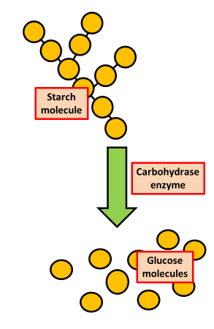
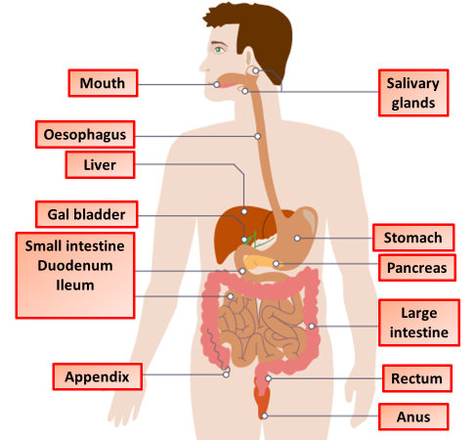

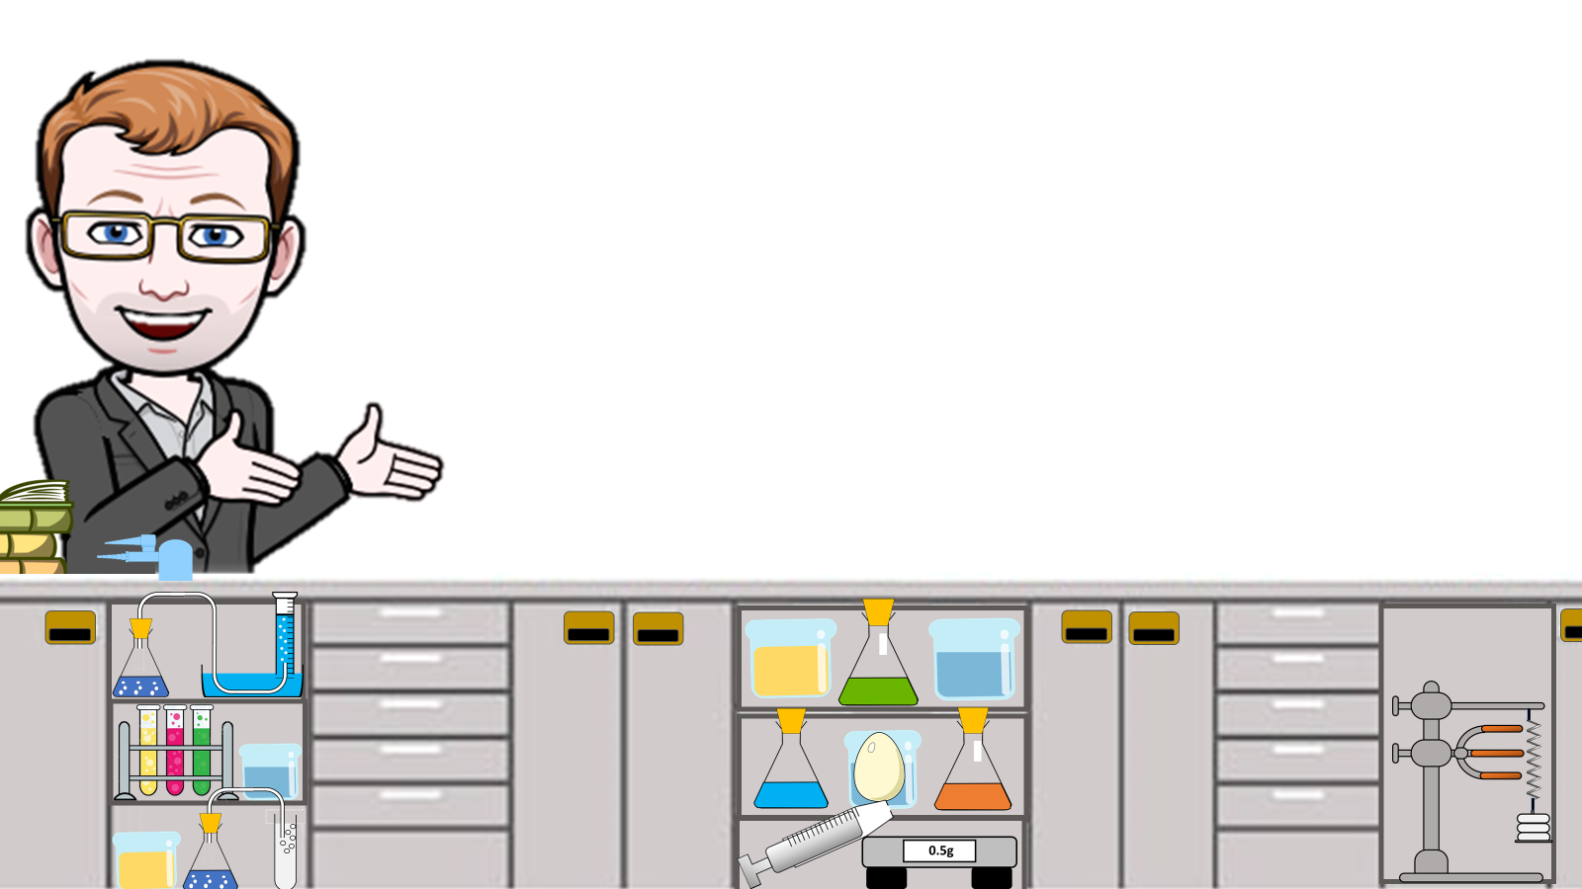
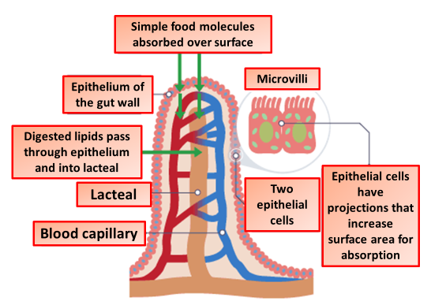
Digestion & Enzymes Notes
Digestion is the process by which food is broken down to be absorbed into the blood stream and distributed around the body. The process is started by saliva in the mouth breaking down carbohydrates. In the stomach, enzymes and acid in digestive juices break down proteins, sugars and fats.
Enzymes are folded into complex 3D shapes that allow smaller molecules to fit into them. In this example, the enzyme splits one molecule into two smaller ones. The breakdown of a substrate by an enzyme. Other enzymes join smaller substrate molecules together into larger ones.
Carbohydrase enzymes break disaccharides and polysaccharides into monosaccharides (simple sugars). Carbohydrase enzymes are produced in your mouth (in saliva), pancreas and small intestine.
Protease enzymes are produced in your stomach, pancreas and small intestine. Protease refers to a group of enzymes whose catalytic function is to hydrolyze peptide bonds of proteins. Protein breaks down into amino acids
Digestive enzymes such as lipase break down lipids in the diet into fatty acids and glycerol. Lipase enzymes are produced in your pancreas and small intestine. Lipase works best at around pH 7.5
The mouth is where food enters the alimentary canal and digestion begins
The salivary glands produce saliva containing amylase
Food is squeezed down the oesophagus
Protease and stomach acid is added in the stomach
Bile is added from the gal bladder and lipase from the pancreas
Nutrients are absorbed into the blood through the vill in the small intestine
Water is absorbed from what remains in the large intestine
Adaptations of Villi
Large surface area: Lots of villi all covered in microvilli
Good blood supply: This helps carry away nutrients which maintain a concentration gradient
Cells of microvilli have lots of mitrochondria: This provides energy so that nutrients can be activity transported in against the concentration gradient

Slide 2
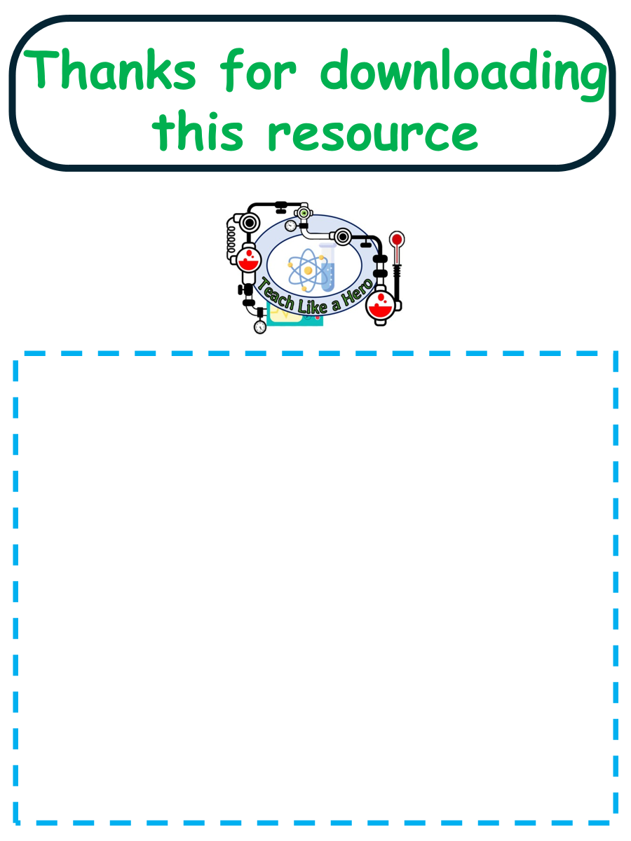
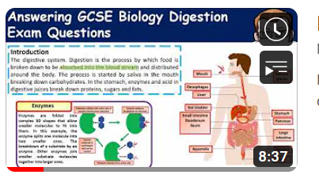


Click here to access my Cells youtube videos
Resources that this activity would work well with
Lesson on TES
Lesson on TPT
Follow me on social media to stay in touch
Keep up to date with my new content:

