Slide 1

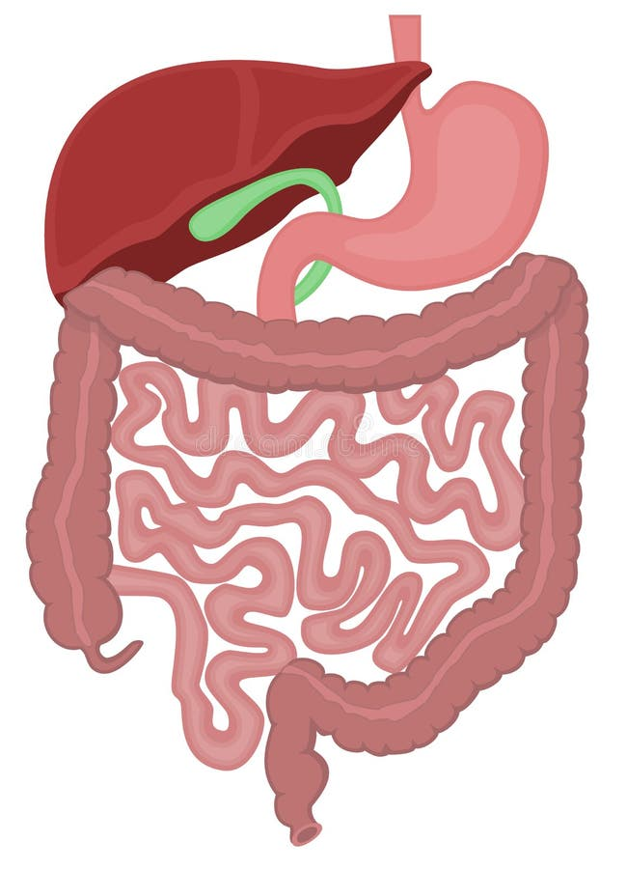
Digestive System Article
So there you are, sitting at lunch, enjoying some grilled-chicken pizza and a few orange wedges. When you're finished, you take a last drink of milk, wipe your mouth, and head to your next class. In a few minutes you're thinking about the capital of Oregon or your science fair project. You've completely forgotten about that pizza lunch you just ate.
The Stomach Acid Superpower: Did you know that the stomach houses a potent acid known as hydrochloric acid? This superheroic substance helps break down food into its smallest components, setting the stage for nutrient absorption. It's so powerful that it could dissolve certain metals – talk about a digestive powerhouse!
Mucus: The Unsung Hero: Meet mucus, the unsung hero of the digestive system. Not only does it protect the delicate lining of the stomach from its own digestive juices, but it also helps food move smoothly through the digestive tract. It's like the invisible guardian ensuring a safe journey for your meals!
Intestinal Surface Area: Unfold the small intestine, and you'd be surprised at its surface area – roughly the size of a tennis court! The countless tiny projections called villi and microvilli significantly increase the absorption area, ensuring that your body extracts maximum nutrients from your food.
Speedy Transit in the Small Intestine: If you think digestion is a slow process, consider this: food can zip through the small intestine in as little as 4 hours! The efficient absorption of nutrients happens in this relatively short span, showcasing the remarkable speed at which your body processes what you eat
Questions
What do we find in the stomach?
What keeps food smoothly moving through the digestive system?
What covers the inside of the intestines?
How long does it take food to pass through your digestive system?

