Slide 1
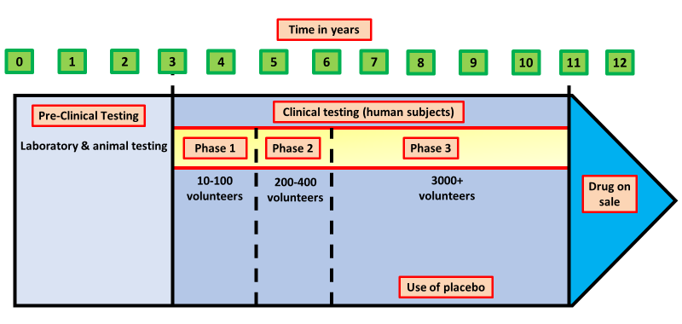
Drug Trailing
Specification Link:
Infection & Response: 4.3.1.9
Highlight key words in the information below:
Why are drugs tested in the laboratory first:
________________________________________________________________________________________________________________________________________________________________________________________________
There are three main stages of testing:
The drugs are tested using computer models and skin cells grown using human stem cells in the laboratory. This allows the efficacy and possible side effects to be tested. Many substances fail this first test of a preclinical drug trial because they damage cells or do not seem to work.
Drugs that pass the first stage are tested on animals in the second part of a preclinical drug trial. In the UK, new medicines have to undergo these tests. But it is illegal to test cosmetics and tobacco products on animals. A typical test involves giving a known amount of the substance to the animals, then monitoring them carefully for any side-effects.
Drugs that have passed animal tests are used in human clinical trials. They are tested on healthy volunteers to check that they are safe. The substances are then tested on people with the illness to ensure that they are safe and that they work. Low doses of the drug are used initially, and if this is safe the dosage increases until the optimum dosage is identified.
What is preclinical trialing?
________________________________________________________________________________________________________________________________
What are the key features of clinical trailing?
________________________________________________________________________________________________________________________________________________________________________________________________
What is a placebo?
________________________________________________________________________________________________
Read the information the right then answer the questions below:
Scientists have trialled a new statin called rosuvastatin.
17 802 people took part in the trial.
All of these people had high levels of a protein called CRP in their blood.
The higher the level of CRP in the blood, the higher the risk of a heart attack.
None of these people had heart conditions at the beginning of the investigation.
None of these people had high LDL (low density lipoprotein) levels.
All of these people were aged 50 or above.
Half the people were given a rosuvastatin tablet each day; the other half were given a placebo.
The trial was stopped 7 months early when it was found that the people given rosuvastatin were 54% less likely to have a heart attack than people given the placebo.
Give two control variables in this investigation.
________________________________________________________________________________
The trial gave reliable results. Give one reason why.
________________________________________________________________________________
The trial was stopped 7 months early. Give one reason why.
________________________________________________________________________________

Slide 2

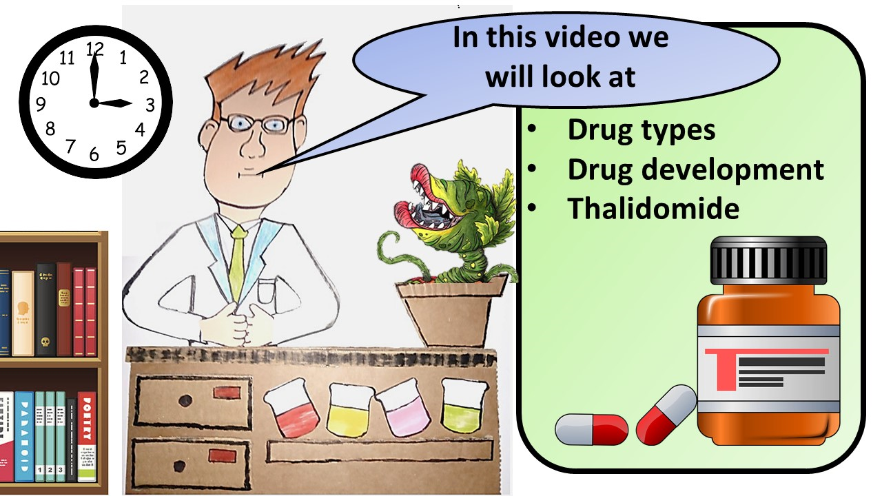


Click here to access my youtube videos
Resources that this activity would work well with
Lesson on TES
Lesson on TPT
Follow me on social media to stay in touch
Keep up to date with my new content:

