Slide 1
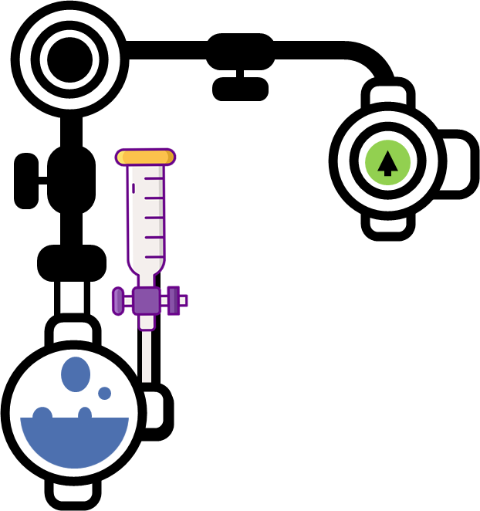
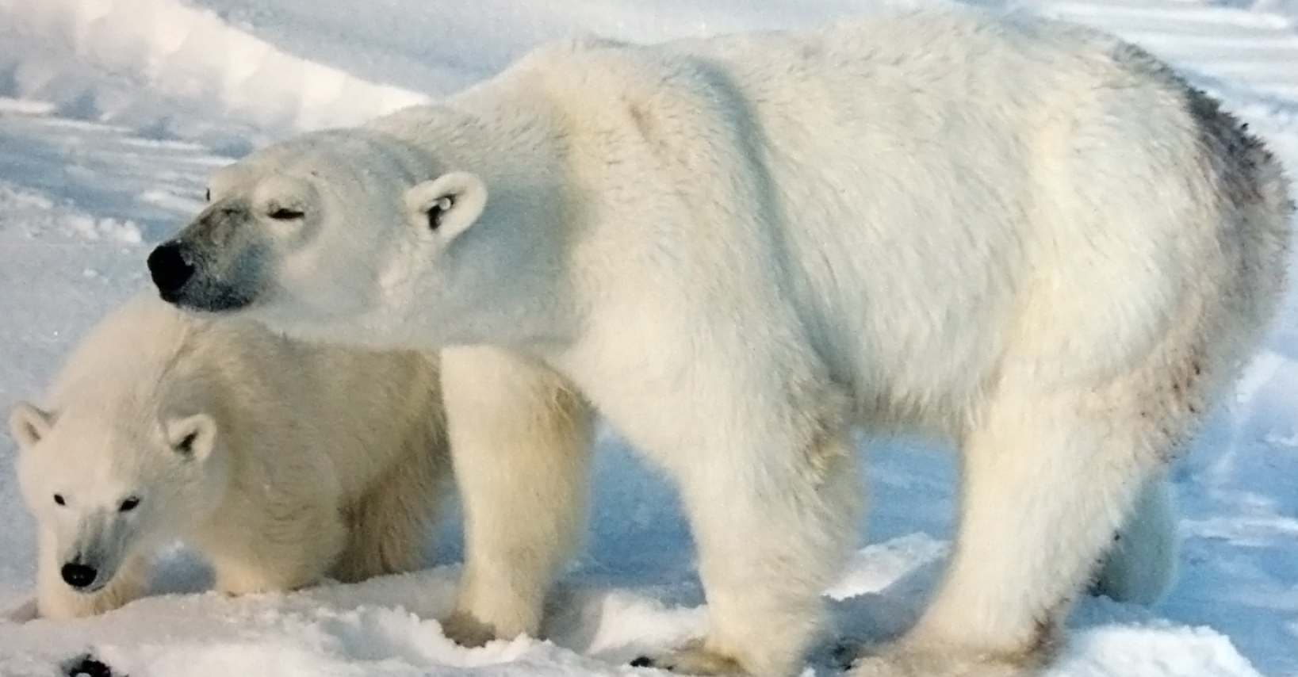
Ecology Notes
An ecosystem is the interaction between a community of living organisms and their environment. A community is two or more populations of organisms. An ecosystem is the interaction of two or more populations of organisms in their environment.
Competition is an interaction between organisms or species in which both the organisms or species are harmed. Limited supply of at least one resource (such as food, water, and territory) used by both can be a factor.
Physiological adaptations of plants are processes which allow them to compete. An example of this is the formation of poisons for defence. The nettle plant stings us when we brush the tiny needles on its leaves, which contain poison. Other plants, like deadly nightshade, are so poisonous they can kill if consumed by humans.
Abiotic factors are non-living variables. Biotic factors are the interactions between organisms. Both affect diversity and distribution.
Abiotic factors are non-living variables that can influence where organisms can live. Examples of abiotic factors include:
light intensity
temperature
soil pH
soil moisture
A shark has fins and a streamlined body that help it swim through water. It has gills, which take in oxygen directly out of the water. Because of its gills, sharks can stay underwater and not have to come to the surface to breathe. Sharks also have a tremendous number of sharp teeth, which make them fierce predators.
Biotic factors are interactions associated with living organisms. They can also I nfluence the distribution of organisms in an ecosystem.
Examples of biotic factors are:
competition for environmental resources
grazing - too little leads to dominant plants outcompeting other species, too much reduces species numbers overall. Both decrease biodiversity
predation - a reduction in predators can lead to an increase in prey. High numbers of prey can lead to overgrazing, which can reduce biodiversity
disease
food availability
The camel has many adaptive traits for their life in the desert. They have wide feet for walking in sand. They have long eyelashes and thin, slit nostrils that they can close to protect them from blowing sand. They are adapted to survive a long time without water and food.
Inhabiting the ice and sea of the Arctic, polar bears are well-equipped for survival in a harsh environment. Two coats of fur and a thick layer of blubber help insulate the polar bear's body from the cold, keeping its temperature at an even 37° C. Polar bears are also equipped with strong noses
Cacti have numerous anatomical and behavioral adaptations for absorbing and storing water, preventing water loss, protecting themselves from predators, limiting damage from the hot sun, saving their energy, requiring few resources, and attracting pollinators.

Slide 2
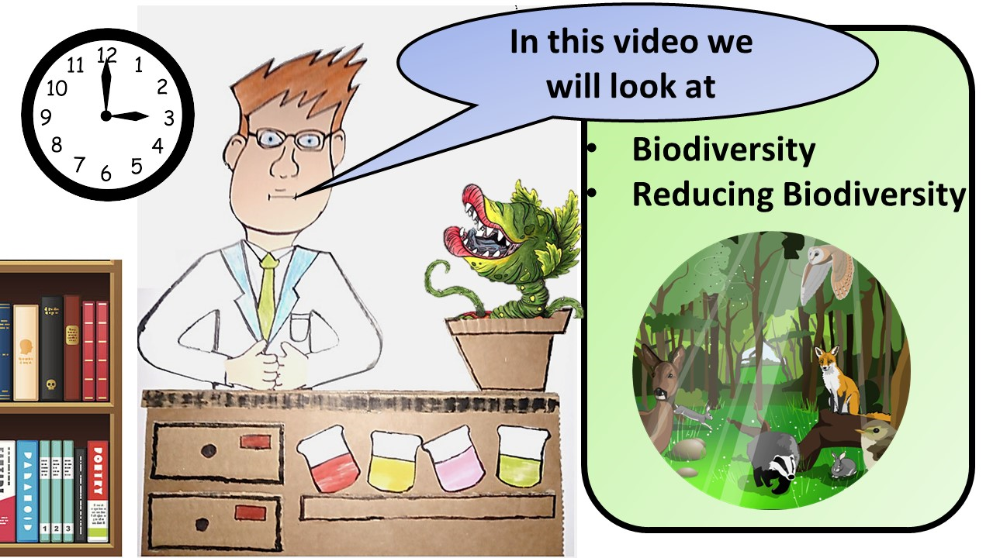
Click here to access my ecology youtube videos
Resources that this activity would work well with
Lesson on TES
Lesson on TPT
Follow me on social media to stay in touch
Keep up to date with my new content:

