Slide 1
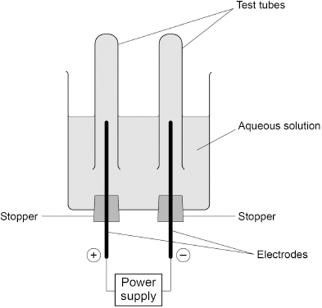

Electrolysis Practice Question
A student investigated the electrolysis of an aqueous solution of a different compound. The figure below shows the apparatus.
Hydrogen was produced at the negative electrode and oxygen was produced at the positive electrode.
Explain how oxygen was produced from water during the electrolysis of this aqueous solution.
Key things to include:
How many electrons does oxygen need to gain
What charge does the oxygen have
Why does the oxygen move to the positive electrode
________________________________________________________________________________________________________________________________________________________________________________________________________________________________________________________________________________________________________________________________________________________________________________________
Answer
Link to video

Slide 2
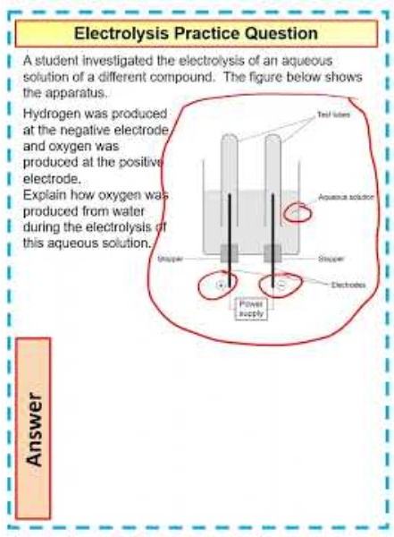
Electrolysis Practice Question

Slide 3
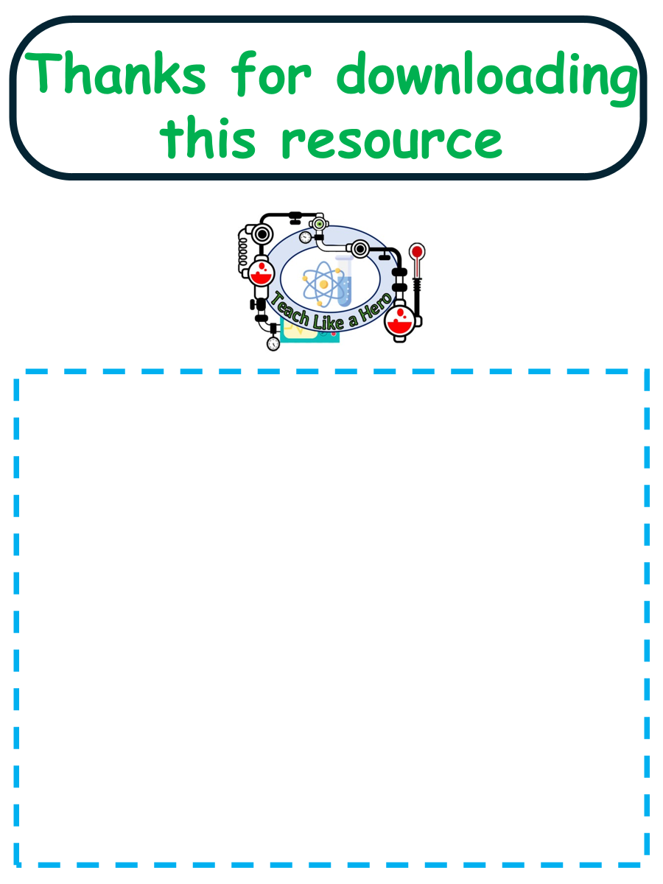
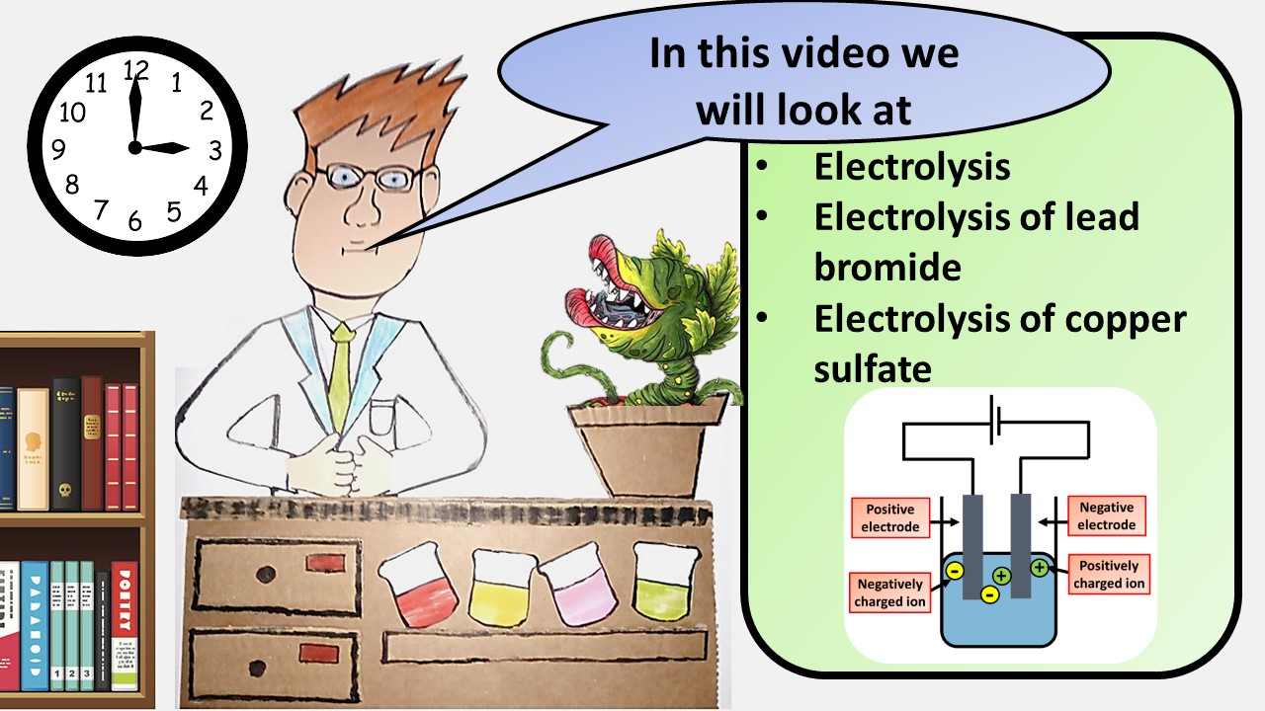


Click here to access my youtube videos
Resources that this activity would work well with
Lesson on TES
Lesson on TPT
Follow me on social media to stay in touch
Keep up to date with my new content:

