Slide 1


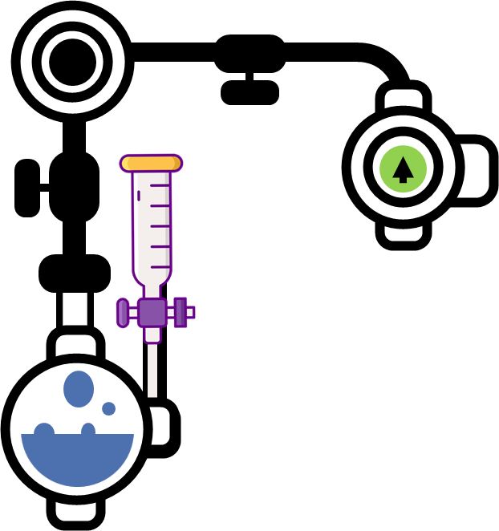


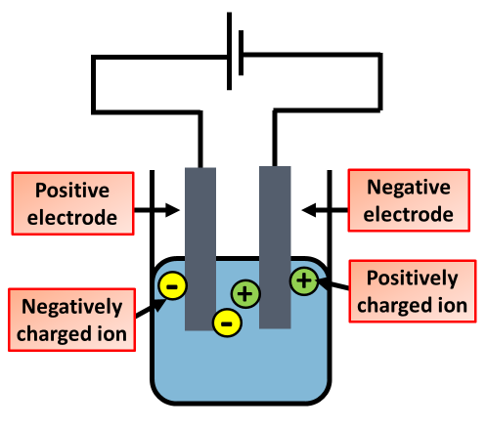

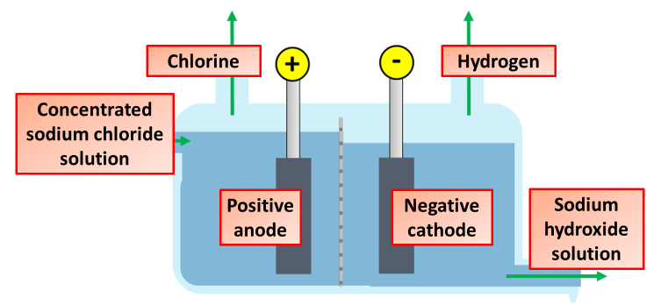
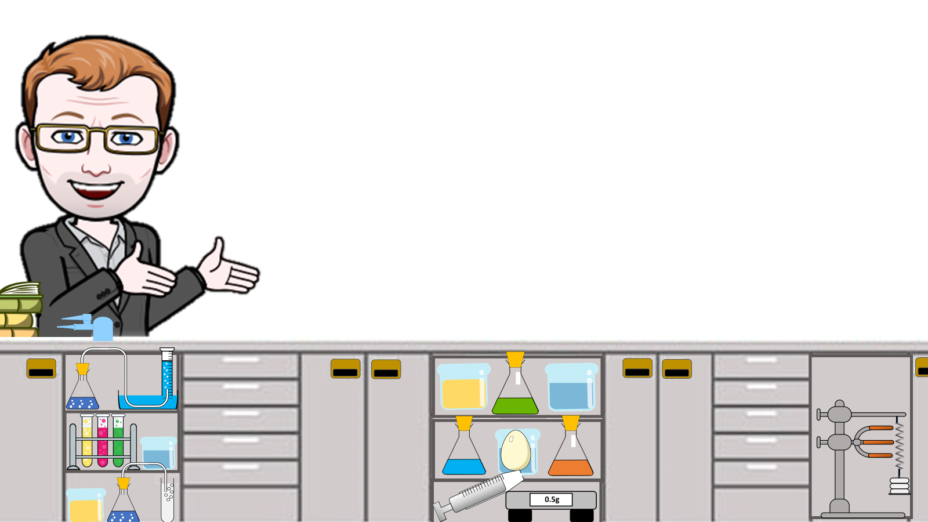
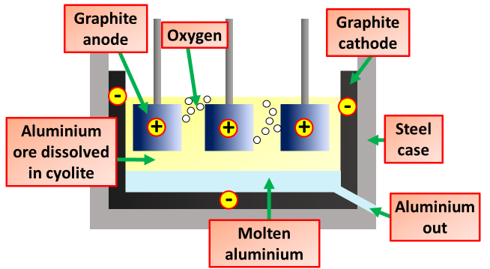
Electrolysis Notes
Electrolysis is the process by which ionic substances are decomposed (broken down) into simpler substances when an electric current is passed through them. Electricity is the flow of electrons or ions. For electrolysis to work, the compound must contain ions.
An ionic lattice is held together by strong electrostatic forces of attraction between the oppositely charged ions. The forces act in all directions in the lattice. This is called ionic bonding.
All ionic compounds when molten can be decomposed when electricity is passed through using electrolysis.
The metal and hydrogen always forms at the cathode.
Non-metal always forms at the anode
Cations travel to the cathode
The electrodes are made from inert material such as graphite, so that they do not involve themselves with the reaction.
Anions travel to the anode
Electrolysis of Brine Water
During the electrolysis, hydrogen and chloride ions are removed from solution whereas sodium and hydroxide ions are left behind in solution. This means that sodium hydroxide is also formed during the electrolysis of sodium chloride solution.
The extraction of aluminium. The ions in the aluminium oxide must be free to move so that electricity can pass through it. Aluminium oxide has a very high melting point (over 2000°C) so it would be expensive to melt it. Aluminium oxide does not dissolve in water, but it does dissolve in molten cryolite. This is an aluminium compound with a lower melting point than aluminium oxide.
Bauxite is purified to produce aluminium oxide
This is then mixed with cryolite to lower the melting point
A positive and negative electrode is placed into this mix
Electrolysis of Water
Electrolysis of water is the process by which water is decomposed into oxygen and hydrogen gas, when electric current is passed through it. Water molecule is decomposed in to H+ and OH- ions, when electric current is passed through it.
The aluminium gains a positive charge
The oxygen gains a negative charge
The aluminium moves towards the negative electrode
The oxygen moves towards the positive electrode

Slide 2
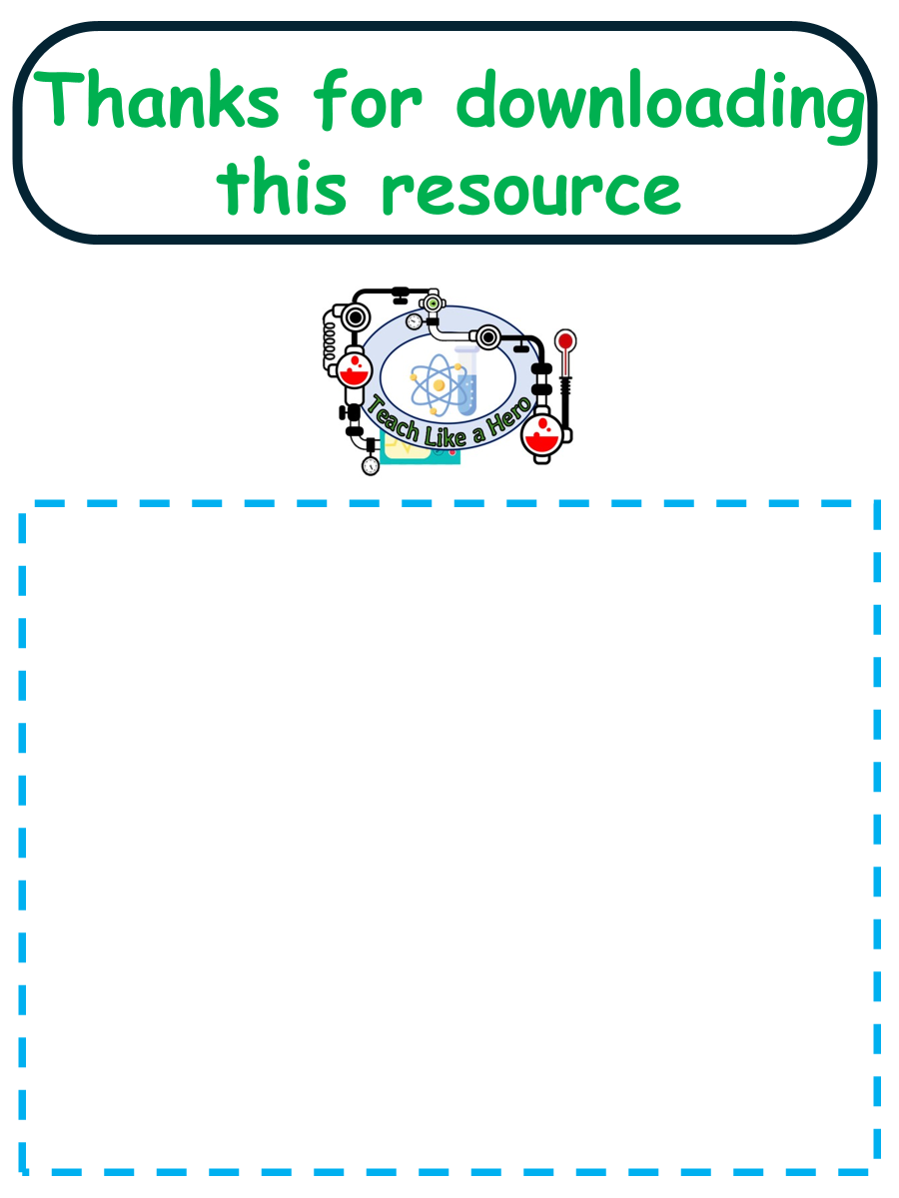
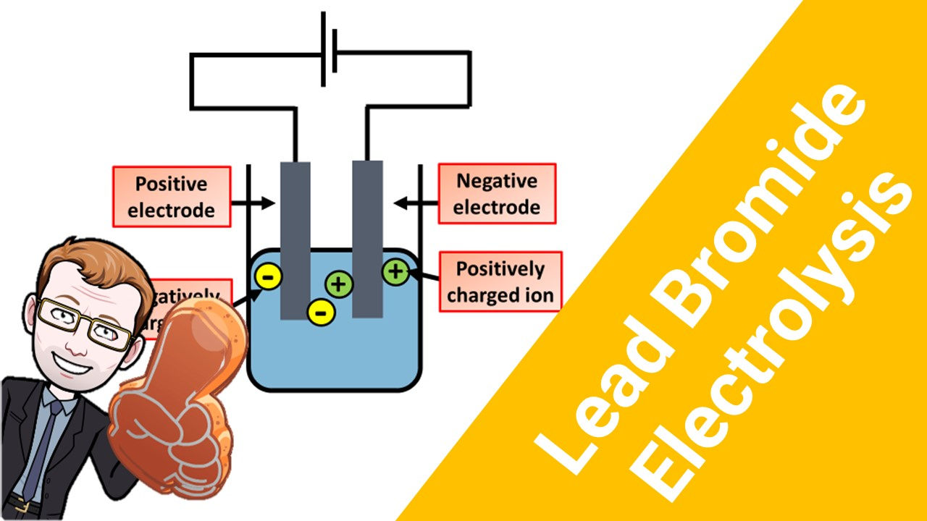


Click here to access my electrolysis youtube videos
Resources that this activity would work well with
Lessons on TES
Lesson on TPT
Follow me on social media to stay in touch
Keep up to date with my new content:

