Slide 1
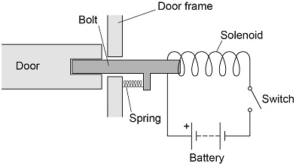
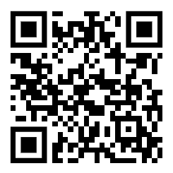
Electromagnetic Door Lock Practice Question
The diagram below shows a diagram of the lock. The door unlocks when the switch is closed.
Explain why the door unlocks when the switch is closed.
Key things to include:
How is an electromagnetic field generated
What effect will that have on the bolt
Why will the door become unlocked
Answer
_____________________________________________________________________________________________________________________________________________________________________________________________________________________________________________________________________________________________________________________________________
Link to video

Slide 2
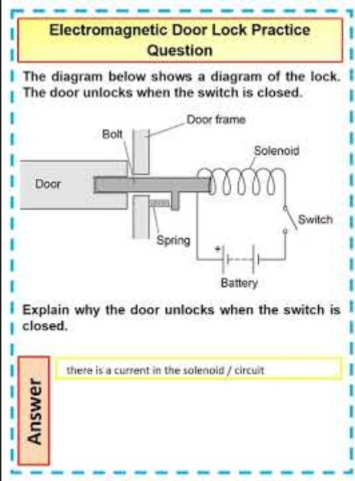
Electromagnetic Door Lock Practice Question

Slide 3

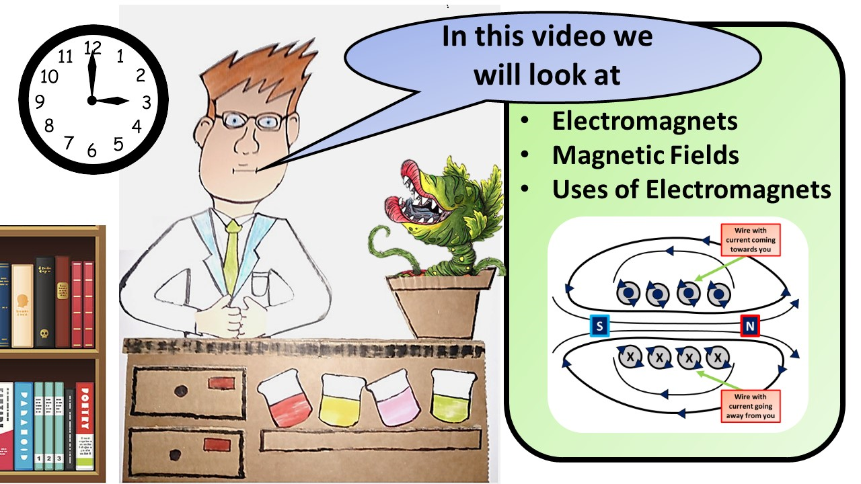


Click here to access my youtube videos
Resources that this activity would work well with
Lesson on TES
Lesson on TPT
Follow me on social media to stay in touch
Keep up to date with my new content:

