Slide 1
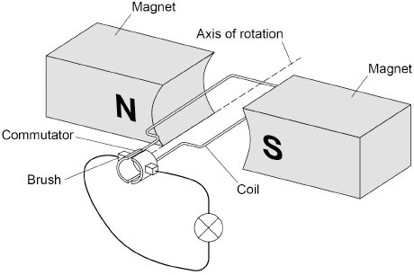

Electromagnetic Induction Practice Question
A dynamo is used to generate an electric current. Figure 1 shows the inside parts of the dynamo connected to a lamp.
The coil is rotated. Explain why a direct current is induced in the coil.
Key things to include:
How is a current induced in the wire
How does the wite move through the magnetic field
How does this generate an alternating current
Answer
_____________________________________________________________________________________________________________________________________________________________________________________________________________________________________________________________________________________________________________________________________
Link to video

Slide 2
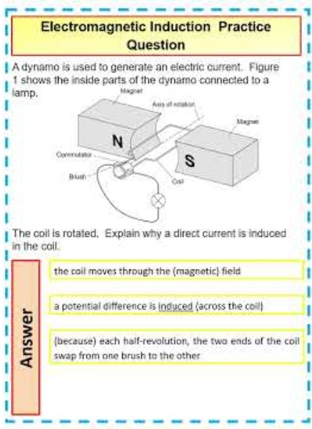
Electromagnetic Induction Practice Question

