Slide 1
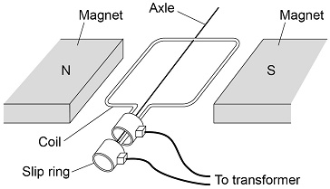

Electromagnetic Induction Practice Question
Figure 2 shows the inside parts of the alternator.
The handle of the alternator is turned, causing the coil to rotate. Explain why an alternating current is induced in the coil.
Key things to include:
How is a current induced in the wire
How does the wite move through the magnetic field
How does this generate an alternating current
Answer
_____________________________________________________________________________________________________________________________________________________________________________________________________________________________________________________________________________________________________________________________________
Link to video

Slide 2
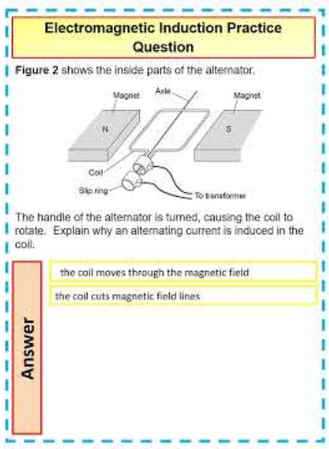
Electromagnetic Induction Practice Question

