Slide 1
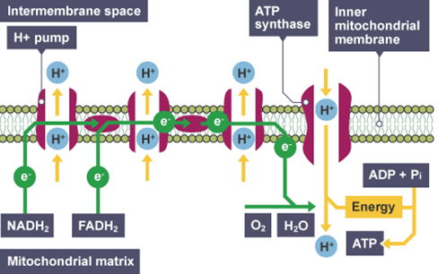
Electron Transport Chain Question
Specification Link:
Energy for Biological Processes
Highlight key words in the information below:
An electron transport chain (ETC) is a series of complexes that transfer electrons from electron donors to electron acceptors via redox (both reduction and oxidation occurring simultaneously) reactions, and couples this electron transfer with the transfer of protons (H+ ions) across a membrane.
Where does the electron transport chain take place?
________________________________________________________________________________________
Describe what happens as electrons move through the electron transport chain
________________________________________________________________________________________________________________________________________________________________________________________________________________________________________________________________________________________________________________________________________________________________________________________________________________________________________________________________________________________________________________________________________________________________________________________________________________
What ions are pumped across the membrane?
____________________________________________
What are the source of the electrons entering the chain?
________________________________________________________________________________________
What does the electron transport chain produce?
________________________________________________________________________________________
What is the final electron acceptor In the chain?
________________________________________________________________________________________
The drug, DNP, destroys the H+ gradient that forms in the electron transport chain. What is the most likely consequence?
__________________________________________________________________________________________________________________________________________________________________________
A person is born with a mutation that causes their cells to not have the ability to produce the NADH dehydrogenase complex, the complex that allows the electron transport chain to make ATP from NADH. Will this patient be able to produce any enery at all from the ETC?
_______________________________________________________________________________________________________________________________________________________________________________________________________________________________________________________________

Slide 2
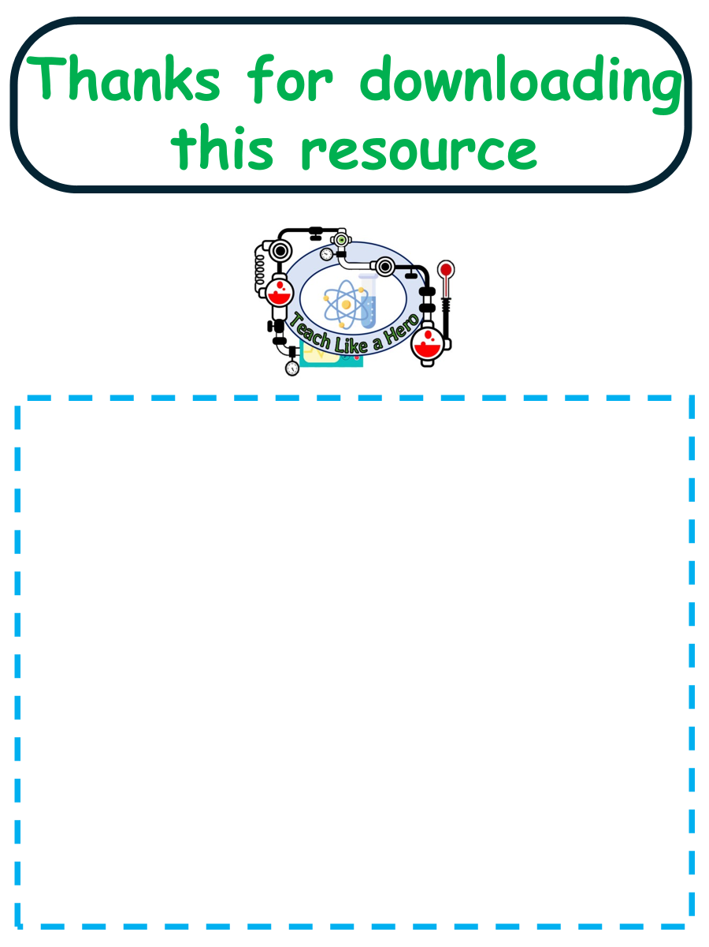
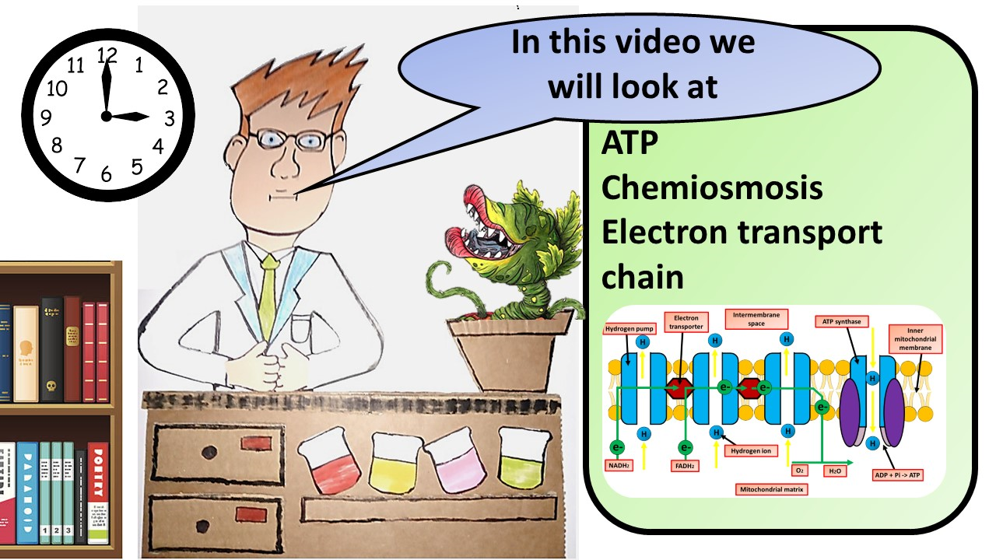


Click here to access my percentage composition youtube videos
Resources that this activity would work well with
Lesson on TES
Lesson on TPT
Follow me on social media to stay in touch
Keep up to date with my new content:

