Slide 1
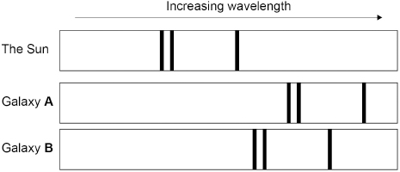
Emission Spectra Practice Question
The Hubble Space Telescope can detect visible light from distant galaxies. The visible light spectra from stars and galaxies include dark lines at specific wavelengths. Figure 2 shows the visible light spectra from the Sun and two galaxies.
Explain what conclusions can be made about galaxies A and B.
Key things to include:
Which galaxy has a greater red shift
What speed are the galaxy's moving away at
Which galaxy is further away
Answer
_____________________________________________________________________________________________________________________________________________________________________________________________________________________________________________________________________________________________________________________________________
Link to video

Slide 2
Emission Spectra Practice Question

