Slide 1
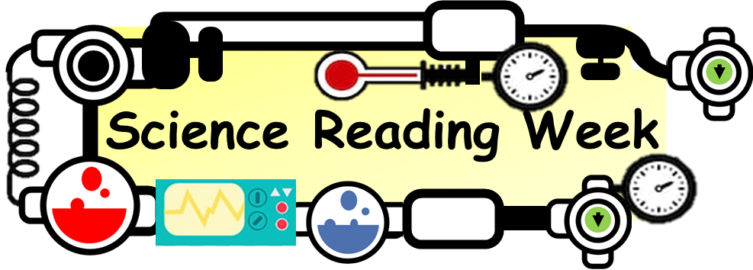
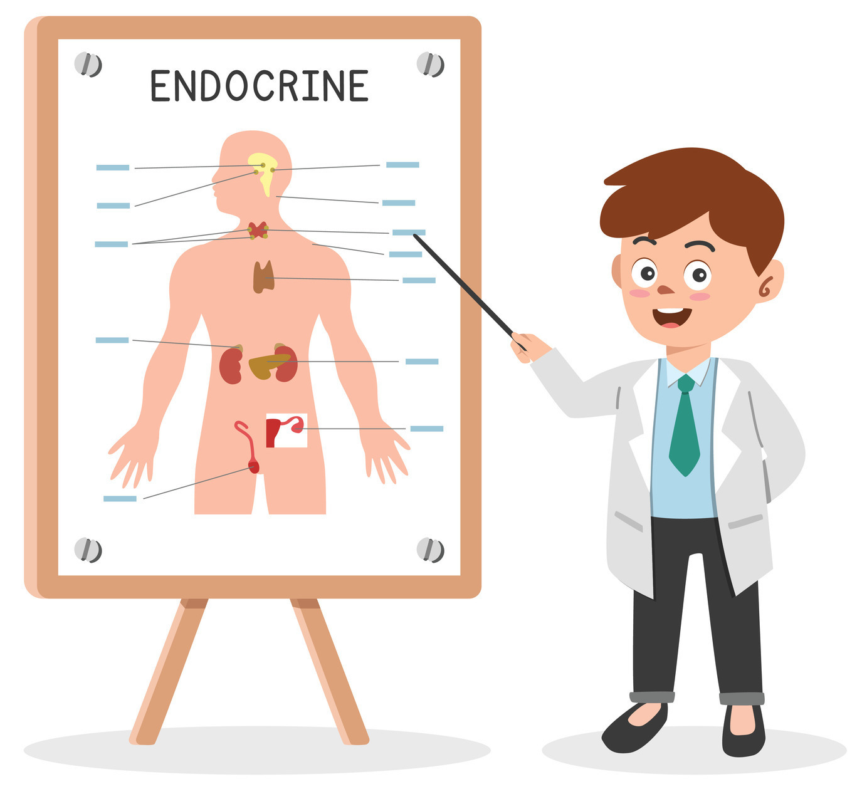
Endocrine System Article
Step into the captivating realm of the Endocrine Kingdom – where hormones reign supreme and glands wield their magical influence!. It's time to discover the fascinating dance of hormones and explore the incredible world of the Endocrine System – where balance is key, and every gland is a superhero in its own right!
Hormonal Symphony: Think of the endocrine system as the conductor of a hormonal symphony. It orchestrates a complex ensemble of glands, each secreting specific hormones that travel through the bloodstream to target organs.
Master Gland - Pituitary Power: Meet the pituitary gland, the maestro of the endocrine orchestra. Despite being no larger than a pea, this powerhouse gland controls the activities of other endocrine glands, regulating growth, metabolism, and even influencing the functions of other organs.
Melatonin Magic in the Pineal Gland: Nestled in the brain, the pineal gland is like a celestial timekeeper. It produces melatonin, the hormone responsible for regulating our sleep-wake cycle. When darkness falls, melatonin rises, inviting the Sandman for a nightly visit.
Adrenaline Adventures: Imagine your body gearing up for an action-packed adventure – that's adrenaline at work! The adrenal glands release this "fight or flight" hormone in response to stress, instantly preparing your body for quick and decisive action.
Thyroid's Metabolic Mastery: The thyroid gland, often dubbed the body's metabolic thermostat, produces hormones that control the rate at which your body uses energy. It's like the engine regulator, ensuring everything runs smoothly to maintain a balanced and energetic life.
Questions
What is the body’s master gland?
How do hormones travel around the body?
What does adrenaline do in the body?
Which gland produces hormones that helps control the rate that your body uses energy?

