Slide 1
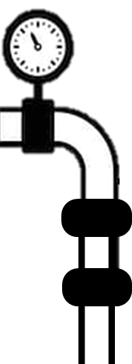

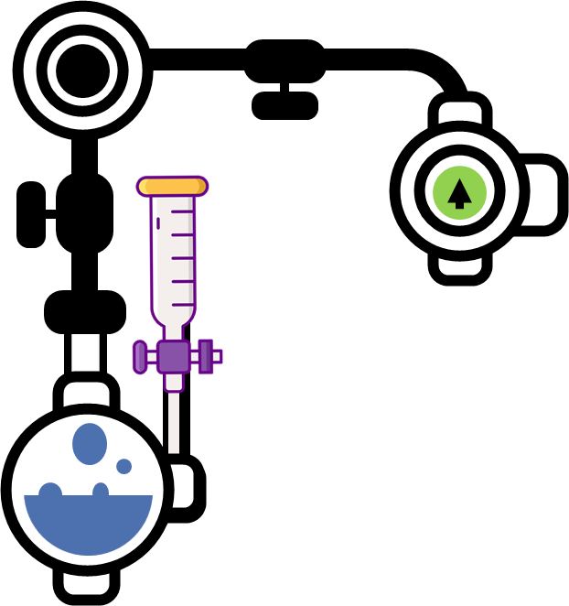

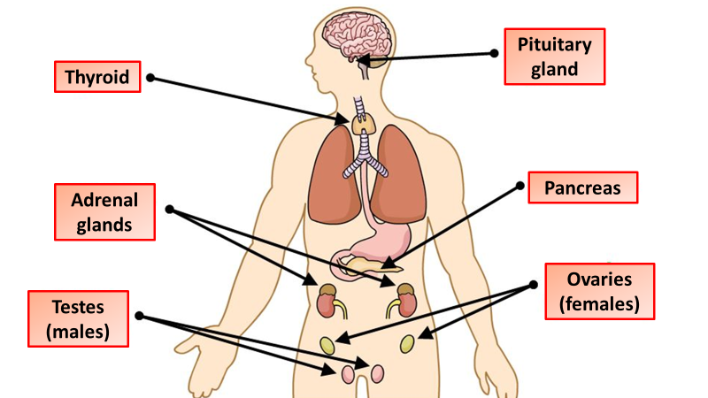
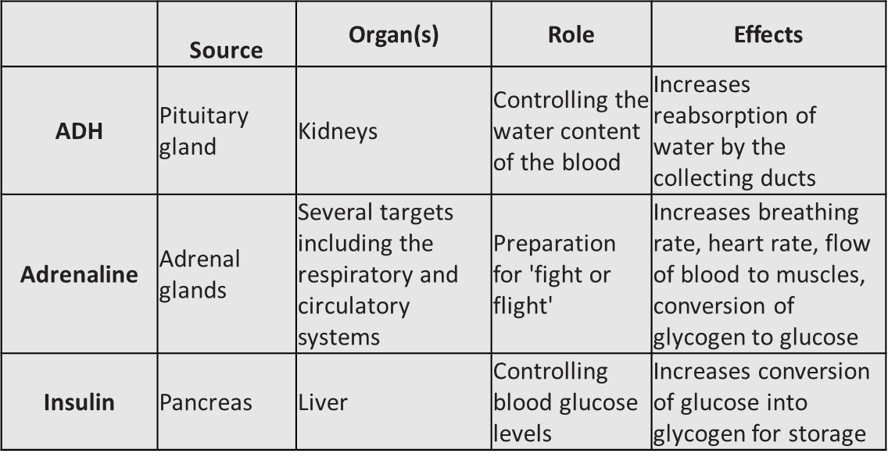
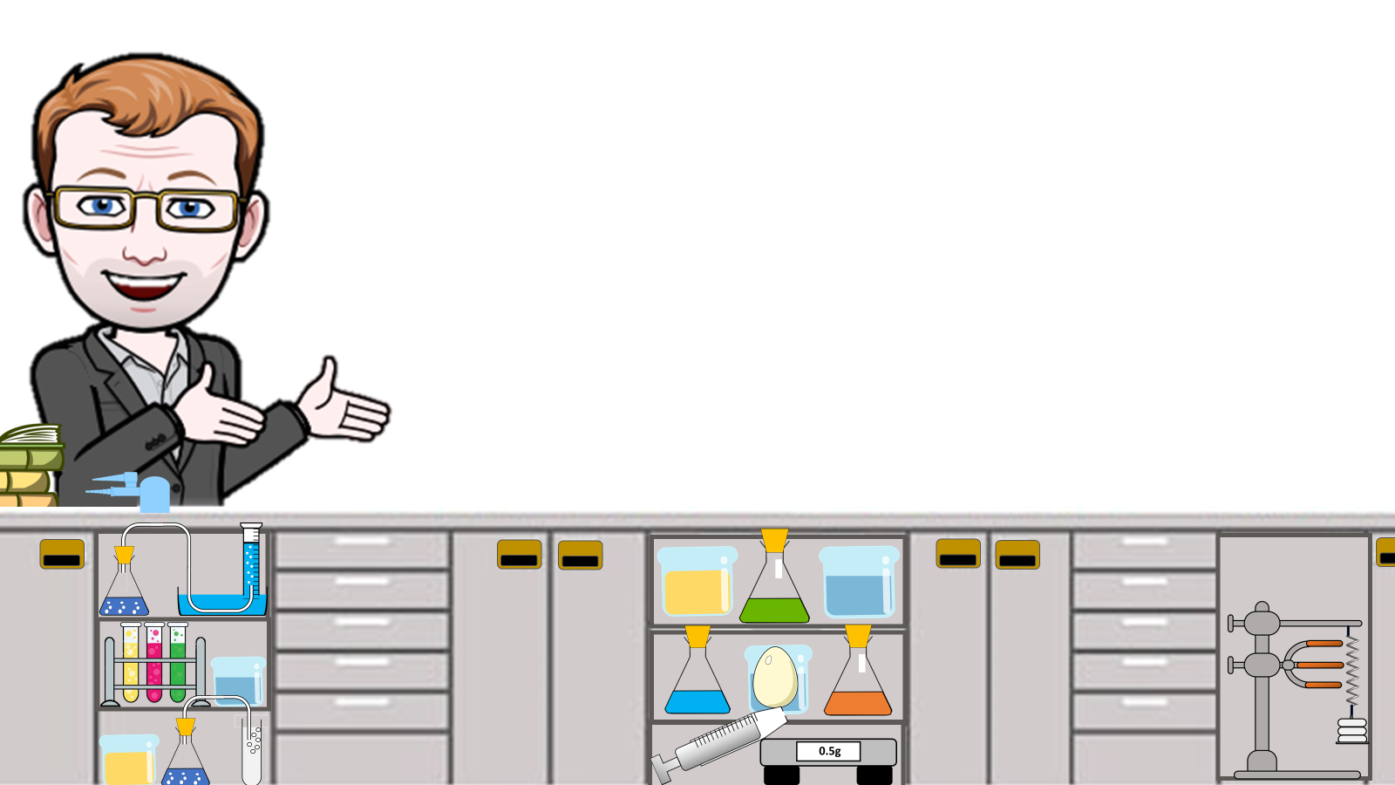
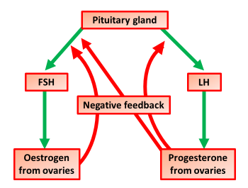
Endocrine System Notes
The endocrine system is a chemical messenger system consisting of hormones, the group of glands of an organism that carry those hormones directly into the circulatory system to be carried towards distant target organs, and the feedback loops of homeostasis that the hormones drive
A hormone is a chemical substance, produced by a gland and carried in the bloodstream, which alters the activity of specific target organs. An example of this is the release of the hormone adrenaline, which is released by the adrenal gland. One of its target organs is the heart, where it increases the heart rate.
The endocrine system is the collection of glands that produce hormones that regulate metabolism, growth and development, tissue function, sexual function, reproduction, sleep, and mood, among other things.
Without your endocrine glands — and the hormones they release — your cells wouldn't know when to do important things. It makes and releases a bunch of hormones that control other glands and body functions
A hormone is a chemical substance, produced by a gland and carried in the bloodstream, which alters the activity of specific target organs. An example of this is the release of the hormone adrenaline, which is released by the adrenal gland. One of its target organs is the heart, where it increases the heart rate.
LH
LH causes the mature egg to be released
Progesterone is a hormone secreted by ovaries. It maintains the lining of the uterus during the middle part of the menstrual cycle and during pregnancy.
The hormone oestrogen is secreted by the ovaries.
it stops FSH being produced - so that only one egg matures in a cycle
it stimulates the pituitary gland to release the hormone LH
The hormone FSH is secreted by the pituitary gland.
it causes an egg to mature in an ovary
it stimulates the ovaries to release the hormone oestrogen
The menstrual cycle is a recurring process which takes around 28 days. During the process, the lining of the uterus is prepared for pregnancy. If implantation of the fertilised egg into the uterus lining does not happen, the lining is then shed. This is known as menstruation.
Several hormones control this cycle – for example, they are involved in controlling the release of an egg each month from an ovary, and changing the thickness of the uterus lining.
Hormones in Reproduction

Slide 2
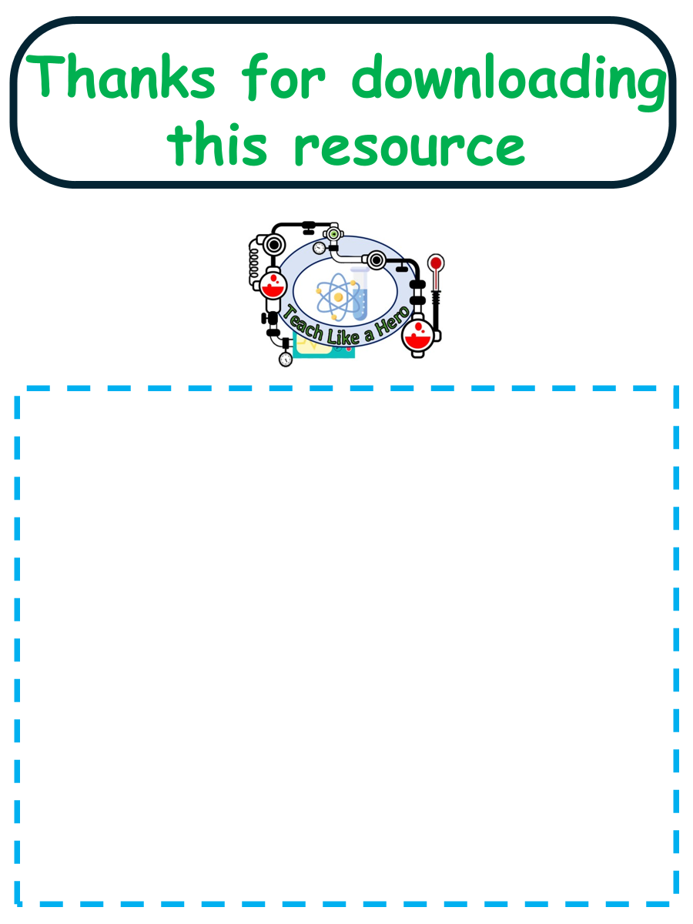
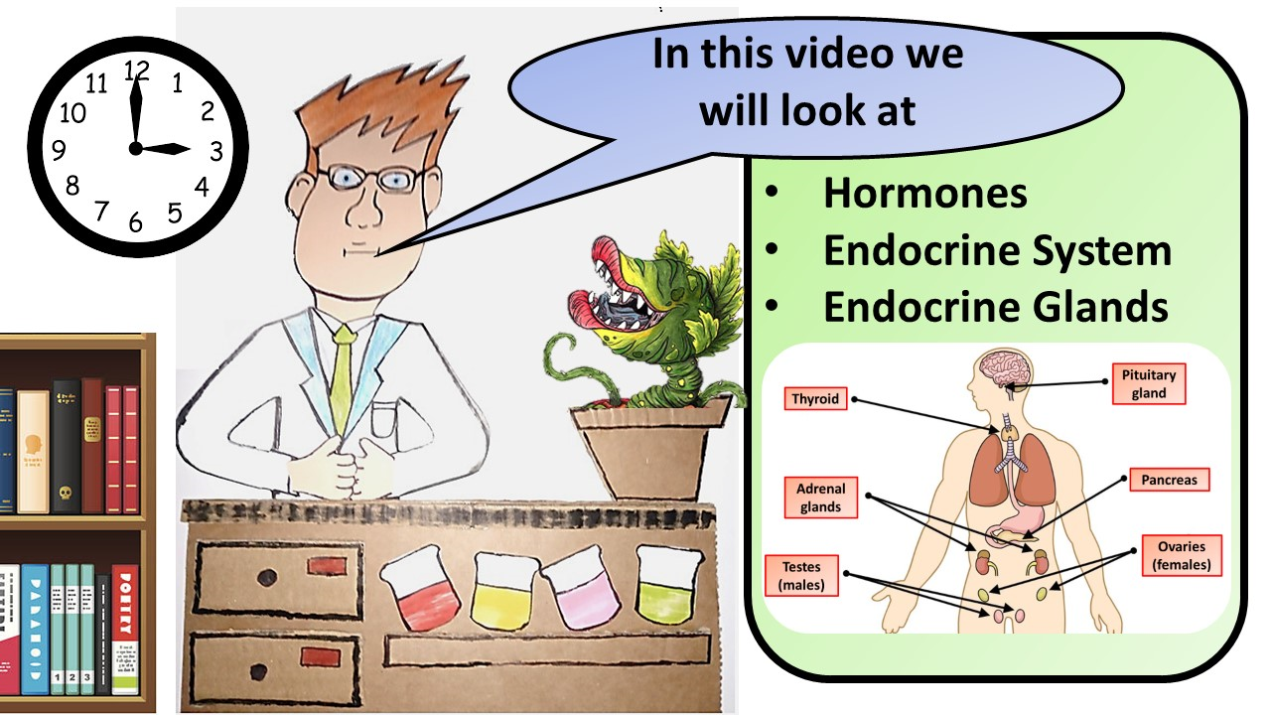
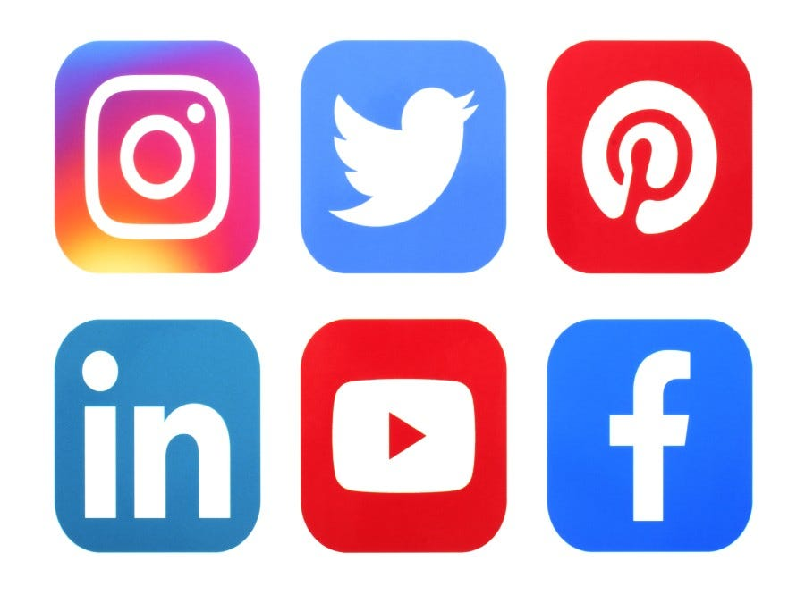

Click here to access my endocrine system video
Resources that this activity would work well with
Lessons on TES
Lessons on TPT
Follow me on social media to stay in touch
Keep up to date with my new content:

