Slide 1
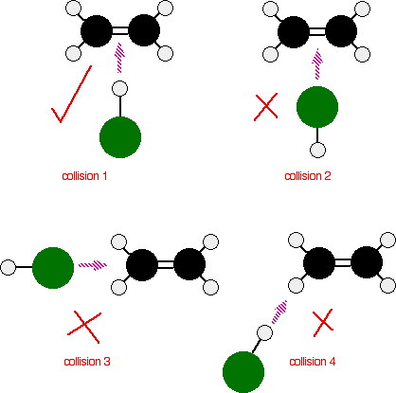
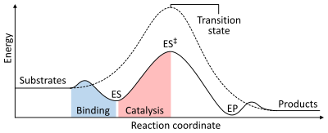
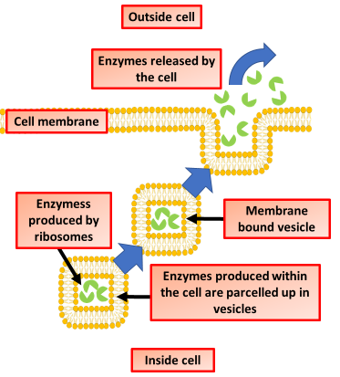
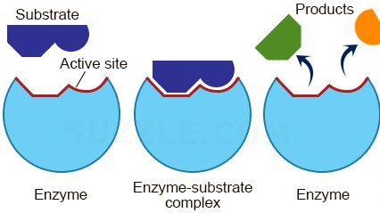
Describe the roles of enzymes in reactions
Describe the mechanism of enzyme action
Key information to include:
What effect do enzymes have on the rate of reaction?
What do anabolic enzymes do?
What do catabolic enzymes do?
What is meant by the term V max
Key information to include:
What is activation energy
How do enzymes lower activation energy?
What is required for a reaction to take place?
What is collision theory?
Explain the lock and key hypothesis
Describe the role of extra cellular enzymes
Key information to include:
What is the active site of an enzyme?
When is an enzyme substrate complex formed?
What do enzymes produce?
Describe the induced fit hypothesis
Key information to include:
What are extra cellular enzymes?
What are the role of extra cellular enzymes?
How are extra cellular enzymes secreted?
How do micro-organisms rely on extra-cellular enzymes

Slide 2
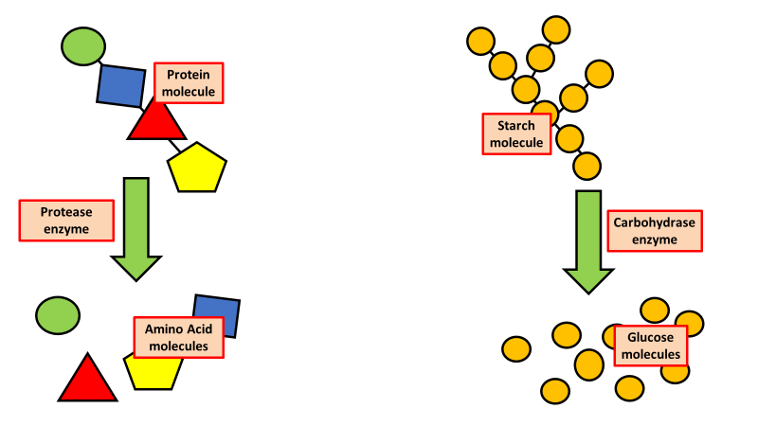
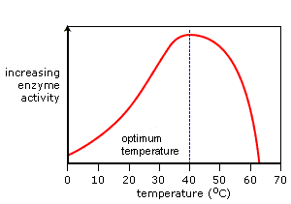
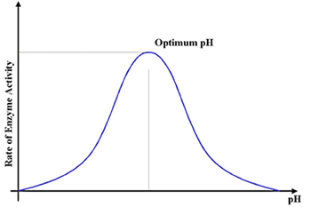
Describe how starch is broken down by enzymes
Describe how proteins are broken down by enzymes
Key information to include:
What is starch?
What is starch broken down into?
Where is starch broken down?
Why does starch need breaking down?
Key information to include:
What is protein?
What is protein broken down into?
Where is protein broken down?
Why does protein need breaking down?
Explain how temperature affects enzyme action
Explain how pH affects enzyme action
Key information to include:
How pH affects enzymes
Why the optimum pH is different for different enzymes
How does pH denature enzymes
Key information to include:
How does temperature affect enzyme action
What is meant by an optimum
Why do enzymes denature when the temperature is too high

Slide 3
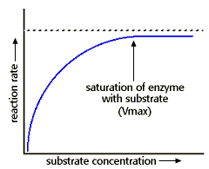
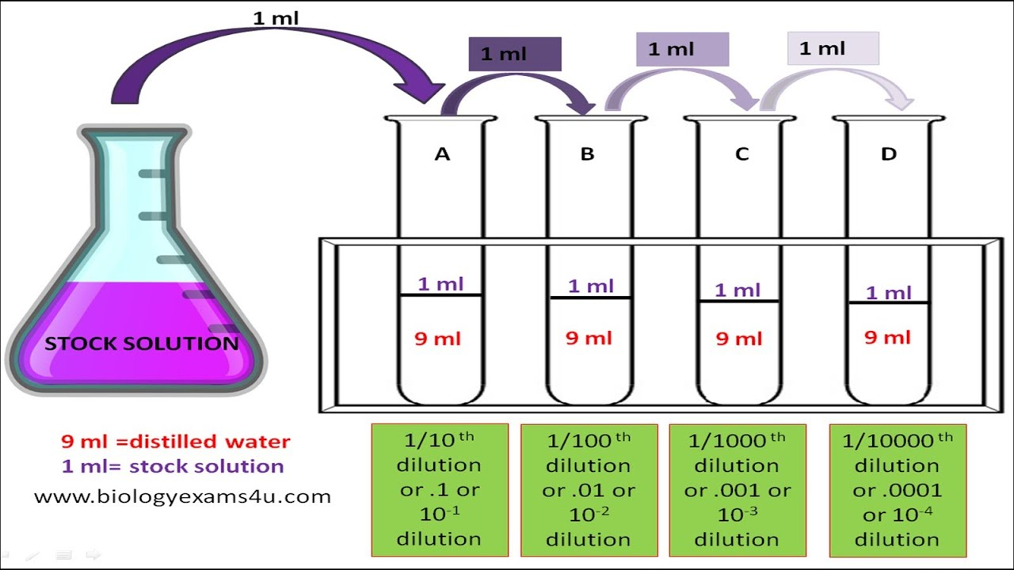
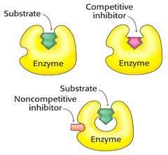
Describe the effect of enzyme & substrate concentration
Describe how a serial dilution is carried out
Key information to include:
What is a serial dilution?
When is a serial dilution used?
How do we carry out a serial dilution?
Key information to include:
What a substrate is
What Vmax is
Why the graph levels out
Explain competitive inhibition
Explain non-competitive inhibition
Key information to include:
What non-competitive inhibition is
How it differs from other types of inhibition
Give examples
How the shape of the active site is changed
Key information to include:
What competitive inhibition is
How it differs from other types of inhibition
Give examples

Slide 4
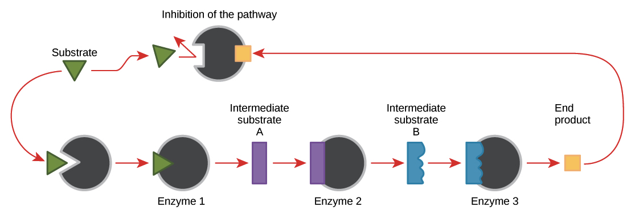
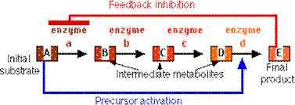
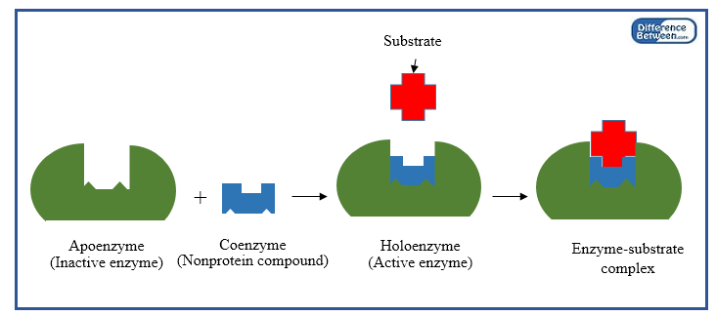
Explain end - product inhibition
Describe precursor activation
Key information to include:
What is end product inhibition
Where do we find end product inhibition
Explain the process
How is the active site altered
Key information to include:
What is precursor activation?
How does precursor activation work?
Where do we find precursor activation?
Explain the difference between cofactors & coenzymes
Key information to include:
What is a cofactor
What is a co-enzyme
How do they interact with enzymes

