Slide 1
Escape the Haunted House Science Game
To help you break, here are some tips!
Don’t cheat, have a go at the task before moving on or checking the answer
If you need more time pause the video!

Slide 2
The rain was coming down in drenching sheets

Slide 3
You run towards an old house to get out of it

Slide 4
As you get to the door it slowly opens and you dash in?

Slide 5
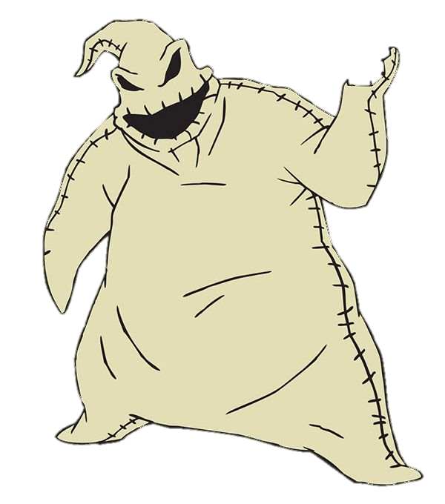
As you walk in the door slams behind you and locks?
You’ll never get out unless you find the skeleton key!

Slide 6
Answer my question and I’ll tell you where to look first
Go into the front room and look behind the round photo
Which of the following organelles would you only find in a plant cell?
1
Nucleus
2
Chloroplast
3
Ribosome
4
Cell membrane

Slide 7
You turn the hands to 5 and the other photo pops open!
Find the round photo in the room and turn it over
How fast does a car move if it travels 20m in 4s?
Speed = distance / time
5m/s
As you turn it over you find a note which reads:
Turn the clock hands to the answer of this question

Slide 8
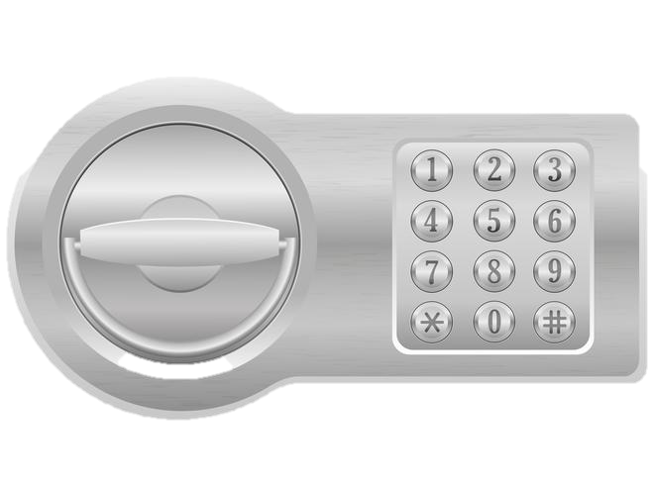
Behind the photo you find a safe. Listen to the cat!
Answer my riddle to find the location
of the safe code:
I have letters and numbers but I’m not a computer keyboard
I’m sometimes stored in a case but I’m not a cellphone
I contain paper but I’m not a ring binder
I have a cover but I’m not a pillow
I have a spine but I don’t have any bones

Slide 9
You open the book to the first page
4
3
2
1
Put the following stages in order showing how acid rain is produced to find the safe code
The acid rain collects in lakes & rivers
1
When it rains it now contains dilute sulphuric acid
2
The sulphur dioxide dissolves in water found in clouds
3
Sulphur dioxide is released when fossil fuels are burnt
4

Slide 10
You type the code into the safe and it opens up
4
3
2
1
Ring the following number
07891 40 50 60
Go to the kitchen

Slide 11
As you walk towards the kitchen the spider refuses to move until you answer his question
A
Diffusion
What process is being shown in this diagram?
B
Osmosis
C
Active transport
D
Running

Slide 12
Answer my riddle to find the location
of the next clue:
I get hot but I never sweat
I cook things but I’m not a chef
I have a door but you don’t go through me
I can sometimes clean myself but I’m not a person
I can be gas or electric but I’m not a car

Slide 13
You open the oven and find the following clue
4
3
Open the cupboard that is shown by the right answer to this question
2
8
1
7
6
12
5
11
What type of movement of molecules requires energy?
10
1
Diffusion
9
2
Osmosis
3
Active transport
4
Chemiosmosis

Slide 14
You open the cupboard and find the next clue
4
3
Open the cupboard that is shown by the right answer to this question
2
8
1
7
6
12
5
11
What is the type of movement that involves water?
10
5
Diffusion
9
6
Osmosis
7
Active transport
8
Chemiosmosis

Slide 15
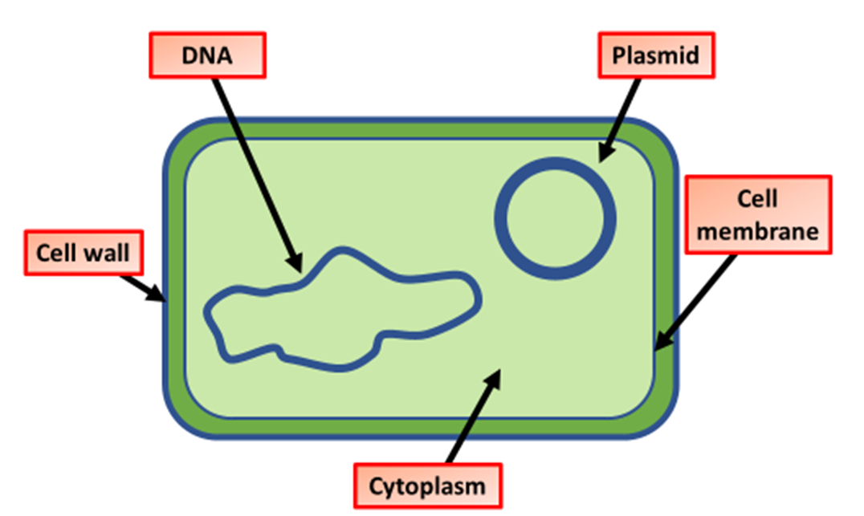
You open the cupboard and find the next clue
4
3
Open the cupboard that is shown by the right answer to this question
2
8
1
7
6
12
5
11
What does a prokaryotic cell not have that an eukaryotic cell does?
10
1
membrane
9
7
Cell wall
4
Nucleus
9
Cytoplasm

Slide 16
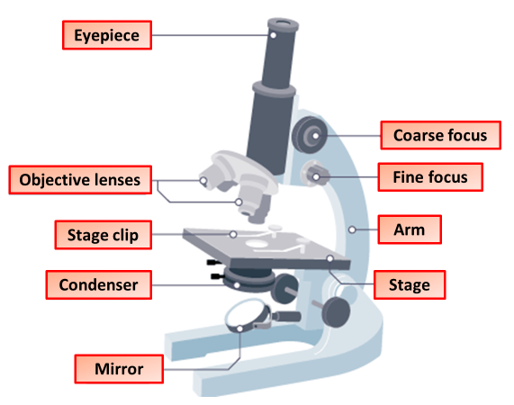
You open the cupboard and find the next clue
4
3
Open the cupboard that is shown by the right answer to this question
2
8
1
7
6
12
5
11
Which part of a microscope changes the magnification?
10
1
Fine focus
9
7
Eyepiece
5
Condenser
9
Objective lens

Slide 17
In the cupboard you find a piece of cheese. Who should you give it to?
4
3
2
8
1
7
6
12
5
11
10
9
Listen out for the snoring

Slide 18
You walk out of the kitchen and go upstairs

Slide 19
Listen out for the snoring!
ZZZZZZZZZZZZZZZZZZZ!

Slide 20
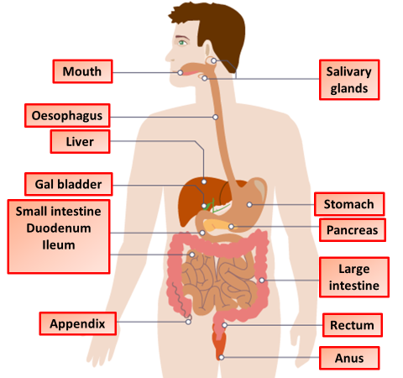
You open the wardrobe door and see a diagram of the body
Answer me these questions 3
ZZZZZZZZZZZZZZZZZZZ!

Slide 21
Where are nutrients absorbed?

Slide 22
Where is very acidic?

Slide 23
Where is water absorbed?

Slide 24
Now check out where undigested food ends up

Slide 25
You walk out of the bedroom and find the bath room

Slide 26
You walk into the bathroom and see…… nothing
The hot water tap gives off lots of steam
Turn the hot tap on

Slide 27
You see something forming on the mirror above the sink
Find the combination for the cabinet lock on the toilet role
What is used to test for starch?
Which is the smallest out of the following list?
What enzyme breaks down fats?
Where is bile stored?
Benedict’s solution
Small intestine
Organ
1
Lipase
1
1
1
Iodine
Tissue
Protease
2
Liver
2
2
2
Biuret solution
Cell
Carbohydrase
3
Pancreas
3
3
3
System
Fatase
4
Gal bladder
4
4
Ethanol
3
2
4
1
4

Slide 28
You enter the code and the cupboard opens
3
2
4
1
Loft Key
In the cupboard you find a key to the loft

Slide 29
You walk back into the corridor and open the loft

Slide 30
You enter the loft and turn on the TV
Use the letters from the correct answers to see where to go next

Slide 31
What is needed if we need more energy that will affect the environment?
A
More minerals
L
More oxygen
E
More food
C
Fossil fuels
C

Slide 32
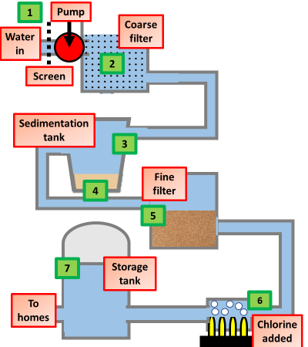
What is used to kill bacteria during water treatment?
A
Florine
E
Chlorine
C
Aluminium sulphate
L
Sand
C
E

Slide 33
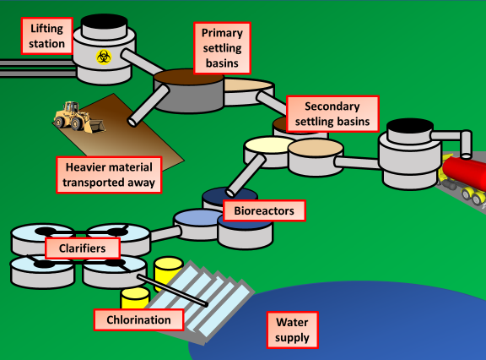
Where in sewage is biological material broken down?
L
Bioreactors
B
Clarifiers
E
Chlorination
C
E
L
R
Settling basins

Slide 34
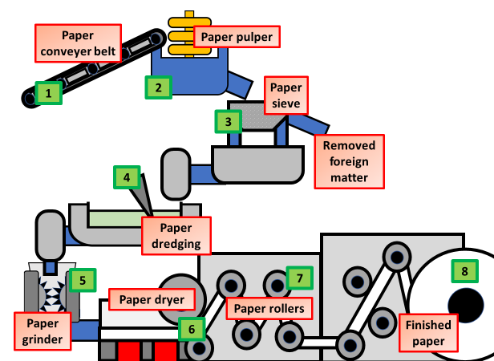
What is the final process in recycling paper?
A
Sieving it
E
Pulping it
L
Rolling it
C
E
L
L
R
Drying it

Slide 35
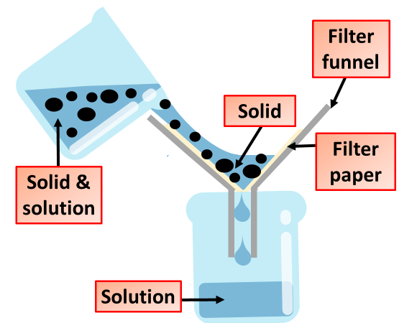
During filtration what removes the solid material?
E
Filter funnel
A
Filter paper
R
Beaker
C
E
L
L
A
L
Solution

Slide 36
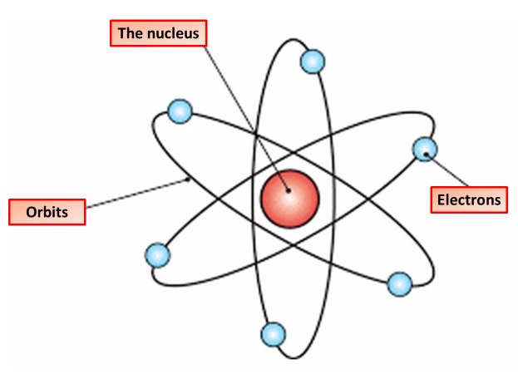
What orbits the nucleus?
A
Protons
R
Electrons
E
Neutrons
C
Atoms
C
E
L
L
E
R

Slide 37
You climb down from the loft

Slide 38
Then back down the stairs and go down into the cellar

Slide 39
To find the key, turn the valves in the correct order
Use the equation below to answer the set of questions to work out the order
1
2
4
3
What is the density of an object with a mass of 10g and a volume of 5cm³?
What is the density of an object with a mass of 7g and a volume of 7cm³?
What is the density of an object with a mass of 16g and a volume of 4cm³?
What is the density of an object with a mass of 45g and a volume of 9cm³?
What is the density of an object with a mass of 90g and a volume of 30cm³?
5

Slide 40
The door opens and reveals the skeleton key!

Slide 41
You run back up the stairs into the entryway

Slide 42
Then to the front door where you use your key
The door swings open!

Slide 43
DID YO ESCAPE?

