Slide 1

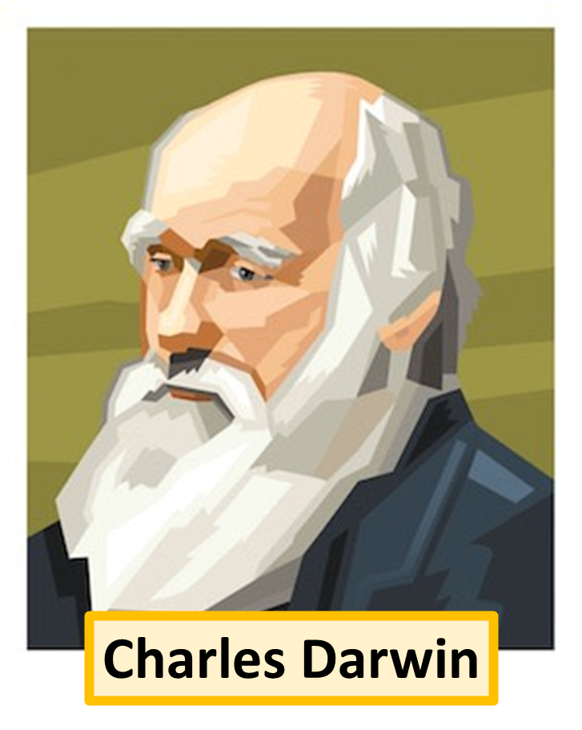
Evolution Article
Evolution is the process by which different species of organisms change and develop over long periods. Charles Darwin, a 19th-century naturalist, is famous for his theory of evolution by natural selection. During his voyage on the HMS Beagle, Darwin observed diverse species and noticed how they were adapted to their environments. He proposed that individuals with traits better suited to their surroundings are more likely to survive and reproduce, passing these advantageous traits to their offspring. Over many generations, these changes accumulate, leading to the development of new species. Darwin's theory, supported by evidence from fossils, genetics, and comparative anatomy, provides a scientific explanation for the diversity of life on Earth and how species adapt and evolve over time.
Evolution is the process by which different species of organisms develop and diversify from their ancestors over long periods. It is driven by mechanisms such as natural selection, where individuals with traits better suited to their environment are more likely to survive and reproduce, passing these advantageous traits to their offspring. Genetic mutations also play a role, introducing new variations that can be beneficial, harmful, or neutral. Over time, these small changes accumulate, leading to the emergence of new species and the incredible diversity of life we see today. Evolution is supported by extensive evidence from fossil records, comparative anatomy, and molecular biology, providing a comprehensive understanding of how life on Earth has changed and adapted over millions of years.
Questions
What was the name of the ship Dawin went on?
What was some of the evidence for evolution?
What is evolution?

