Slide 1
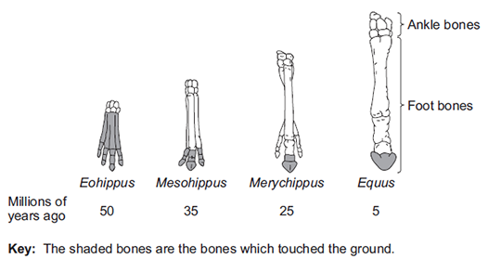

Evolution Structure Question
The diagram below shows changes in the foot bones of four ancestors of modern horses over the past 50 million years.
The changes in the arrangement of the foot bones of horses support Darwin’s theory of evolution by natural selection. Explain how the arrangement of the foot bones of Eohippus could have evolved into the arrangement of the foot bones of Equus.
_______________________________________________________________________________________________________________________________________________________________________________________________________________________________________________________________________________________________________________________________________________________________________________________________________________________________________
Answer
Link to video

Slide 2
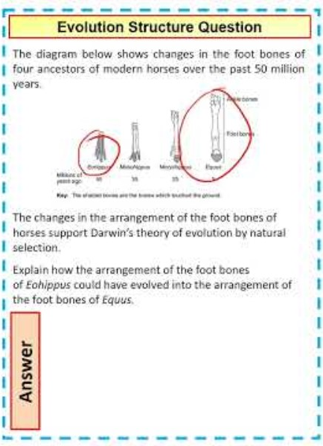
Evolution Structure Question

Slide 3

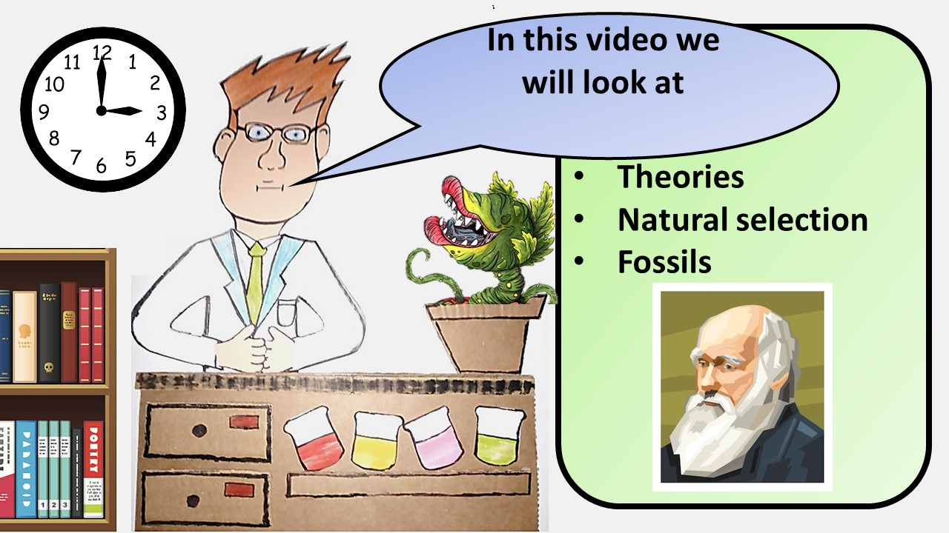


Click here to access my youtube videos
Resources that this activity would work well with
Lesson on TES
Lesson on TPT
Follow me on social media to stay in touch
Keep up to date with my new content:

