Slide 1
Atmosphere Evolution Practice Question
Describe the composition of the Earth’s Atmosphere and describe in detail how the Earth’s atmosphere has developed.
On early earth volcanoes produced a lot of Carbon Dioxide. This was the main gas in the atmosphere.
About 3.4 billion years ago, simple organisms evolved such as bacteria and algae.
Simple organisms used carbon dioxide dissolved in water to produce their shells
Simple organisms such as algae can make their food from by photosynthesis
Answer
Photosynthesis produces oxygen. This was really helpful to animal life which need oxygen to respire
Ammonia in the atmosphere reacted with oxygen to form water and nitrogen
There then became a balance between photosynthesis and respiration. The current composition of the Earth’s atmosphere is (Nitrogen 78%, Oxygen 21%, Argon 0.9%, Carbon dioxide 0.04%, others – trace amount)
The earth’s atmosphere is now getting carbon dioxide due to pollution

Slide 2
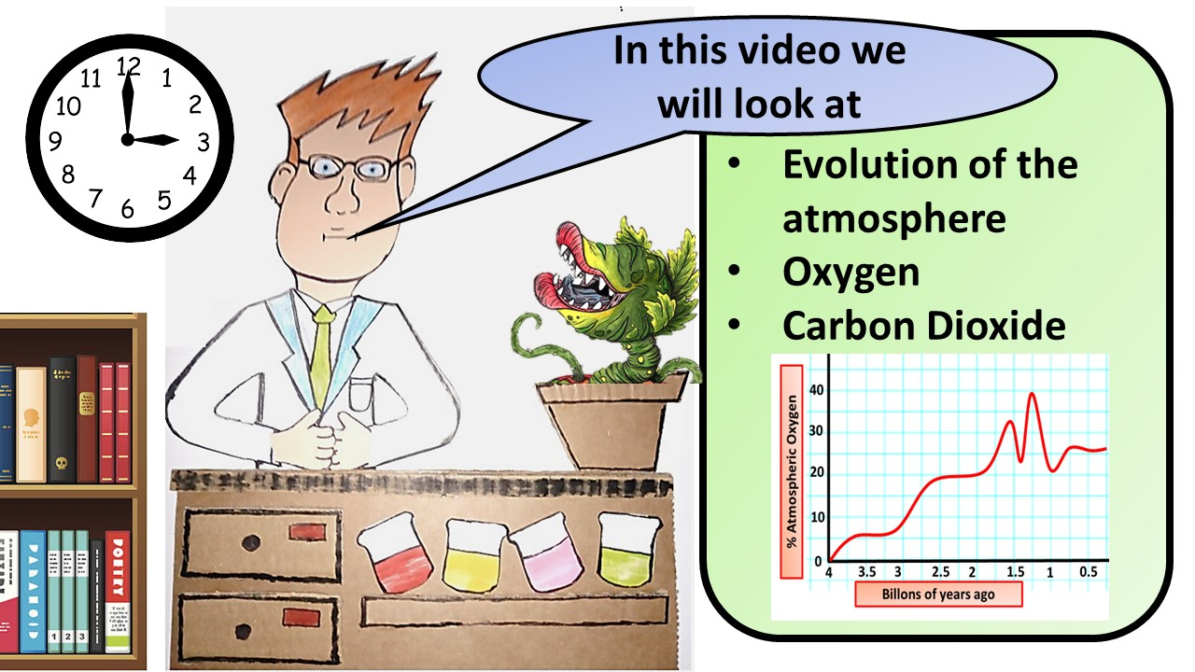
Click here to access my youtube videos
Resources that this activity would work well with
Lesson on TES
Lesson on TPT
Follow me on social media to stay in touch
Keep up to date with my new content:

