Slide 1
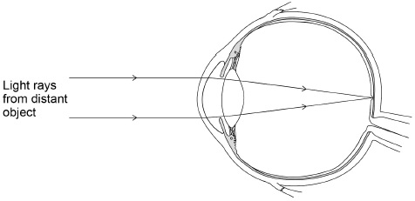
Eye Focusing Question
The human eye can focus on objects at different distances. Figure 1 shows how a clear image of a distant object is formed in a person’s eye.
Explain how the person’s eye could adjust to form a clear image of a nearer object.
Key things to include:
What is the role of ciliary muscles
What happens to the lens
How is the image focused on the retina
_______________________________________________________________________________________________________________________________________________________________________________________________________________________________________________________________________________________________________________________________________________________________________________________________________________________________________
Answer
Link to video

Slide 2
Eye Focusing Question

Slide 3
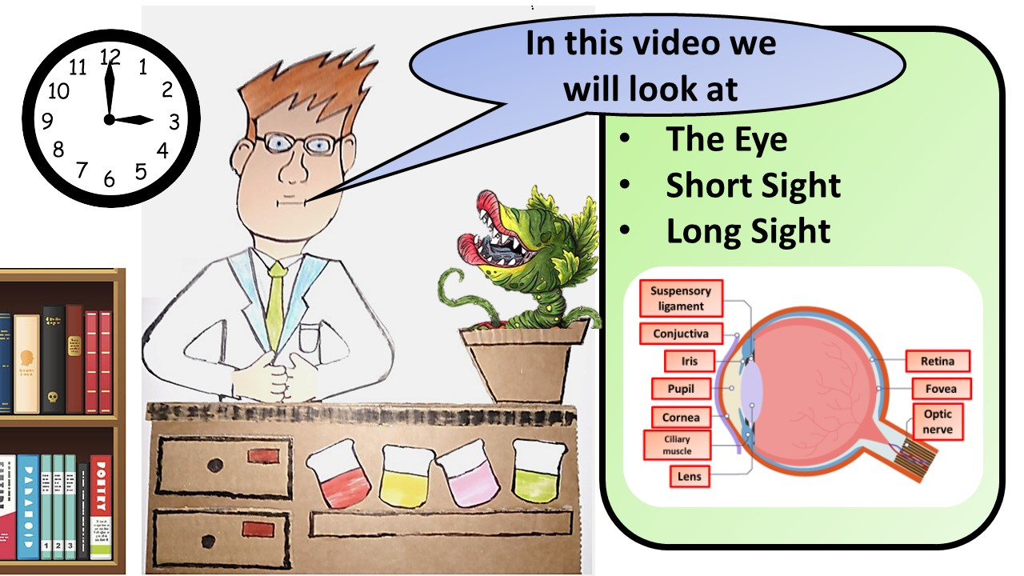
Click here to access my youtube videos
Resources that this activity would work well with
Lesson on TES
Lesson on TPT
Follow me on social media to stay in touch
Keep up to date with my new content:

