Slide 1
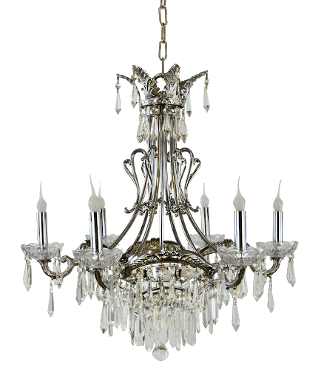

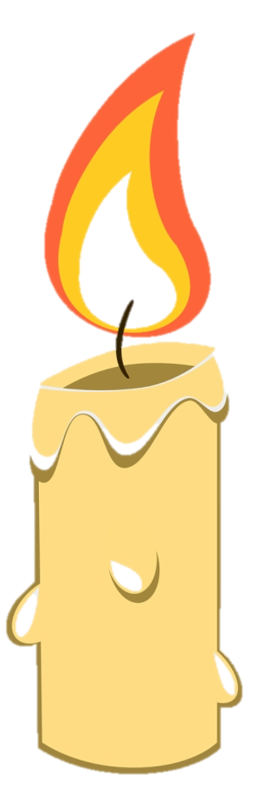
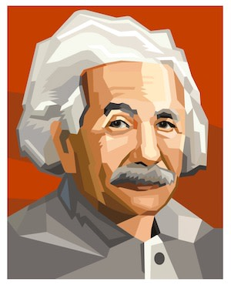
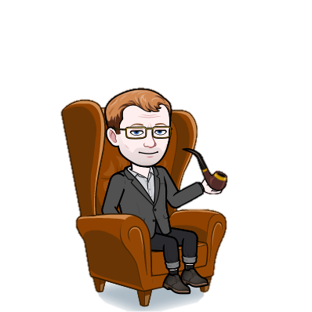
Albert Einstein
Albert Einstein was a German-born theoretical physicist who developed the theory of relativity, one of the two pillars of modern physics. His work is also known for its influence on the philosophy of science.

Slide 2
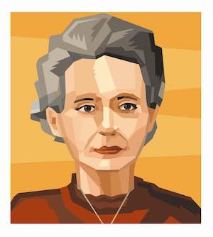
Marie Curie
Marie Skłodowska Curie, born Maria Salomea Skłodowska, was a Polish and naturalized-French physicist and chemist who conducted pioneering research on radioactivity.

Slide 3
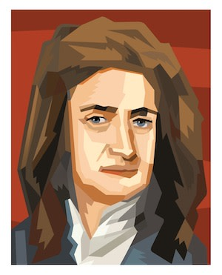
Isaac Newton
Sir Isaac Newton PRS was an English mathematician, physicist, astronomer, theologian, and author who is widely recognised as one of the most influential scientists of all time and as a key figure in the scientific revolution

Slide 4
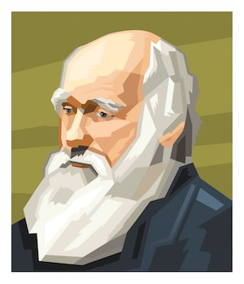
Charles Darwin
Charles Robert Darwin was an English naturalist, geologist and biologist, best known for his contributions to the science of evolution. His proposition that all species of life have descended over time from common ancestors is now widely accepted, and considered a foundational concept in science.

Slide 5
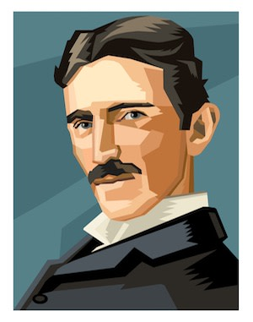
Nikola Tesla
Nikola Tesla was a Serbian-American inventor, electrical engineer, mechanical engineer, and futurist who is best known for his contributions to the design of the modern alternating current electricity supply system.

Slide 6
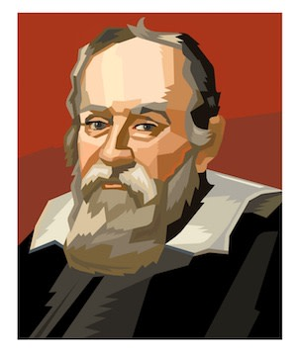
Galileo Galilei
Galileo di Vincenzo Bonaulti de Galilei was an Italian astronomer, physicist and engineer, sometimes described as a polymath, from Pisa. Galileo has been called the "father of observational astronomy", the "father of modern physics", the "father of the scientific method", and the "father of modern science".

Slide 7
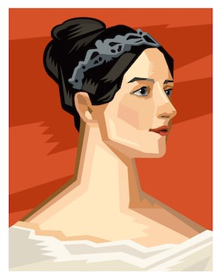
Ada Lovelace
Augusta Ada King, Countess of Lovelace was an English mathematician and writer, chiefly known for her work on Charles Babbage's proposed mechanical general-purpose computer, the Analytical Engine.

Slide 8
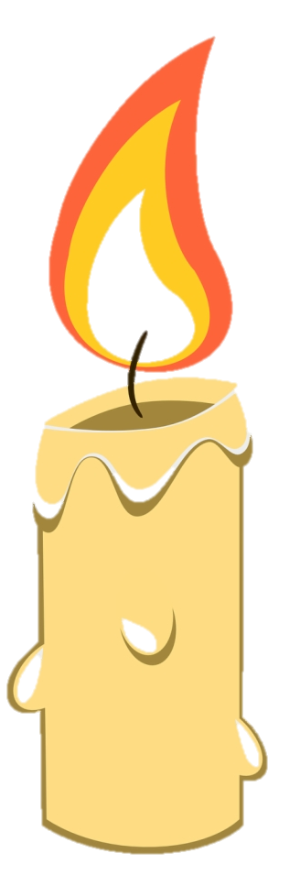
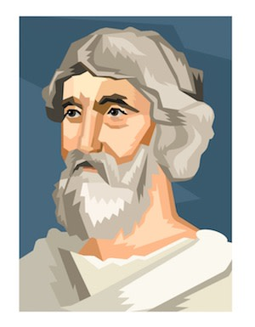
Pythagoras
Pythagoras of Samos was an ancient Ionian Greek philosopher and the eponymous founder of Pythagoreanism. His political and religious teachings were well known in Magna Graecia and influenced the philosophies of Plato, Aristotle, and, through them, Western philosophy.

Slide 9
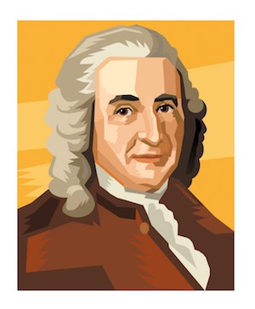
Carl Linnaeus
Carl Linnaeus, also known after his ennoblement as Carl von Linné, was a Swedish botanist, zoologist, and physician who formalised binomial nomenclature, the modern system of naming organisms. He is known as the "father of modern taxonomy"

Slide 10
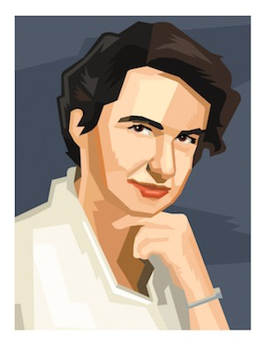
Rosalind Franklin
Rosalind Elsie Franklin was an English chemist and X-ray crystallographer whose work was central to the understanding of the molecular structures of DNA, RNA, viruses, coal, and graphite

Slide 11
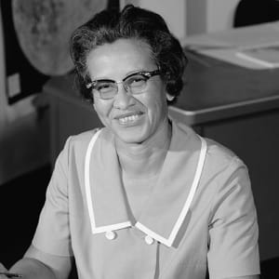
Katherine Johnson
One of NASA's human 'computers,' Katherine Johnson performed the complex calculations that enabled humans to successfully achieve space flight

Slide 12
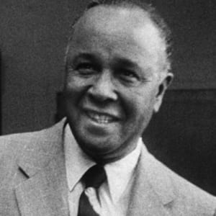
Percy Julian
African American chemist Percy Julian was a pioneer in the chemical synthesis of medicinal drugs such as cortisone, steroids and birth control pills.

Slide 13
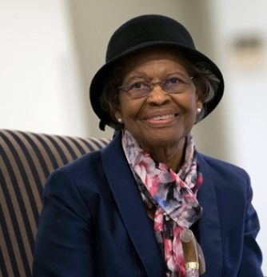
Gladys West
Gladys West leveraged her mathematical and programming expertise to invent an accurate model of the Earth which was used as the foundation for the creation of the Global Positioning System

Slide 14
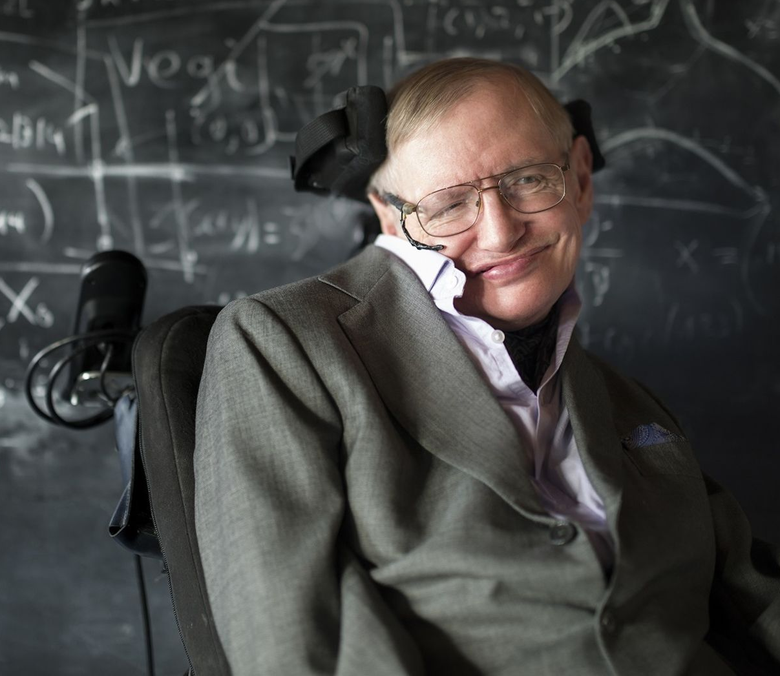
Stephen Hawking
Hawking's scientific works included a collaboration with Roger Penrose on gravitational singularity theorems in the framework of general relativity and the theoretical prediction that black holes emit radiation, often called Hawking radiation.

Slide 15
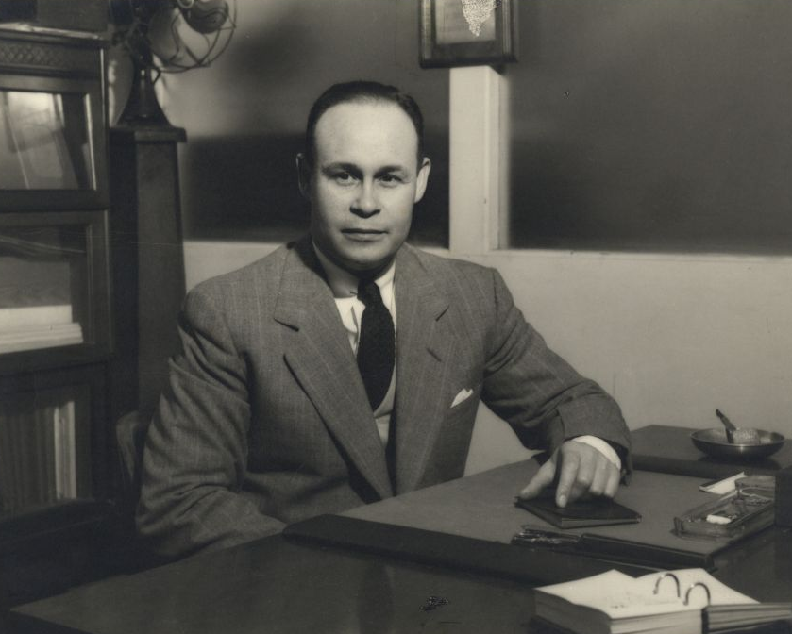
Dr. Charles Drew
Dr. Charles Drew was a brilliant, pioneering doctor who developed new methods for storing blood for transfusions and created the first blood bank. Drew standardized the protocols for collecting and storing blood, ultimately helping to pilot a national blood-banking program in 1941

Slide 16
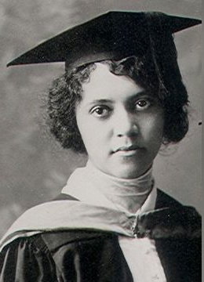
Alice Augusta Ball
Chemist Alice Augusta Ball developed a successful treatment for Hansen's Disease, also known as leprosy, a bacterial infection that can result in severe nerve damage if left untreated

Slide 17
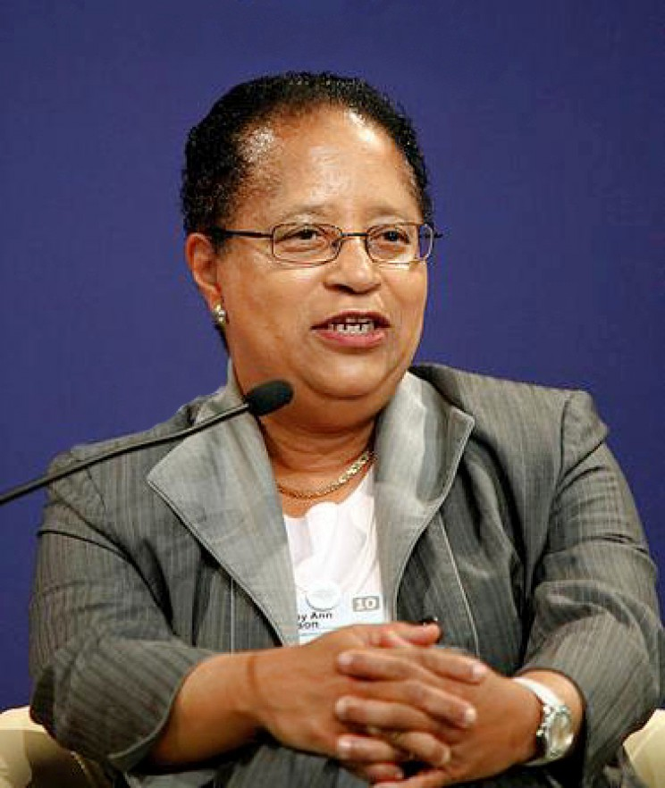
Dr. Shirley Ann Jackson
Her main contributions to science revolved around advancements in telecommunications that helped lead to the direct development of technologies like the portable fax machine, touch-tone phones and fiber optic cables and many more.

Slide 18
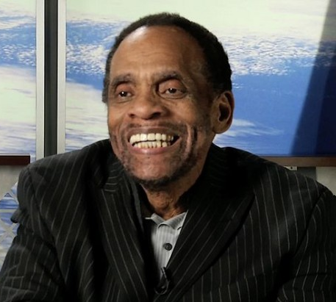
George Edward Alcorn Jr.
George is best known for his work on, and the invention of, the X-Ray Spectrometer. This invention was widely adopted by NASA and his invention would earn him the NASA Goddard Space Flight Center Inventor of the Year award in 1984.

Slide 19
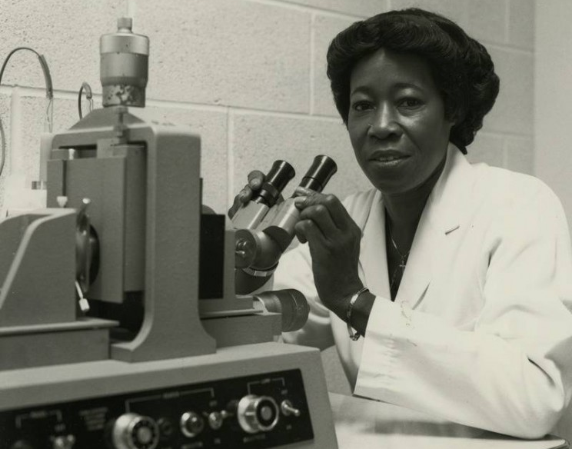
Bettye Washington Greene
Bettye is best known for her research and development into the production of latex and other polymers. She is also credited as being the first African-American female Ph.D. chemist to join the Dow Chemical Company.

Slide 20
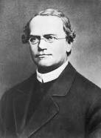
Gregor Mendel
Gregor Johann Mendel was a scientist, Augustinian friar and abbot of St. Thomas' Abbey in Brno, Margraviate of Moravia. Mendel was born in a German-speaking family in the Silesian part of the Austrian Empire and gained posthumous recognition as the founder of the modern science of genetics.

Slide 21
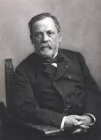
Louis Pasteur
Louis Pasteur was a French biologist, microbiologist and chemist renowned for his discoveries of the principles of vaccination, microbial fermentation and pasteurization. He is remembered for his remarkable breakthroughs in the causes and prevention of diseases

Slide 22
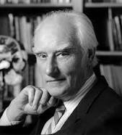
Francis Crick
Francis Harry Compton Crick OM FRS was a British molecular biologist, biophysicist, and neuroscientist. In 1953, he co-authored with James Watson the academic paper proposing the double helix structure of the DNA molecule.

Slide 23
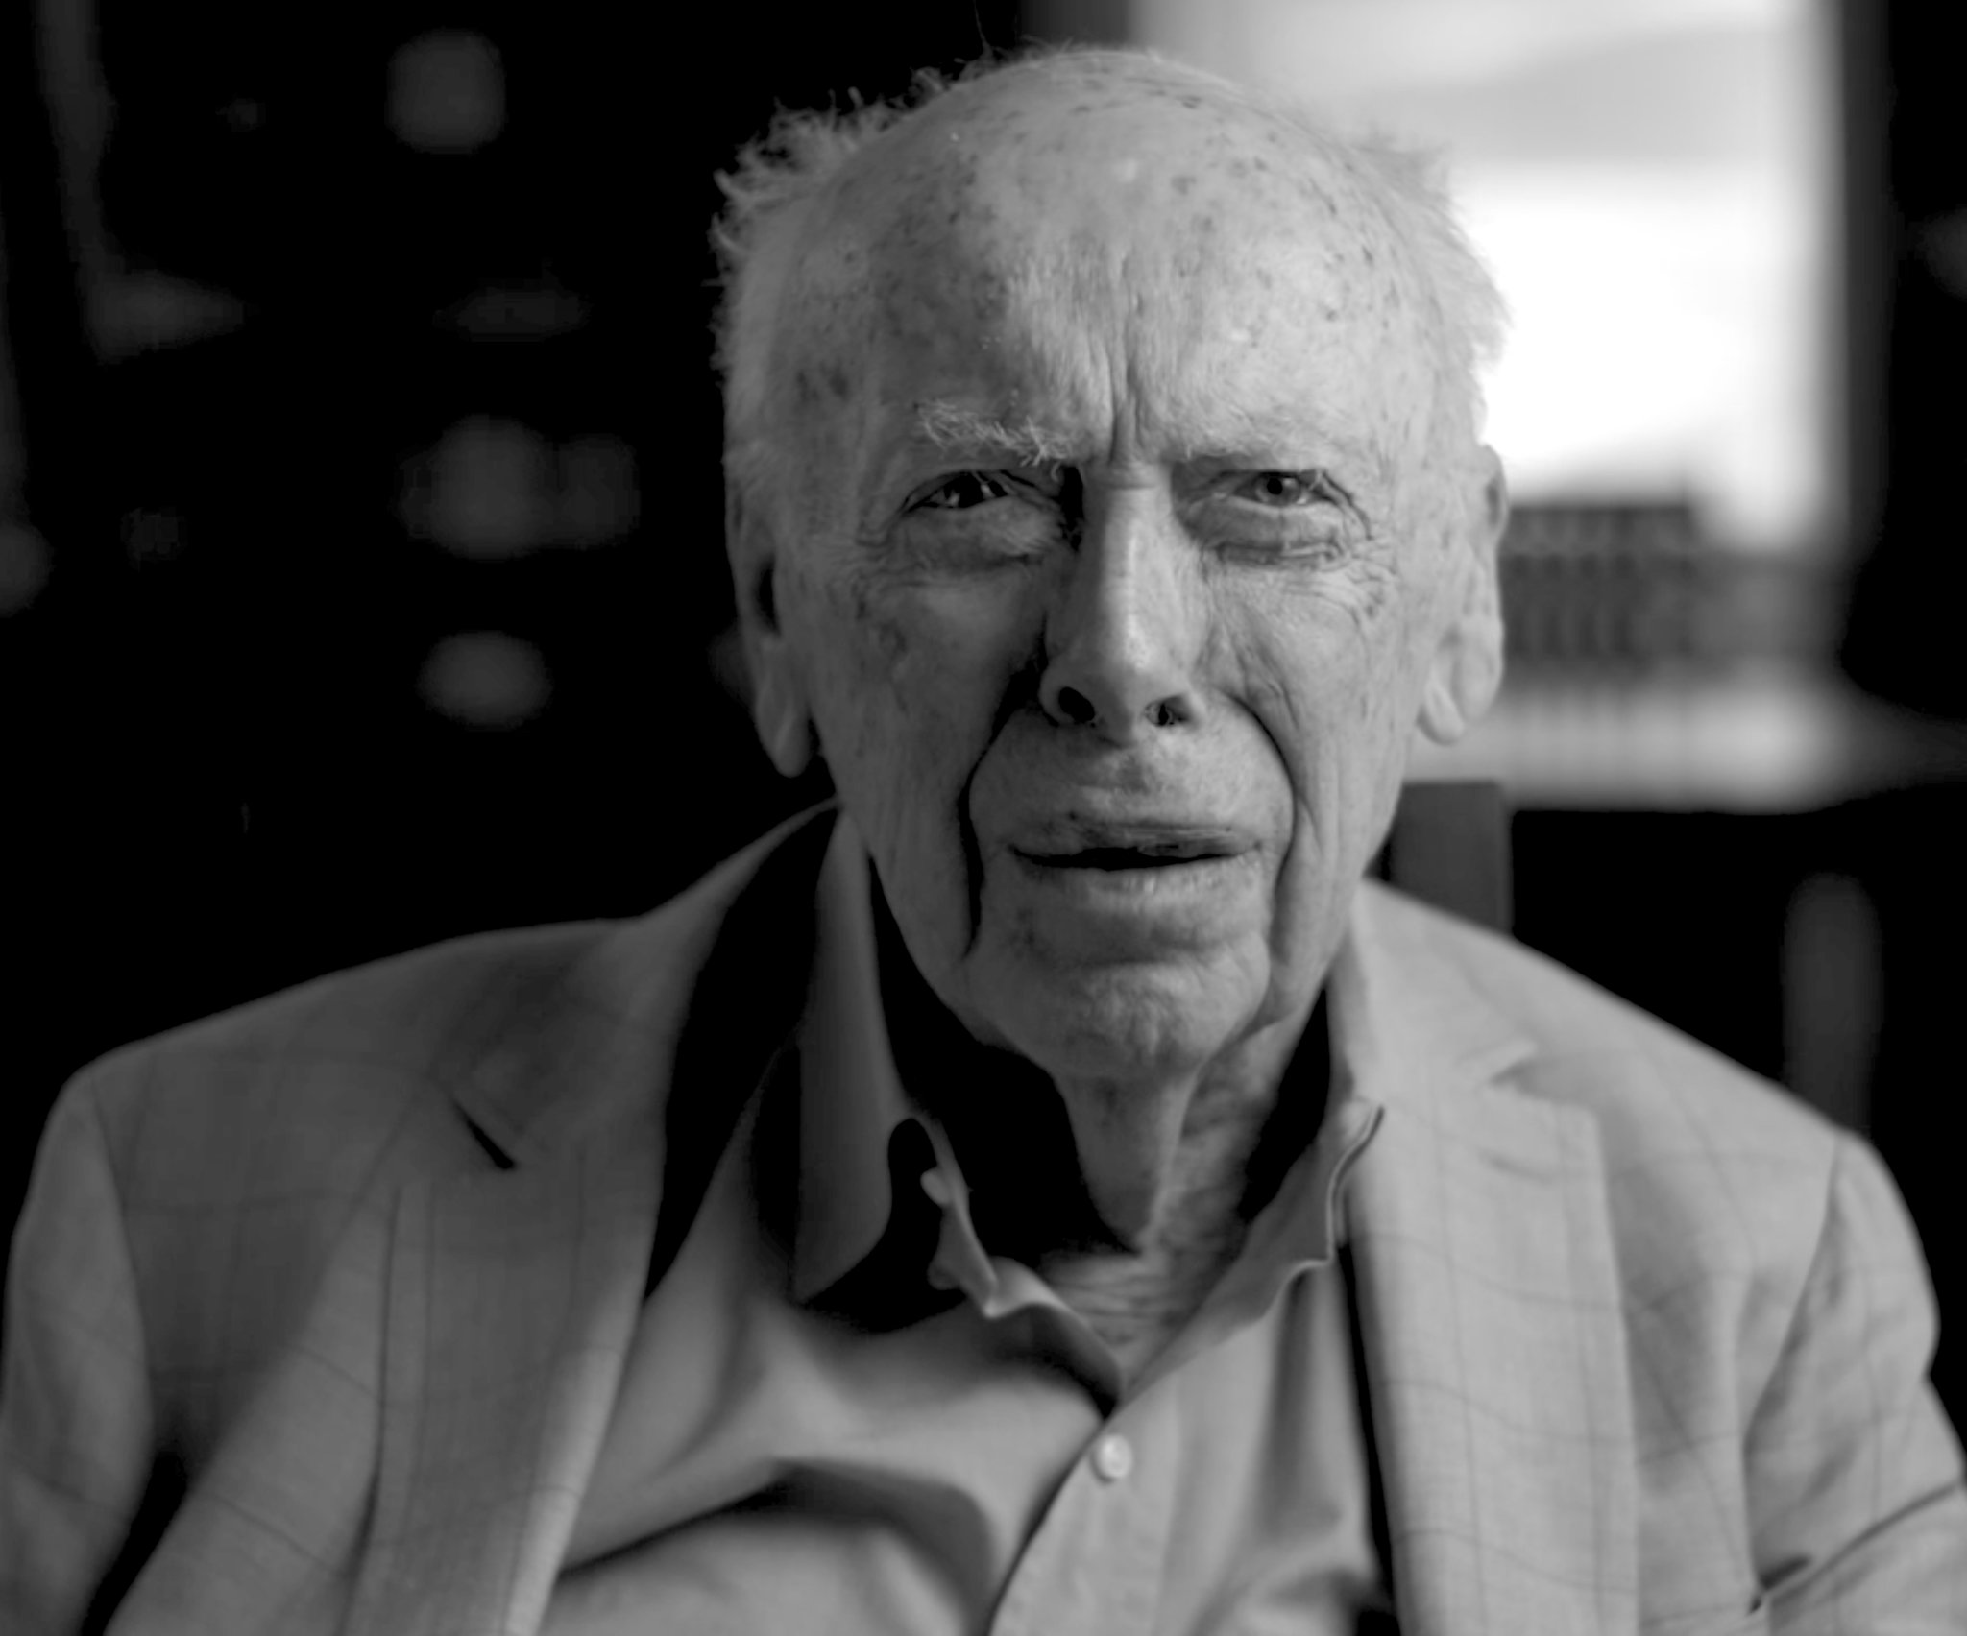
James Watson
James Dewey Watson KBE is an American molecular biologist, geneticist and zoologist. In 1953, he co-authored with Francis Crick the academic paper proposing the double helix structure of the DNA molecule

Slide 24
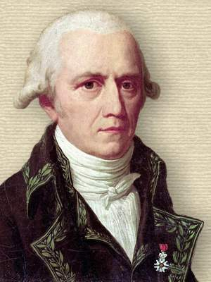
Lamarck
Jean-Baptiste Pierre Antoine de Monet, chevalier de Lamarck, often known simply as Lamarck, was a French naturalist. He was a soldier, biologist, and academic, and an early proponent of the idea that biological evolution occurred and proceeded in accordance with natural laws

Slide 25
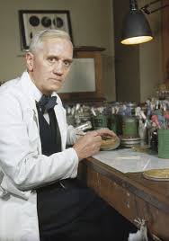
Alexander Fleming
Sir Alexander Fleming FRS FRSE FRCS was a Scottish physician and microbiologist. His best-known discoveries are the enzyme lysozyme in 1923 and the world's first broadly effective antibiotic substance

Slide 26
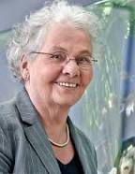
Christiane Nüsslein-Volhard
Christiane Nüsslein-Volhard is a German developmental biologist and 1995 Nobel Prize-winner. Nüsslein-Volhard earned her PhD in 1974 from the University of Tübingen, where she studied protein-DNA interaction

Slide 27
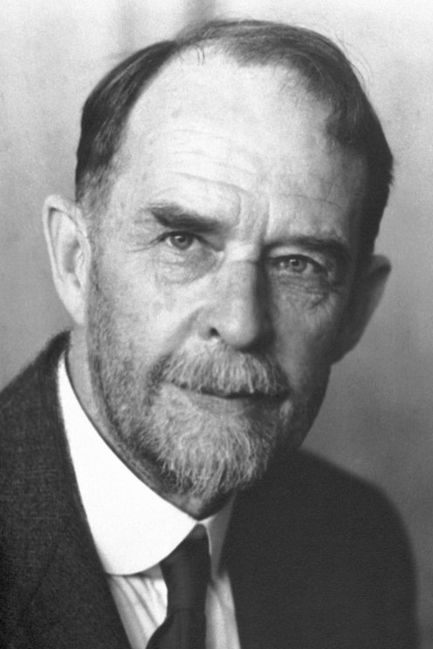
Thomas Hunt Morgan
Thomas Hunt Morgan was an American evolutionary biologist, geneticist, embryologist, and science author who won the Nobel Prize in Physiology or Medicine in 1933 for discoveries elucidating the role that the chromosome plays in heredity.

Slide 28
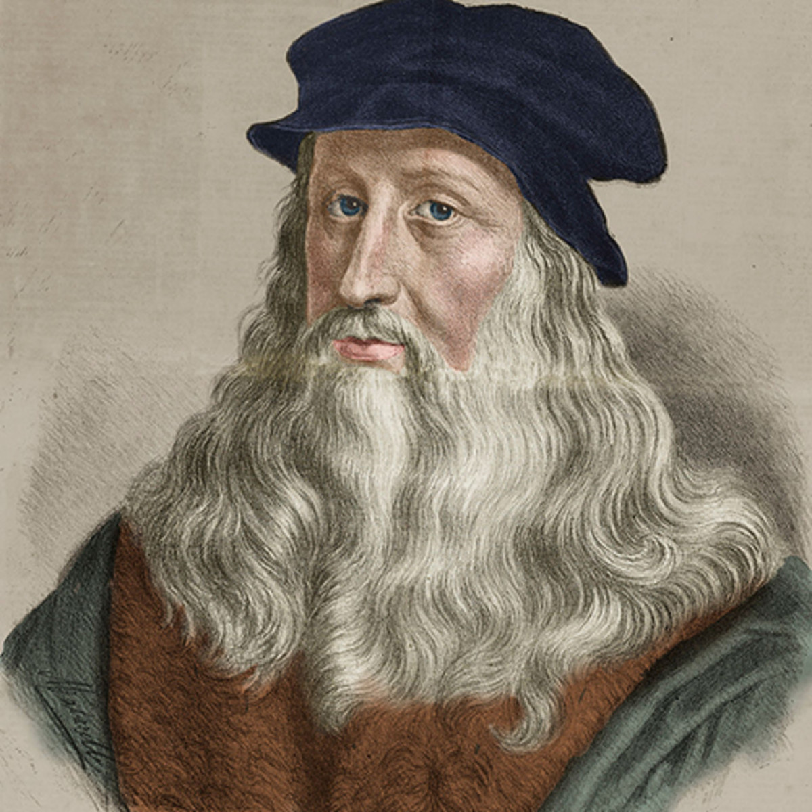
Leonardo da Vinci
Leonardo da Vinci was an Italian polymath of the Renaissance whose areas of interest included science and invention, drawing, painting, sculpture, architecture, music, mathematics, engineering, literature, anatomy, geology, astronomy, botany, paleontology, and cartographyre, anatomy, geology, astronomy, botany, paleontology, and cartography

Slide 29
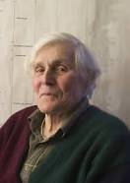
Carl Woese
Carl Richard Woese was an American microbiologist and biophysicist. Woese is famous for defining the Archaea in 1977 by phylogenetic taxonomy of 16S ribosomal RNA

Slide 30
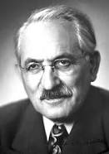
Selman Waksman
Selman Abraham Waksman was a Ukrainian-born Jewish-American inventor, biochemist and microbiologist whose research into the decomposition of organisms that live in soil enabled the discovery of streptomycin and several other antibiotics

Slide 31
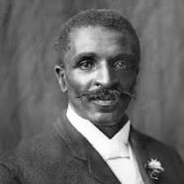
George Washington Carver
George Washington Carver was an American agricultural scientist and inventor. He promoted alternative crops to cotton and methods to prevent soil depletion. He was the most prominent black scientist of the early 20th century

Slide 32
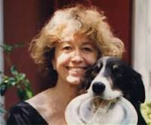
Polly Matzinger
Polly Celine Eveline Matzinger is an immunologist who proposed the danger model theory of how the immune system works. In 2002, Discover magazine recognized Matzinger as one of the 50 most important women in science

Slide 33
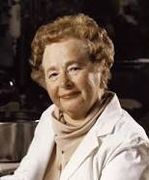
Gertrude B. Elion
Gertrude "Trudy" Belle Elion was an American biochemist and pharmacologist, who shared the 1988 Nobel Prize in Physiology or Medicine with George H. Hitchings and Sir James Black for their use of innovative methods of rational drug design for the development of new drugs

Slide 34
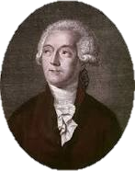
Antoine Lavoisier
Antoine-Laurent de Lavoisier, also Antoine Lavoisier after the French Revolution, was a French nobleman and chemist who was central to the 18th-century chemical revolution

Slide 35
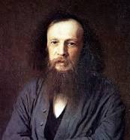
Dmitri Mendeleev
Dmitri Ivanovich Mendeleev was a Russian chemist and inventor. He is best remembered for formulating the Periodic Law and creating a farsighted version of the periodic table of elements

Slide 36
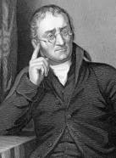
John Dalton
John Dalton FRS was an English chemist, physicist, and meteorologist. He is best known for introducing the atomic theory into chemistry, and for his research into colour blindness, sometimes referred to as Daltonism in his honour

Slide 37
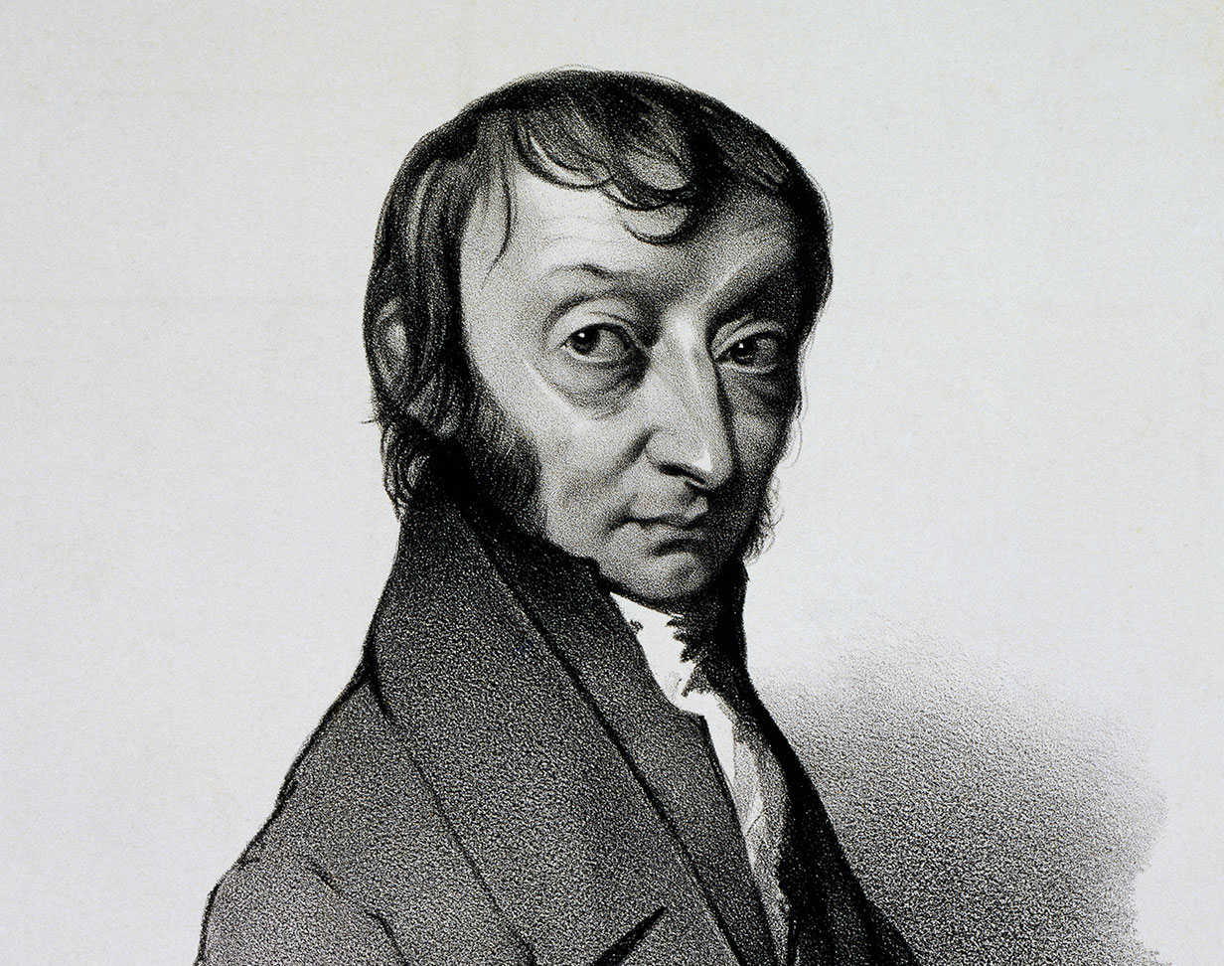
Amedeo Avogadro
Lorenzo Romano Amedeo Carlo Avogadro, Count of Quaregna and Cerreto, was an Italian scientist, most noted for his contribution to molecular theory now known as Avogadro's law, which states that equal volumes of gases under the same conditions of temperature and pressure will contain equal numbers of molecules

Slide 38
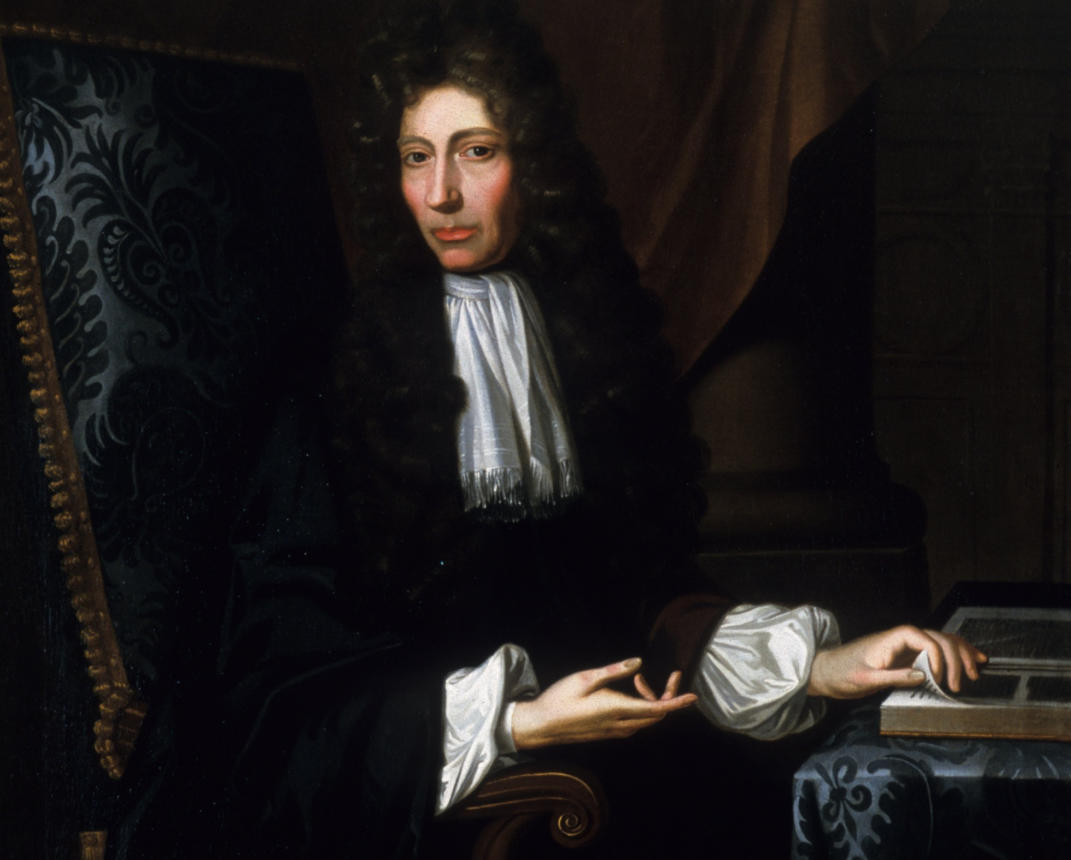
Robert Boyle
Robert Boyle FRS was an Anglo-Irish natural philosopher, chemist, physicist, and inventor. Boyle is largely regarded today as the first modern chemist, and therefore one of the founders of modern chemistry, and one of the pioneers of modern experimental scientific method

Slide 39
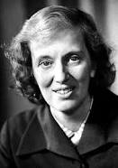
Dorothy Hodgkin
Dorothy Mary Crowfoot Hodgkin OM FRS HonFRSC was a British chemist who advanced the technique of X-ray crystallography to determine the structure of biomolecules, which became an essential tool in structural biology

Slide 40
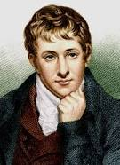
Humphry Davy
Sir Humphry Davy, 1st Baronet PRS MRIA FGS FRS was a Cornish chemist and inventor, who is best remembered today for isolating, by using electricity, a series of elements for the first time

Slide 41
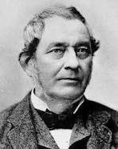
Robert Bunsen
Robert Wilhelm Eberhard Bunsen was a German chemist. He investigated emission spectra of heated elements, and discovered caesium and rubidium with the physicist Gustav Kirchhoff.

Slide 42
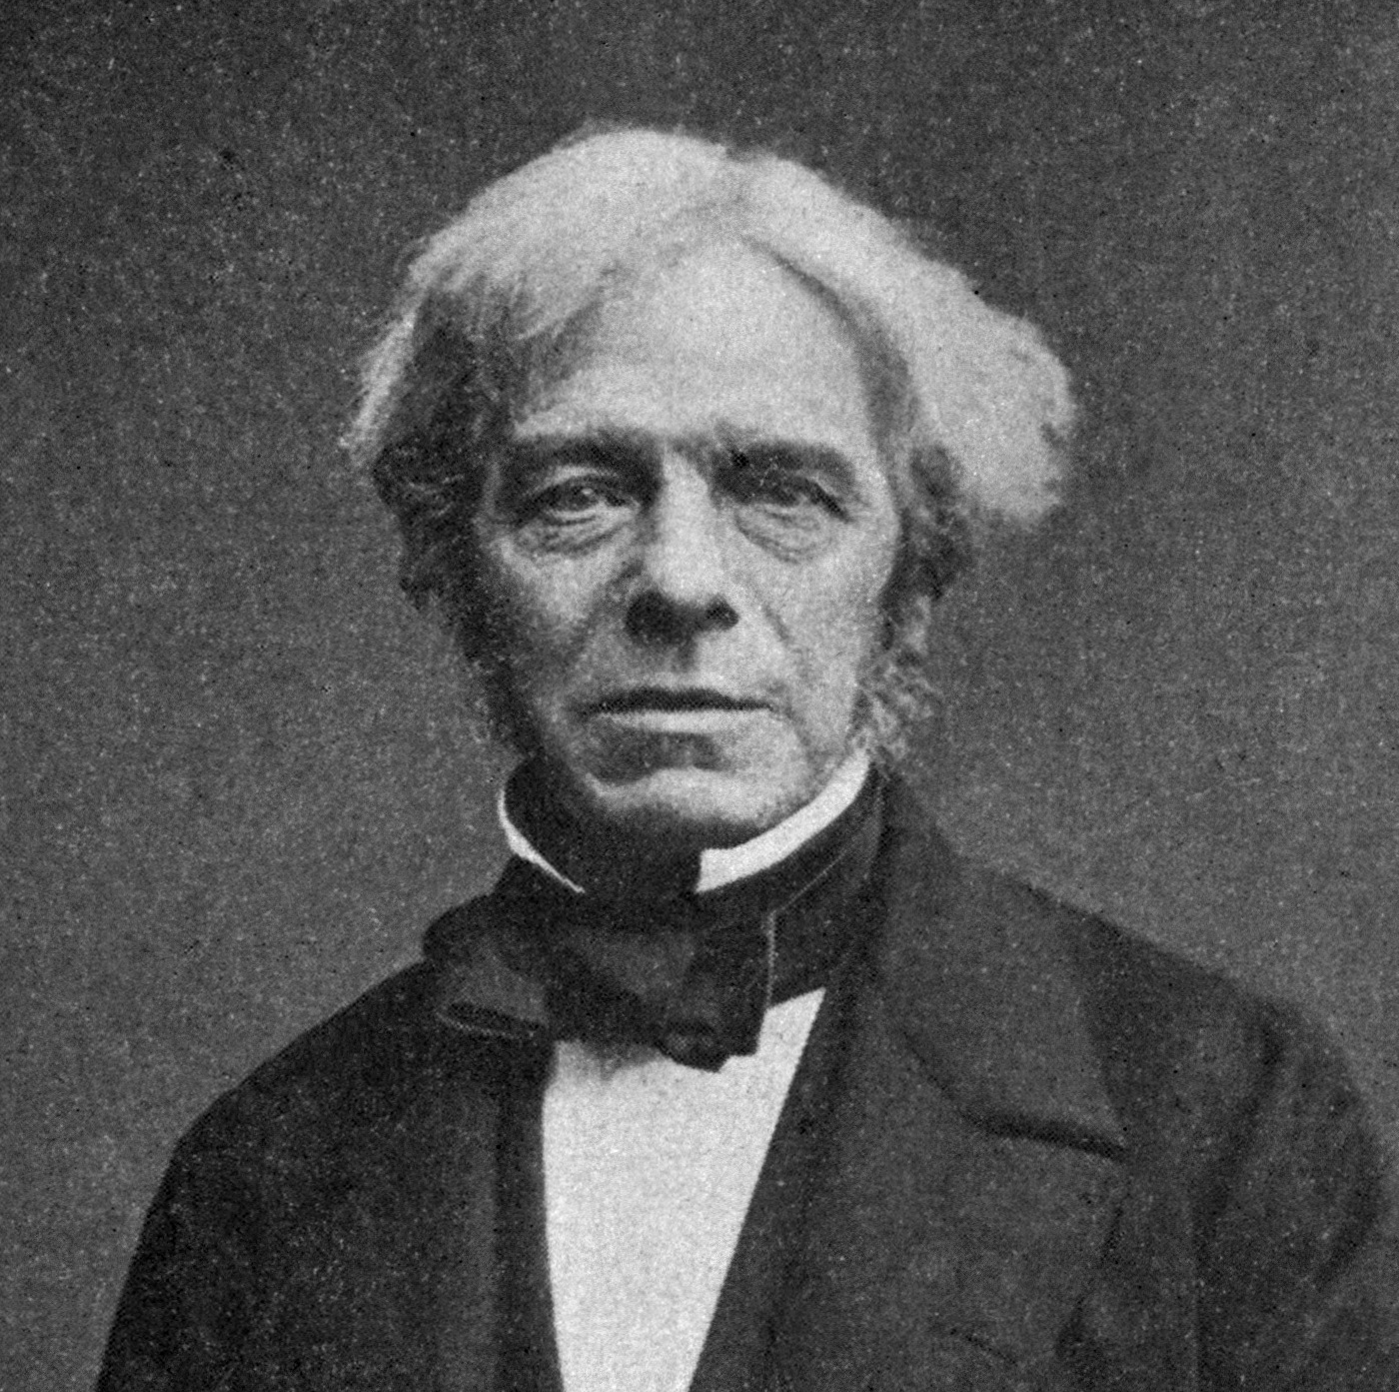
Michael Faraday
Michael Faraday FRS was an English scientist who contributed to the study of electromagnetism and electrochemistry. His main discoveries include the principles underlying electromagnetic induction, diamagnetism and electrolysis.

Slide 43
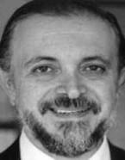
Mario J. Molina
Mario José Molina-Pasquel Henríquez is a Mexican chemist. He played a pivotal role in the discovery of the Antarctic ozone hole, and was a co-recipient of the 1995 Nobel Prize in Chemistry

Slide 44
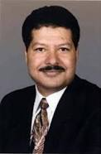
Ahmed Zewail
Ahmed Hassan Zewail was an Egyptian chemist, known as the "father of femtochemistry". He was awarded the 1999 Nobel Prize in Chemistry for his work on femtochemistry and became the first Egyptian to win a Nobel Prize in a scientific field.

Slide 45
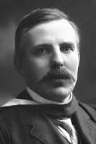
Ernest Rutherford
Ernest Rutherford, 1st Baron Rutherford of Nelson, OM, FRS, HonFRSE was a New Zealand-born British physicist who came to be known as the father of nuclear physics.

Slide 46
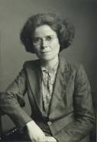
Kathleen Lonsdale
Dame Kathleen Lonsdale, DBE, FRS was an Irish pacifist, prison reformer and crystallographer. She proved, in 1929, that the benzene ring is flat by using X-ray diffraction methods to elucidate the structure of hexamethylbenzene.

Slide 47

Joseph Louis Gay-Lussac
Joseph Louis Gay-Lussac was a French chemist and physicist. He is known mostly for his discovery that water is made of two parts hydrogen and one part oxygen

Slide 48

Henry Cavendish
Henry Cavendish FRS was an English natural philosopher, scientist, and an important experimental and theoretical chemist and physicist. He is noted for his discovery of hydrogen, which he termed "inflammable air"

Slide 49

Harold Urey
Harold Clayton Urey was an American physical chemist whose pioneering work on isotopes earned him the Nobel Prize in Chemistry in 1934 for the discovery of deuterium.

Slide 50

William Henry Perkin
Sir William Henry Perkin, FRS was a British chemist and entrepreneur best known for his serendipitous discovery of the first synthetic organic dye, mauveine, made from aniline.

