Slide 1
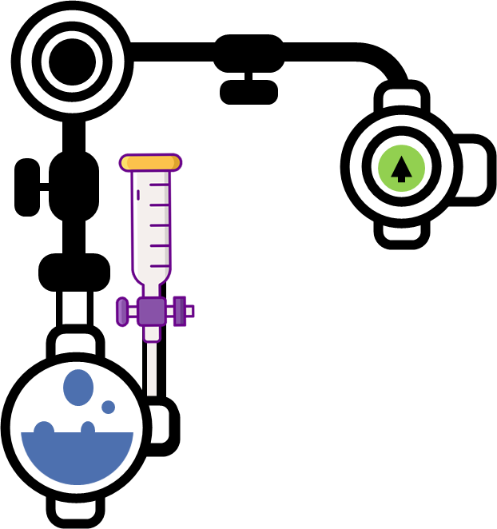
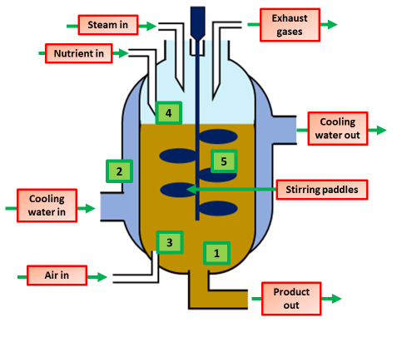
Food Production Notes
Food security is a measure of the availability of food required to support people of a household, region, country or any specified area. It is a measure of how much food there is, if it is of suitable quality and whether people can access it.
The dramatic rise in world population growth is forcing questions to be asked about how existing global food manufacturing practices can ensure that there is enough nutritious food available for everyone in the world.
There is a need to investigate new manufacturing methods to ensure future security of our food supply chains
Organic farming uses natural methods to grow foods. This means using organic fertilisers and pesticides, such as animal slurry and natural predators and no artificial fertilisers or pesticides. Yields from organic crops are initially low, but they increase over time until they are in line with inorganic crops. Farmers using organic methods use other ways to combat pests and diseases.
Intensive farming is an agricultural intensification and mechanization system that aims to maximize yields from available land through various means, such as heavy use of pesticides and chemical fertilizers.
Sustainable fishing: Fish catches have declined markedly and are likely to fall further, a study has found, with warming oceans to blame. Around the world, fish populations have fallen over the past 80 years
Use of a rod (fishing pole): It’s a responsible fishing method because fisherman can quickly release unwanted catch from their hooks soon after it was caught.
The fungus Fusarium is used to produce mycoprotein. This is protein produced from a fungus. The fungus is grown in large containers called fermenters.
Harpooning: Catching larger fish such as swordfish with hand-thrown harpoons (just like in the whaling days) or with barbs fired from a gun
The pH and temperature are maintained at the optimum
Floating traps and weirs, which guide the fish into ever-smaller boxes, harm neither fish nor the environment.
The temperature is controlled by a water jacket that surrounds the whole fermenter
Reef nets, used for salmon in the Northwest, are shallow, near-the-surface nets that the salmon swim right into, then are tipped into holding tanks.
The mixture inside is stirred to make sure all the oxygen and nutrients are equally distributed
Wire-mesh traps that lie on the bottom can damage the ocean floor if they’re dragged, which has led to their being banned in some parts of the world. Used properly, they’re usually not harmful.
Sterile oxygen is added to make sure that aerobic respiration occurs
A food source like glucose syrup is added

Slide 2
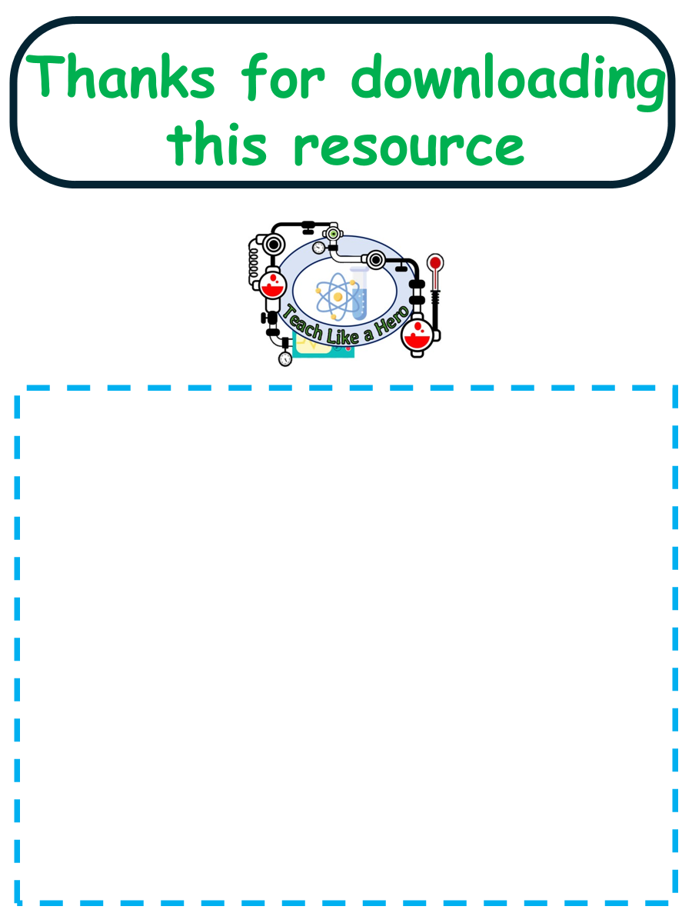
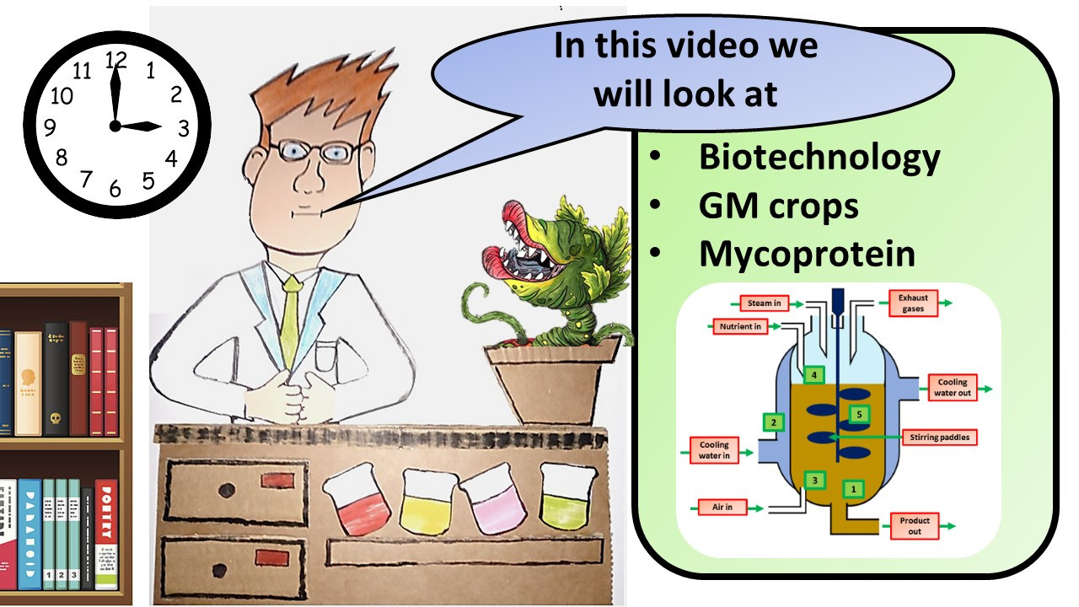
Click here to access my biotechnology video
Resources that this activity would work well with
Lesson on TES
Lesson on TPT
Follow me on social media to stay in touch
Keep up to date with my new content:

