Slide 1
Fossils
Specification Link
Inheritance:
Highlight key words in the information below:
What are fossils?
__________________________________________________________________________________
A fossil is the preserved remains of a dead organism from millions of years ago. Fossils are found in rocks and can be formed from:
Hard body parts, such as bones and shells, which do not decay easily or are replaced by minerals as they decompose.
Parts of organisms that have not decayed because one or more of the conditions needed for decomposition are absent. For example, dead animals and plants can be preserved in amber, peat bogs, tar pits, or in ice.
Preserved traces of organisms, such as footprints, burrows and rootlet traces - these become covered by layers of sediment, which eventually become rock.
What are hard body parts replaced by?
__________________________________________________________________________________
What sorts of conditions stop organisms from decomposing?
__________________________________________________________________________________
What do organisms need to be covered by before becoming fossils?
__________________________________________________________________________________
Draw a diagram summarizing the problems with the fossil record
Evidence about extinct species of animals and plants comes from fossils.
Below is a photograph of a fossil of a bird-like animal called Archaeopteryx. Archaeopteryx lived about 150 million years ago.
Suggest how the fossil of Archaeopteryx was formed.
Answer:
_______________________________________________________________________________________________________________________________________________________________________________________________________________________________________________________________________________________________
Scientists have found other fossils of the ancestors of modern birds, but the fossil record is very incomplete.
Suggest two reasons why there are gaps in the fossil record.
Answer:
____________________________________________________________________________________________________________________________________________________________________________________________________________________________________________________________

Slide 2

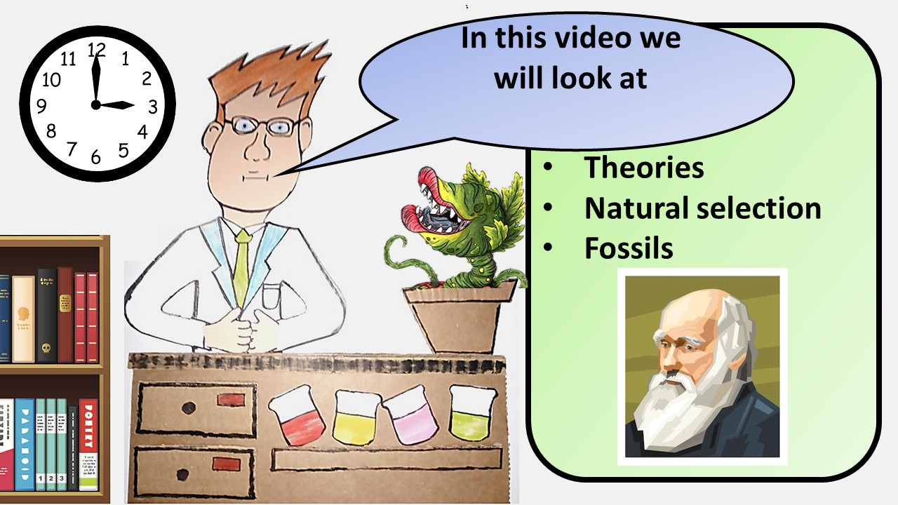


Click here to access my youtube videos
Resources that this activity would work well with
Lesson on TES
Lesson on TPT
Follow me on social media to stay in touch
Keep up to date with my new content:

