Slide 1
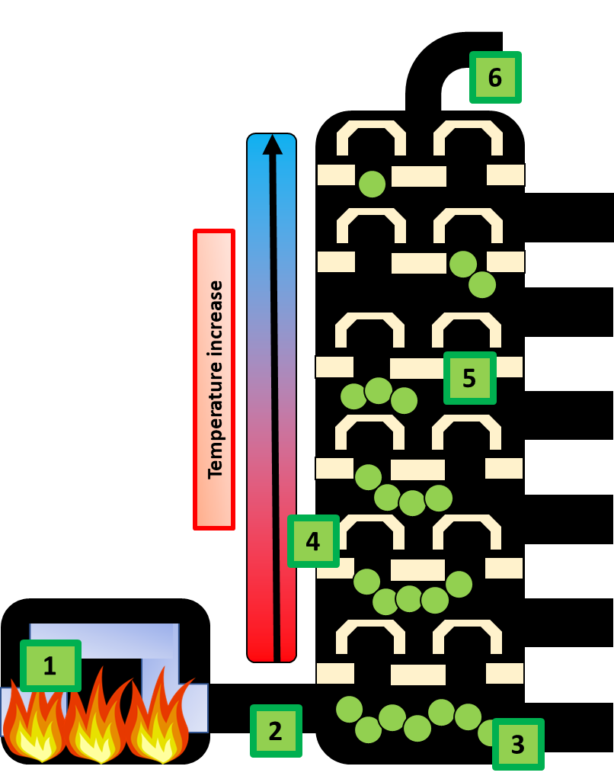
Fractional Distillation Practice Question
We drill for crude oil as it is found deep below the ground. Crude oil needs to be separated out into separate fractions before we can use it. Describe and explain how the fractions are separated in a fractionating column.
crude oil is heated (to above 350 ºC)
crude oil is vaporized
vapours/gases go into (fractionating) column
column is hot at bottom, cool at top or correct temperature
Answer
substances/vapours condense at their boiling points
different substances/vapours condense at different levels in column
low boiling points at the top of column or high boiling points at the bottom
liquids/fractions contain a mixture of substances
fractions have substances with a range of boiling points continuous process

Slide 2
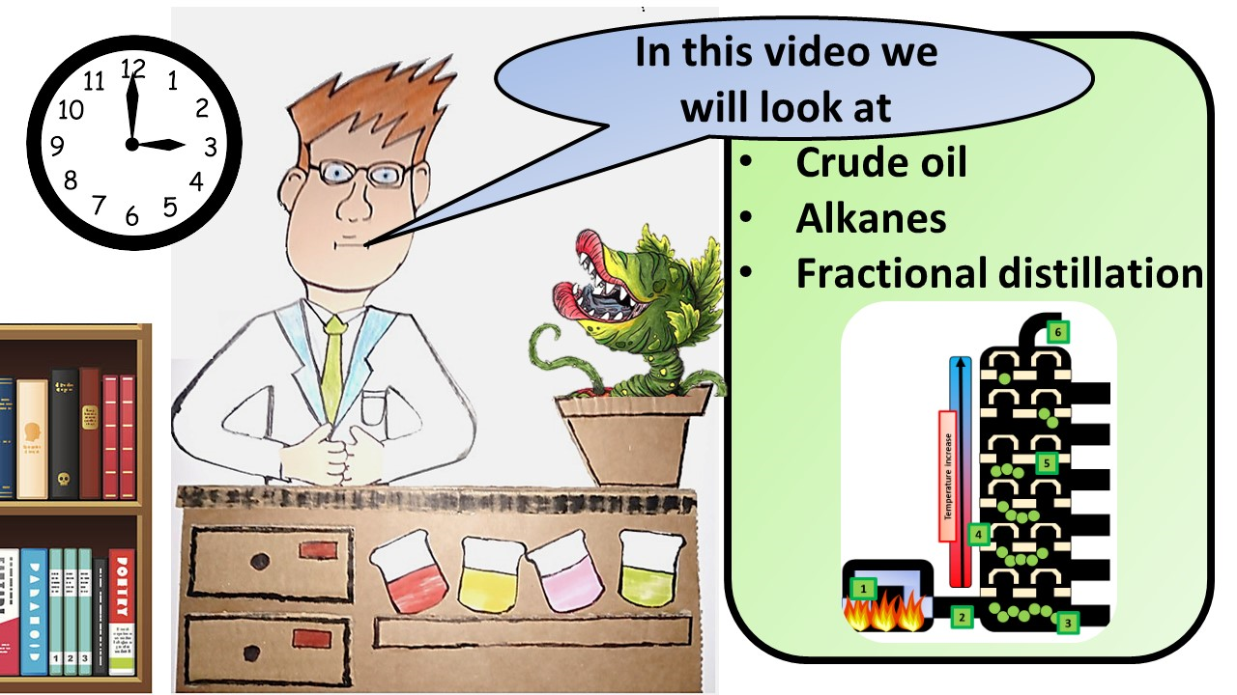
Click here to access my youtube videos
Resources that this activity would work well with
Lesson on TES
Lesson on TPT
Follow me on social media to stay in touch
Keep up to date with my new content:

