Slide 1
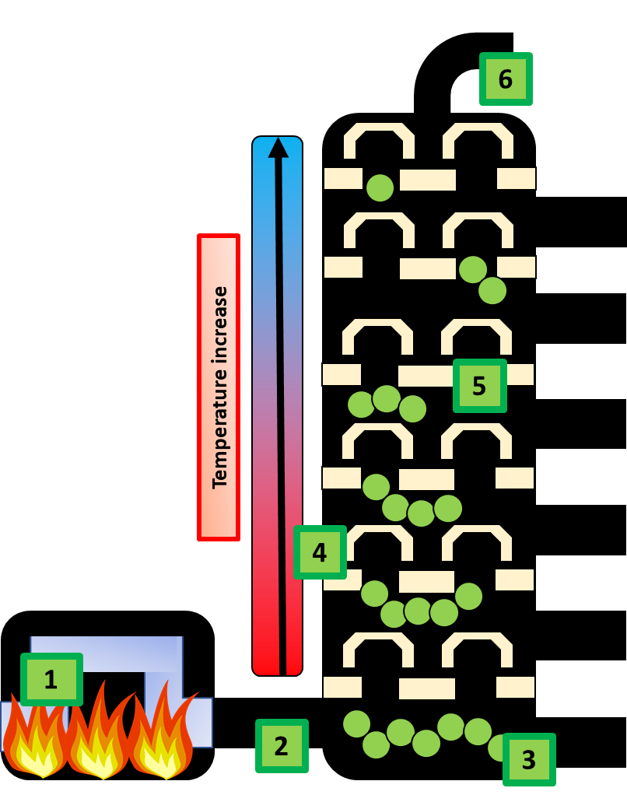
Fractional Distillation Question
Specification Link:
Organic Chemistry
Highlight key words or phrases
Crude oil is a mixture of hydrocarbons . The crude oil is evaporated and its vapours condense at different temperatures in the fractionating column. Each fraction contains hydrocarbon molecules with a similar number of carbon atoms and a similar range of boiling points.
The diagram shows how oil can be split up using fractional distillation. Describe this process in 6 stages:
______________________________________________________________________________________________________________________________________________________________________________________________________________________________________________________________________________________________________________________________
Alkanes are saturated hydrocarbons. This means that their carbon atoms are joined to each other by single bonds. This makes them relatively unreactive, apart from their reaction with oxygen in the air - which we call burning or combustion.
The table below shows the properties of different alkanes
What is the trend in boiling points against the length of alkane?
________________________________________________________________________________________________________________________________________________________
Compound | State at room temperature (20 °C) | Boiling point in °C
ethane, C₂H₆ | gas | – 89
butane, C₄H₁₀ | gas | 0
hexane, C₆H₁₄ | liquid | +69
pentadecane, C₁₅H₃₂ | liquid | +270
heptadecane, C₁₇H₃₆ | solid | +302
What is the trend in state at room temperature against the length of alkane?
__________________________________________________________________________________________________________________
Each fraction is a mixture of compounds. Most of these compounds are hydrocarbons, made up of the elements hydrogen and carbon.
Explain the difference between a mixture and a compound
.__________________________________________________________________________________________________________________________________________________________________________
Explain the difference between a compound and an element.
__________________________________________________________________________________________________________________________________________________________________________
Describe how the equipment to the left could be used to measure the rate of photosynthesis:
_______________________________________________________________________________________________________________________________________________________________________________________________________________________________________________________________

