Slide 1
Brain function
Ear function
Eye function
Lung function
Heart function
Liver function
Stomach function
Intestine function
Kidney function

Slide 2
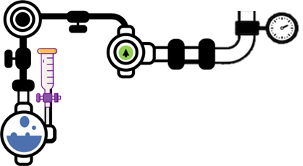
Brain function
Use the information below to summarise the function of the brain
The brain is the control centre of the body. It processes information from our senses, controls our movements, and manages our thoughts, emotions, and memory. It also regulates vital functions such as heartbeat and breathing.

Slide 3
Stomach function
Use the information below to summarise the function of the stomach
The stomach is a muscular organ that breaks down food using acids and enzymes. It turns food into a semi-liquid form called chyme, which can then be further digested and absorbed in the intestines.

Slide 4
Intestine function
Use the information below to summarise the function of the intestines
The intestines are divided into the small and large intestines. The small intestine absorbs nutrients from digested food, while the large intestine absorbs water and forms waste to be excreted from the body.

Slide 5
Eye function
Use the information below to summarise the function of the eye
The eye sends signals along this nerve and the brain can then form images. Because of the optic nerve's position, your eye actually has a blind spot. When light rays hit the retina, the image formed is actually upside down. It is your brain that turns it around.

Slide 6
Ear function
Use the information below to summarise the function of the ear
The pinna is the part of the ear that is visible on the side of the head. It funnels sound into the ear. Ear canal - a 2cm passage way that leads from the pinna to the ear drum. Ear drum - a thin flap of skin that vibrates with sound.

Slide 7
Kidney function
Use the information below to summarise the function of the kidney
The kidneys filter waste products and excess substances from the blood to form urine. They also help regulate blood pressure, maintain fluid and electrolyte balance, and produce hormones that affect other body functions.

Slide 8
Lung function
Use the information below to summarise the function of the lungs
The lungs are responsible for breathing. They take in oxygen from the air we breathe and transfer it to the blood, while also removing carbon dioxide from the blood and expelling it out of the body.

Slide 9
Liver function
Use the information below to summarise the function of the liver
The liver has many important functions, including processing nutrients absorbed from the intestines, detoxifying harmful substances, and producing bile, which helps digest fats.

Slide 10
Heart function
Use the information below to summarise the function of the heart
The heart is a muscular organ that pumps blood throughout the body. It ensures that oxygen-rich blood reaches all parts of the body and that carbon dioxide and other waste products are carried away from the tissues to be removed from the body.

