Slide 1
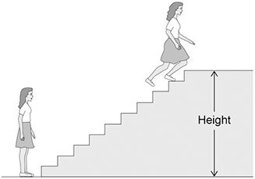
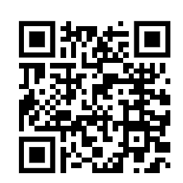
GPE / Power Calculation
The figure below shows a girl doing an experiment to determine her power output by running to the top of some stairs.
The mass of the girl was 60.0 kg.
The height of the stairs was 175 cm.
The girl ran to the top of the stairs in 1.40 s.
gravitational field strength = 9.8 N/kg
GPE = mass x gravity x height
Power = energy / time
Convert the height into meters
Calculate the GPE
Answer
Substitute in to calculate power
Calculate the value for power

Slide 2
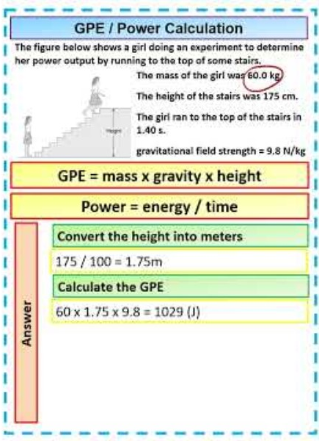
GPE / Power Calculation

