Slide 1
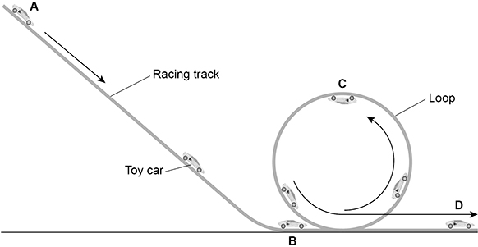

GPE / KE Calculation
The figure below shows a toy car in different positions on a racing track. Calculate the maximum possible speed of the toy car when it reaches position B.
mass of toy car = 0.040 kg
vertical height between position A and position B = 90 cm
gravitational field strength = 9.8 N/kg
GPE = mass x gravity x height
KE = 0.5 x mass x V²
Convert the height into meters
Calculate the GPE
Answer
Substitute in to calculate V²
Calculate the value for V

Slide 2
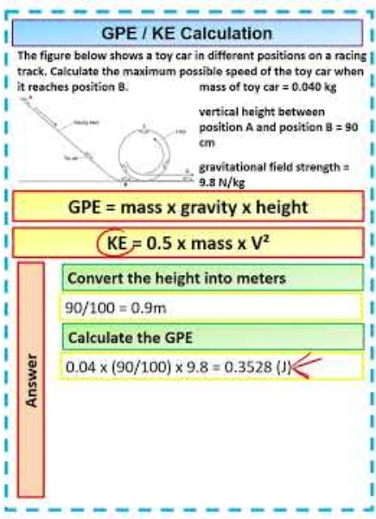
GPE / KE Calculation

