Slide 1
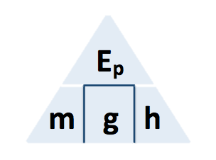

GPE Calculation
In one day, 2 500 000 kg of water passes through the hydroelectric generator.
The change in gravitational potential energy of the water is 367.5 MJ.
gravitational field strength = 9.8 N/kg
Calculate the mean change in vertical height of the water as it moves through the hydroelectric generator.
GPE = mass x gravity x height
Answer
Convert MJ to J
Rearrange equation to give the height
Substitute in values
Calculate the value for height

Slide 2
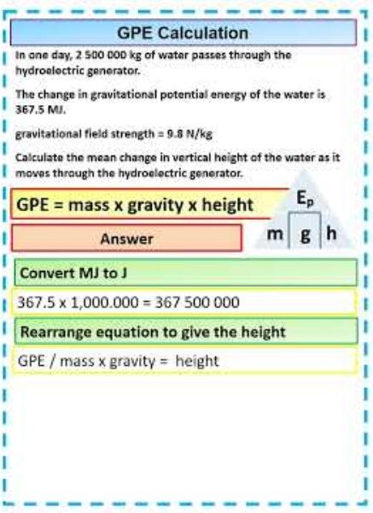
GPE Calculation

