Slide 1
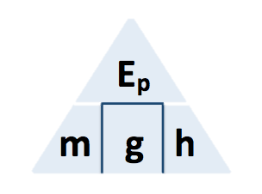
GPE Calculation
In one day, 2 500 000 kg of water passes through the hydroelectric generator.
The change in gravitational potential energy of the water is 367.5 MJ.
gravitational field strength = 9.8 N/kg
Calculate the mean change in vertical height of the water as it moves through the hydroelectric generator.
GPE = mass x gravity x height
Answer
Convert MJ to J
367.5 x 1,000.000 = 367 500 000
Rearrange equation to give the height
GPE / mass x gravity = height
Substitute in values
367,500,000 / 2,500,000 x 9.8 = height
Calculate the value for height
Height = 15m

