Slide 1
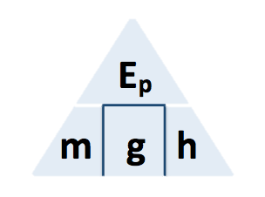
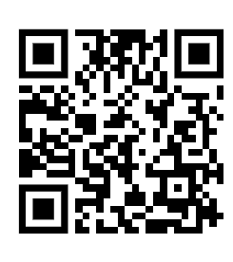
GPE Calculation
The decrease in gravitational potential energy of one rider on the slide was 8.33 kJ.
The rider moved through a vertical height of 17.0m.
gravitational field strength = 9.8 N/kg
Calculate the mass of the rider.
GPE = mass x gravity x height
Answer
Convert KJ to J
Rearrange equation to give the mass
Substitute in values
Calculate the value for mass

Slide 2
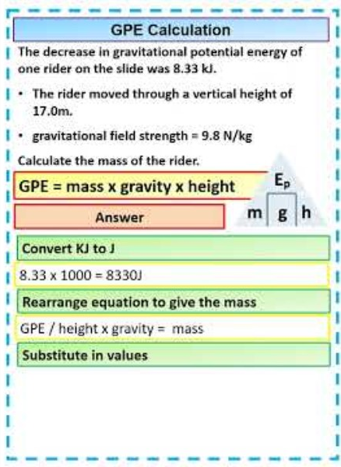
GPE Calculation

