Slide 1
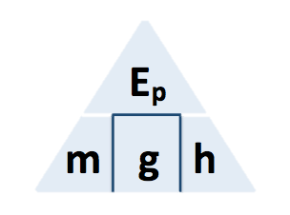
GPE Calculation
The decrease in gravitational potential energy of one rider on the slide was 8.33 kJ.
The rider moved through a vertical height of 17.0m.
gravitational field strength = 9.8 N/kg
Calculate the mass of the rider.
GPE = mass x gravity x height
Answer
Convert KJ to J
8.33 x 1000 = 8330J
Rearrange equation to give the mass
GPE / height x gravity = mass
Substitute in values
38330 / 17 x 9.8 = mass
Calculate the value for height
mass = 50 Kg

