Slide 1
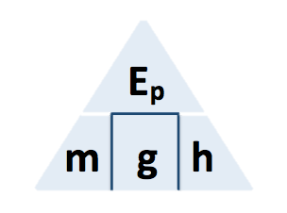
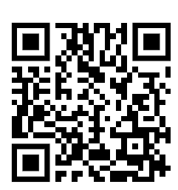
GPE Calculation
A person slides down a zip wire
As the person slides down the zip wire, the change in the gravitational potential energy of the person is 1.47 kJ
The mass of the person is 60 kg
gravitational field strength = 9.8 N/kg
Calculate the change in vertical height of the person.
GPE = mass x gravity x height
Answer
Convert KJ to J
Rearrange equation to give the height
Substitute in values
Calculate the value for height

Slide 2
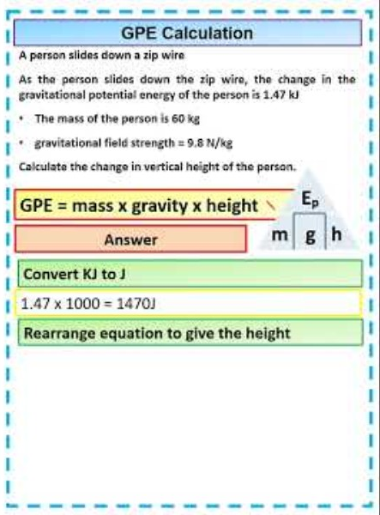
GPE Calculation

