Slide 1
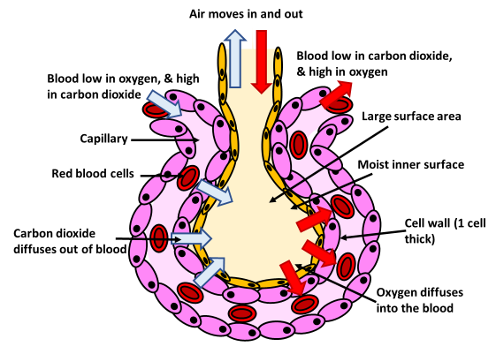
Gas Exchange Surfaces
Specification Link:
Gas Exchange Surfaces
The diagram below shows the structure of the alveoli
Highlight key words in the information below
At the end of each of the many tiny branches of our bronchial tree, we find openings to microscopic sacs. Each little sac is an alveolus, singular for alveoli. There may be several alveoli coming from one duct, forming a little clump. These groups of alveoli somewhat resemble a cluster of grapes that are all attached. It is in the alveoli that one of the most important transfers in our entire body takes place. It is here that the respiratory system comes into direct contact with the circulatory system, or blood vessels.
Describe how each of the following increases gas exchange:
Good ventilation?
_________________________________________________________________________________________________________________________________________________________________________________________
Good circulation?
____________________________________________________________________________________________________________________________________________________
A large surface area?
_________________________________________________________________________________________________________________________________________________________________________________________
Moist surface?
____________________________________________________________________________________________________________________________________________________
Short diffusion distance?
_________________________________________________________________________________________________________________________________________________________________________________________
The alveoli of the human lungs cluster together in alveolar sacs. These clusters are commonly said to resemble clusters of grapes, as the nearly spherical alveoli appear to bud away from "stems" (alveolar ducts). Describe in detail how blood becomes oxygenated in the lungs:
__________________________________________________________________________________________________________________________________________________________________________________________________________________________________________________________________________________________________________________________________________________________________________________________________________________________________________________________________________________________________________________________________________________________________________________________________________________________
_____________________________________________________________________________________________________________________________________________________________________________________________________________________________________________________________________________________________________________
______________________________________________________________________________________

Slide 2

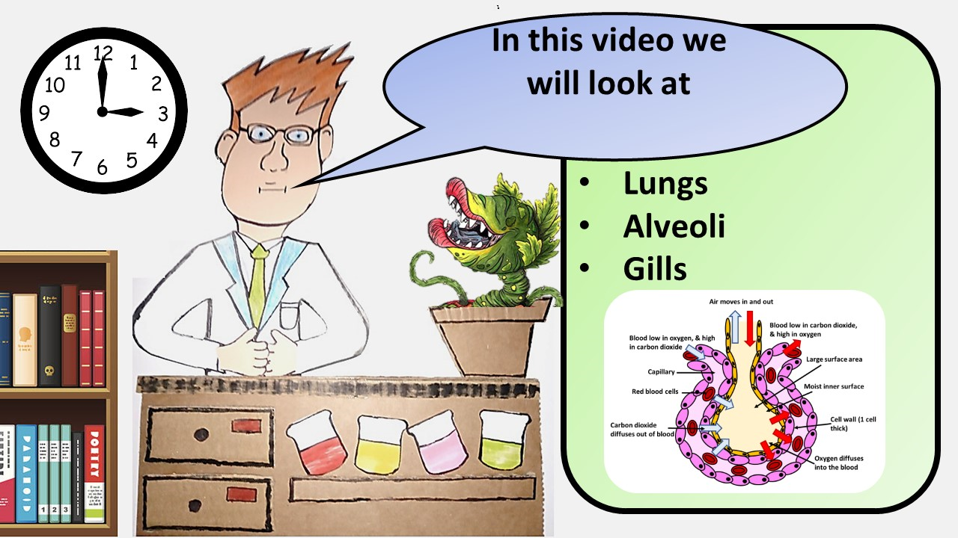


Click here to access my percentage composition youtube videos
Resources that this activity would work well with
Lesson on TES
Lesson on TPT
Follow me on social media to stay in touch
Keep up to date with my new content:

