Slide 1
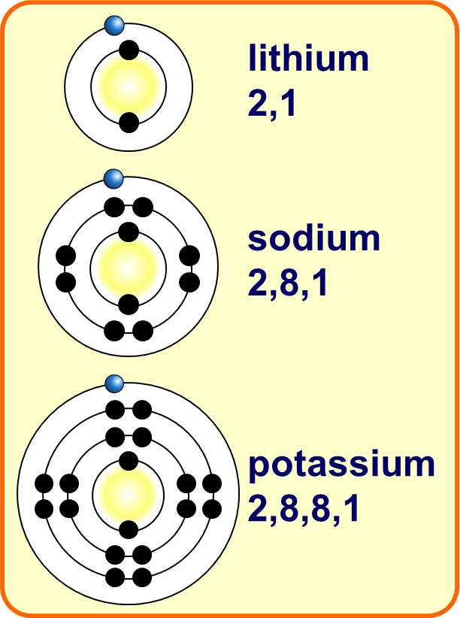
Group 1 Elements Practice Question
Explain why the reactivity of elements changes going down Group 1.
Key things to include:
How many electrons need to be lost
What effect does distance from the nucleus have
________________________________________________________________________________________________________________________________________________________________________________________________________________________________________________________________________________________________________________________________________________________________________________________
Answer
Link to video

Slide 2
Group 1 Elements Practice Question

Slide 3
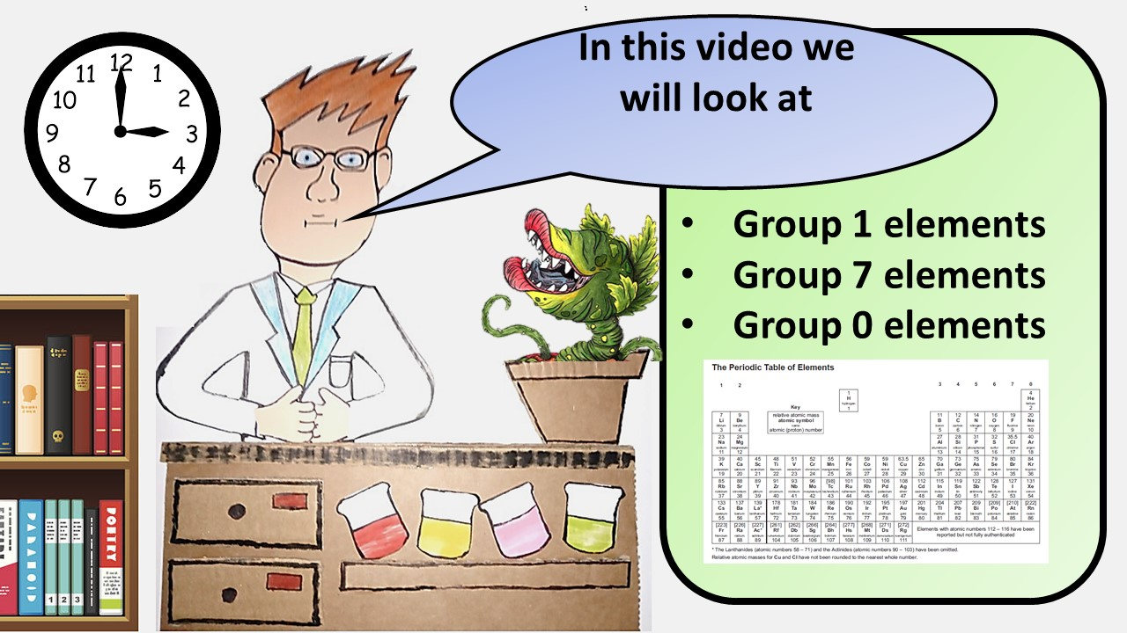
Click here to access my youtube videos
Resources that this activity would work well with
Lesson on TES
Follow me on social media to stay in touch
Keep up to date with my new content:

