Slide 1
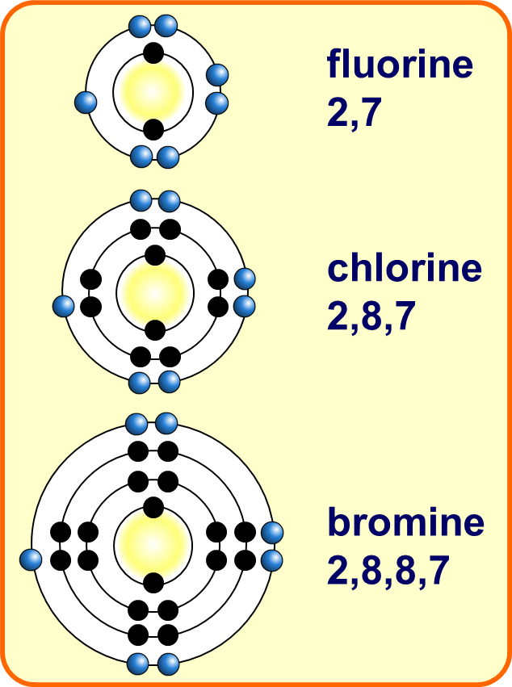
Group 7 Practice Question
Explain why chlorine is more reactive than iodine.
Key things to include:
How many electrons do group 7 elements need to gain
What effect does distance from the nucleus have
Answer
_________________________________________________________________________________________________________________________________________________________________________________________________________________________________________________________________________________________________________________________________________
Link to video

Slide 2
Group 7 Practice Question

Slide 3
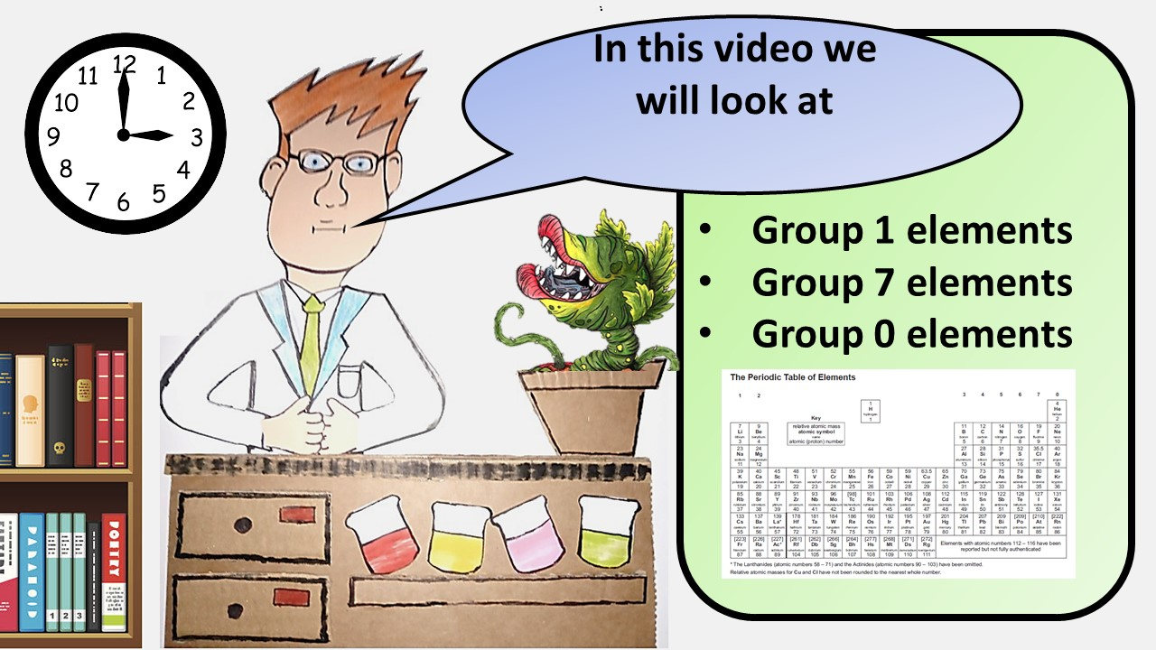
Click here to access my youtube videos
Resources that this activity would work well with
Lesson on TES
Follow me on social media to stay in touch
Keep up to date with my new content:

