Slide 1
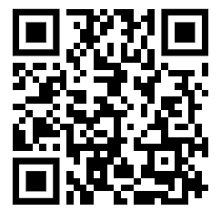
Haber Process Practice Question
Ammonia is manufactured from nitrogen and hydrogen by the Haber process:
The forward reaction is exothermic.
The conditions used in the Haber process are:
• 200 atmospheres pressure
• 450 °C
• iron catalyst.
Use the equation and your knowledge of reversible reactions to explain why these conditions are used in the Haber process. To get full marks you must consider both yield and rate of reaction in your answer.
.
Key things to include:
The effect of temperature
The effect of pressure
The effect of a catalyst
Answer
_____________________________________________________________________________________________________________________________________________________________________________________________________________________________________________________________________________________________________________________________________
Link to video

Slide 2
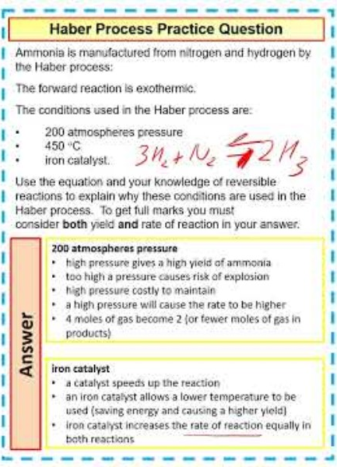
Haber Process Practice Question

Slide 3

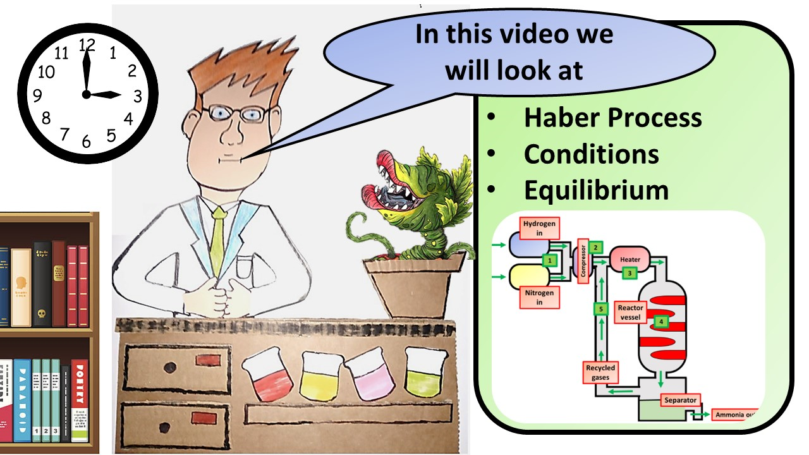


Click here to access my youtube videos
Resources that this activity would work well with
Lesson on TES
Lesson on TPT
Follow me on social media to stay in touch
Keep up to date with my new content:

