Slide 1
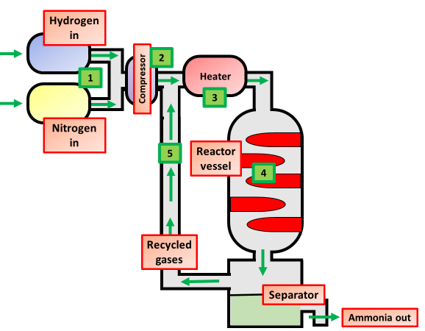
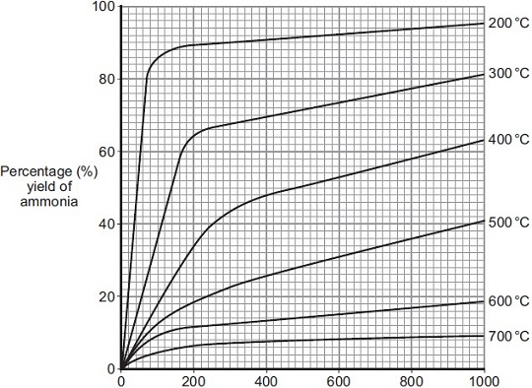
Haber Process Question
Specification Link:
Using Resources: 4.10.4.1
Annotate the diagram of the Haber process below:
Explain why iron is used in the reactor for the Haber process:
____________________________________________________________________________________________________________
Describe how the ammonia is separated from the other gases.:
____________________________________________________________________________________________________________
What happens to the mixture of unreacted gases (nitrogen and hydrogen)?
______________________________________________________________________________________________________
Complete and balance the chemical equation for the production of ammonia from nitrogen and hydrogen.
N₂ + 3 H₂ __________
Explain what compromise conditions are and what conditions are used in the Haber process:
____________________________________________________________________________________________________________________________________________________________________________________________________________
The figure below shows how the equilibrium yield of ammonia changes with pressure at different temperatures.
Use the equation and your knowledge of reversible reactions to explain why these conditions are used in the Haber process.
.________________________________________________________________________________________________________________________________________________________________________________________________________________________________________________________________________________
Describe how the equipment to the left could be used to measure the rate of photosynthesis:
_______________________________________________________________________________________________________________________________________________________________________________________________________________________________________________________________

