Slide 1


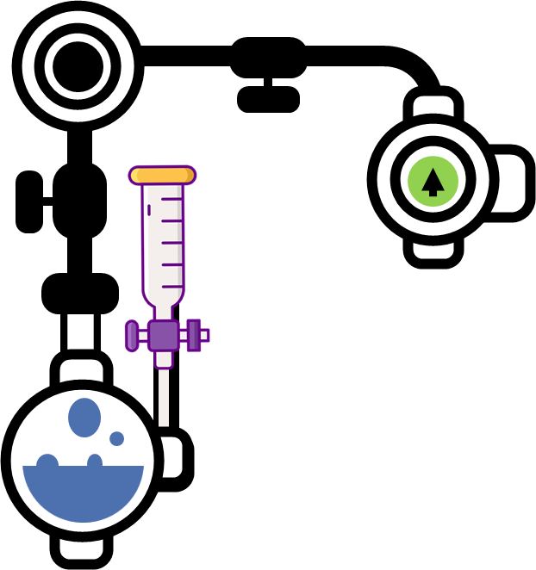

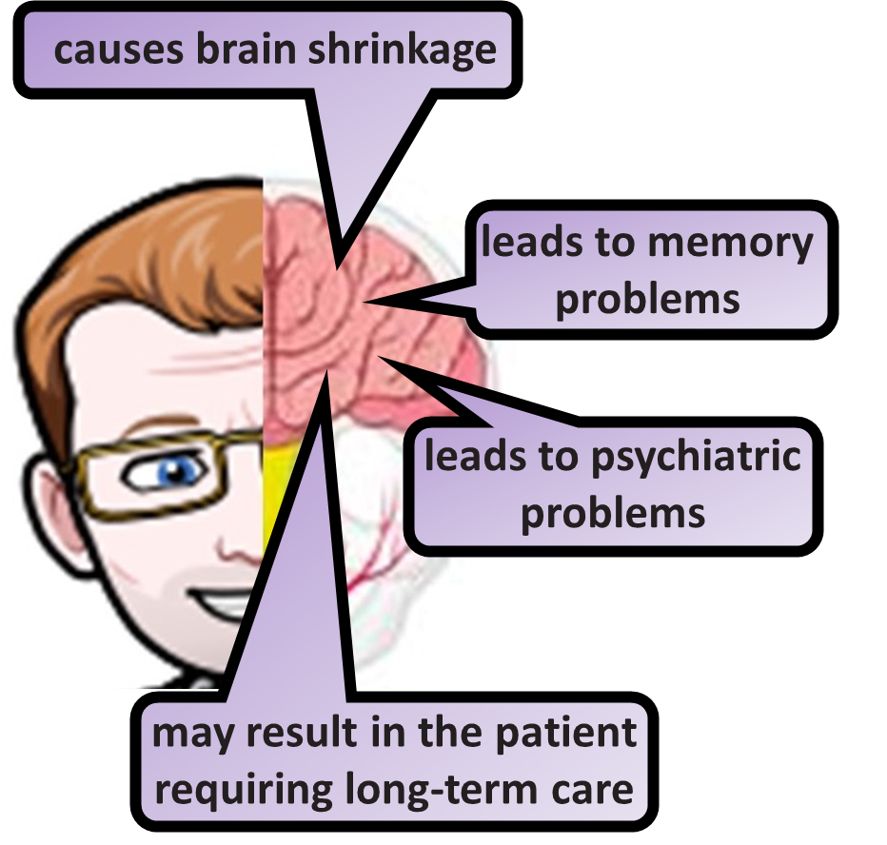
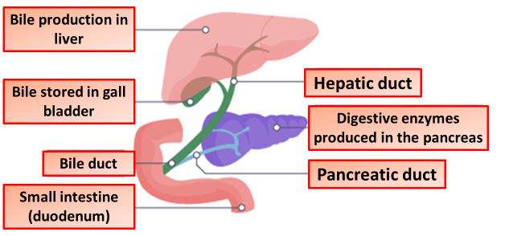

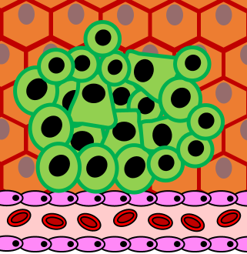
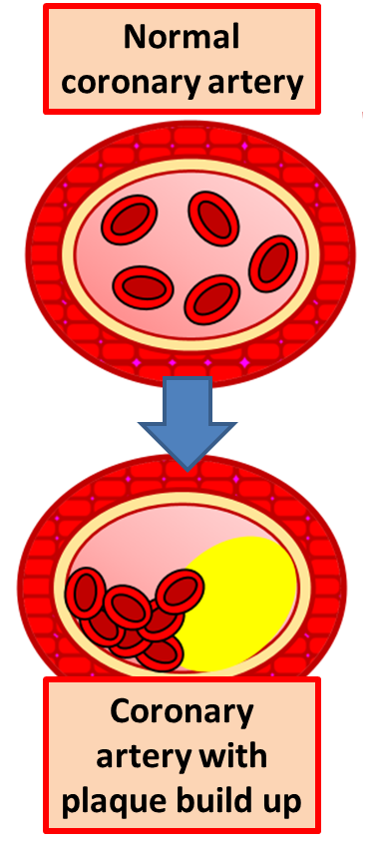

Non-communicable diseases
Health is the state of physical and mental well-being. Factors work together and affect physical and mental health. A disease is a disorder that affects an organism's body, organs, tissues or cells.
communicable, which can be transferred from one person to another, or from one organism to another, eg in humans, these include measles, food poisoning and malaria
non-communicable, which are not transferred between people or other organisms
Over time, excessive alcohol use can lead to the development of chronic diseases and other serious problems including: High blood pressure, heart disease, stroke, liver disease, and digestive problems. Cancer of the breast, mouth, throat, esophagus, liver, and colon.
Alcohol has a profound effect on the complex structures of the brain. It blocks chemical signals between brain cells (called neurons), leading to the common immediate symptoms of intoxication, including impulsive behavior, slurred speech, poor memory, and slowed reflexes.
Type 2 diabetes is a common condition that causes the level of sugar (glucose) in the blood to become too high. It can cause symptoms like excessive thirst, needing to pee a lot and tiredness. It can also increase your risk of getting serious problems with your eyes, heart and nerves.
A tumor is any abnormal proliferation of cells, which may be either benign or malignant. A benign tumor, such as a common skin wart, remains confined to its original location, neither invading surrounding normal tissue nor spreading to distant body sites.
A benign tumor is a mass of cells (tumor) that lacks the ability to invade neighboring tissue or metastasize. These do not spread into, or invade, nearby tissues; however, they can sometimes be quite large.
Malignant tumors are cancerous tumors that can potentially result in death. Unlike benign tumors, malignant ones grow quickly, and can spread to new territory in a process known as metastasis.
Coronary heart disease (CHD) is a disease in which a waxy substance called plaque builds up inside the coronary arteries. These arteries supply oxygen-rich blood to your heart muscle. When plaque builds up in the arteries, the condition is called atherosclerosis.
Both nicotine and carbon monoxide (from the smoke) put a strain on the heart by making it work faster. They also increase your risk of blood clots. Other chemicals in cigarette smoke can damage the lining of your coronary arteries, leading to furring of the arteries. Smoking damages the lining of the arteries, including the coronary arteries. The damage encourages the build-up of fatty material in the arteries. This can lead to a heart attack or a stroke.

Slide 2

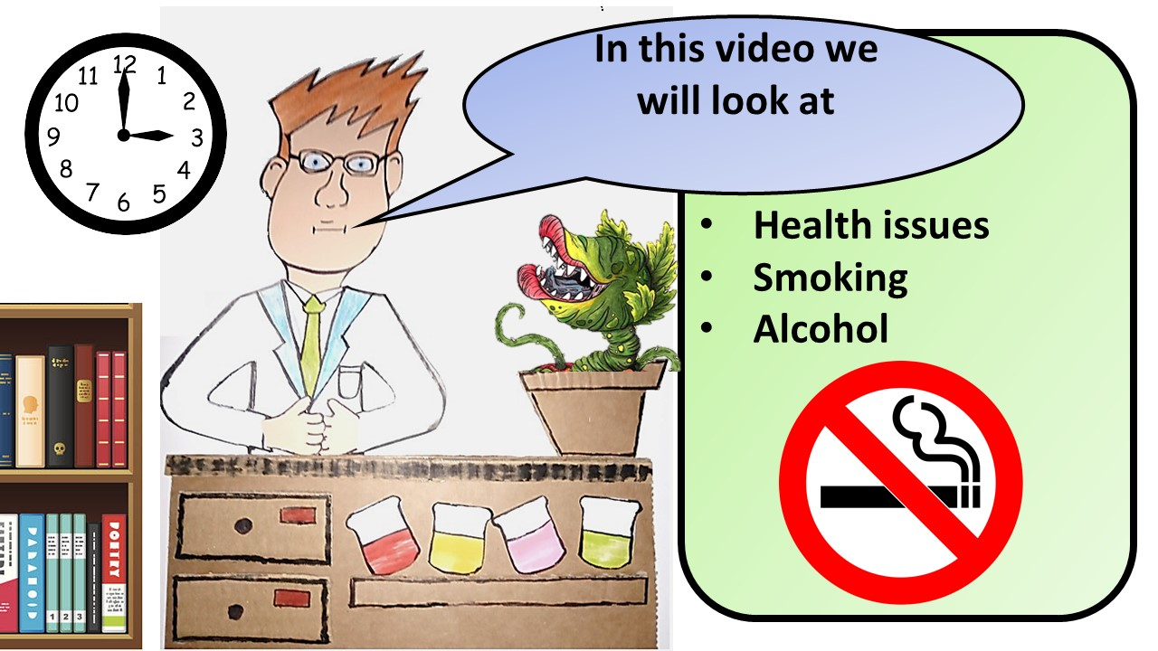


Click here to access my health youtube videos
Resources that this activity would work well with
Lesson on TES
Follow me on social media to stay in touch
Keep up to date with my new content:

