Slide 1


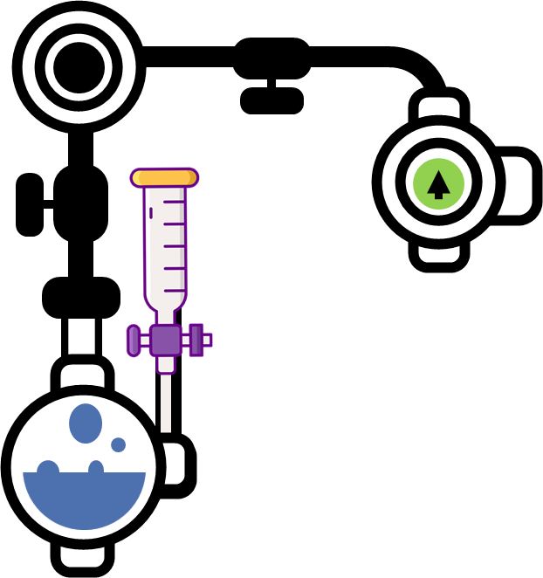
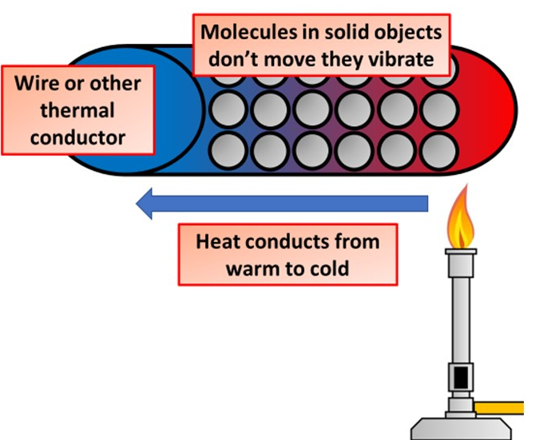


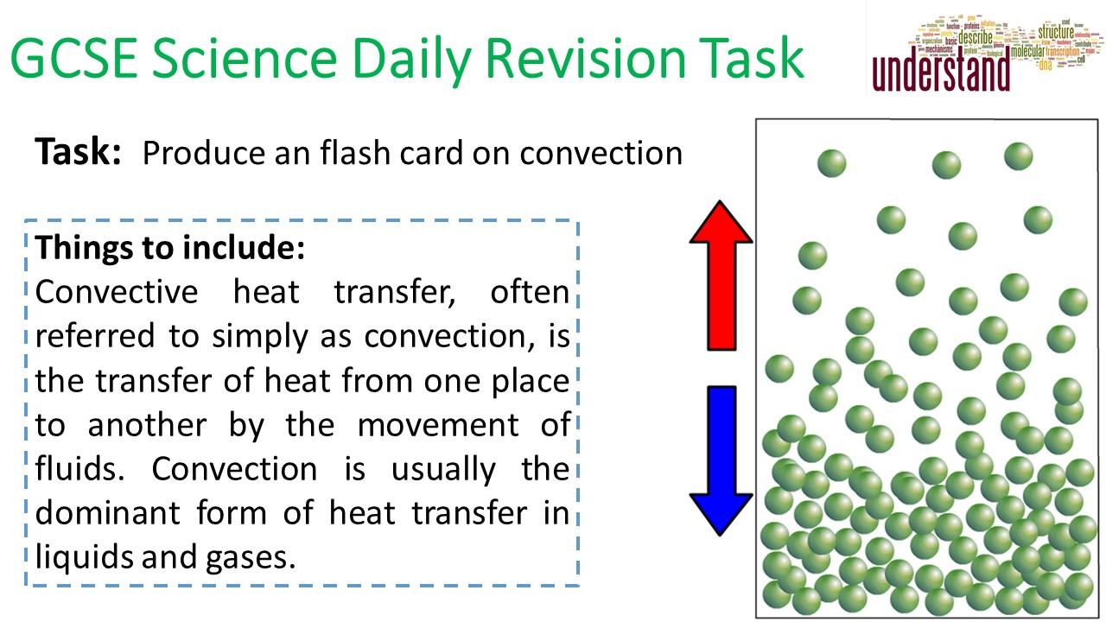

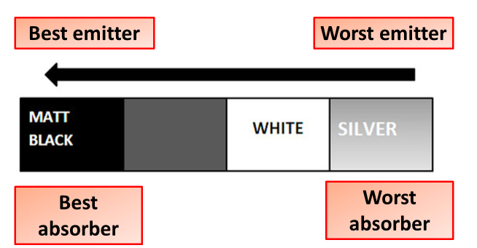
Heat Transfer Notes
The Thermal Energy Store is the Energy Store associated with the temperature of an object. The hotter an object the more energy in the thermal energy store. The more mass an object has the more energy in its thermal energy store. Different materials can store different amounts of energy at the same temperature.
Thermal energy can only move from a higher temperature material to a lower temperature material - there must be a negative temperature gradient for a net flow of thermal energy.
Conduction
Conduction occurs when two object at different temperatures are in contact with each other. Heat flows from the warmer to the cooler object until they are both at the same temperature. Conduction is the movement of heat through a substance by the collision of molecules.
When a substance is heated, its particles gain internal energy and move more vigorously. The particles bump into nearby particles and make them vibrate more.
Convection
Convection is the transfer of heat by the movement of a fluid (liquid or gas) between areas of different temperature. Warm air is less dense than cold air, and so convection currents can form in the presence of a temperature gradient.
A substance that does not transfer energy easily from the hot part to the cold part is called an insulator. Air and plastics are insulators.
A substance that transfers energy easily from the hot part to the cold part is called a conductor. Metals are good conductors.
This passes internal energy through the substance by conduction, from the hot end to the cold end.
Liquids and gases are fluids. The particles in these fluids can move from place to place. Convection occurs when particles with a lot of heat energy in a liquid or gas move and take the place of particles with less heat energy. Heat energy is transferred from hot places to cooler places by convection.
Liquids and gases expand when they are heated. This is because the particles in liquids and gases move faster when they are heated than they do when they are cold. As a result, the particles take up more volume. This is because the gap between particles widens
The liquid or gas in hot areas is less dense than the liquid or gas in cold areas, so it rises into the cold areas. The denser cold liquid or gas falls into the warm areas. In this way, convection currents that transfer heat from place to place are set up.
Radiation
Heat can be transferred by infrared radiation. When infrared radiation is absorbed by an object it is heated and its temperature rises. Light from the sun reaching earth. Because no particles are involved, radiation can work through the vacuum of space.

