Slide 1
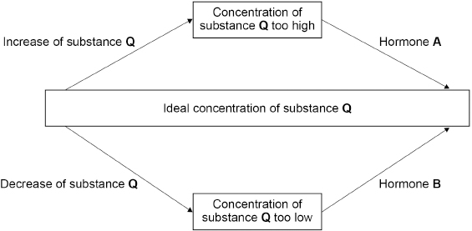
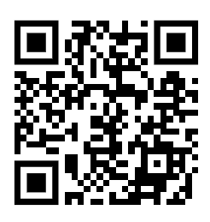
Homeostasis Question
The figure below shows how the concentration of substance Q in the blood is controlled by negative feedback.
Explain how the concentration of substance Q in the blood is controlled by negative feedback. Use information from the figure above.
Key things to include:
How is substance Q increase
How is substance Q decreased
Answer
_________________________________________________________________________________________________________________________________________________________________________________________________________________________________________________________________________________________________________________________________________
Link to video

Slide 2
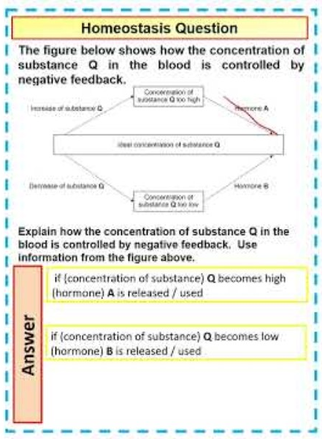
Homeostasis Question

Slide 3

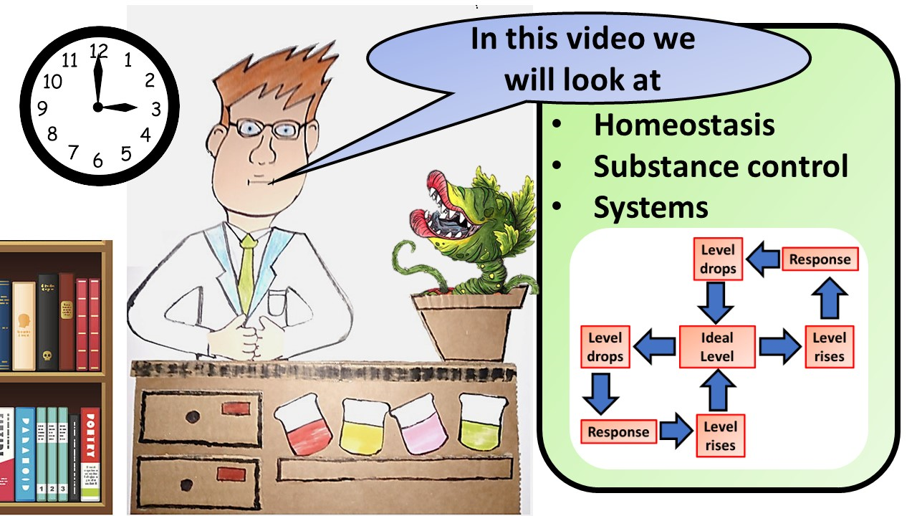


Click here to access my youtube videos
Resources that this activity would work well with
Lesson on TES
Lesson on TPT
Follow me on social media to stay in touch
Keep up to date with my new content:

