Slide 1
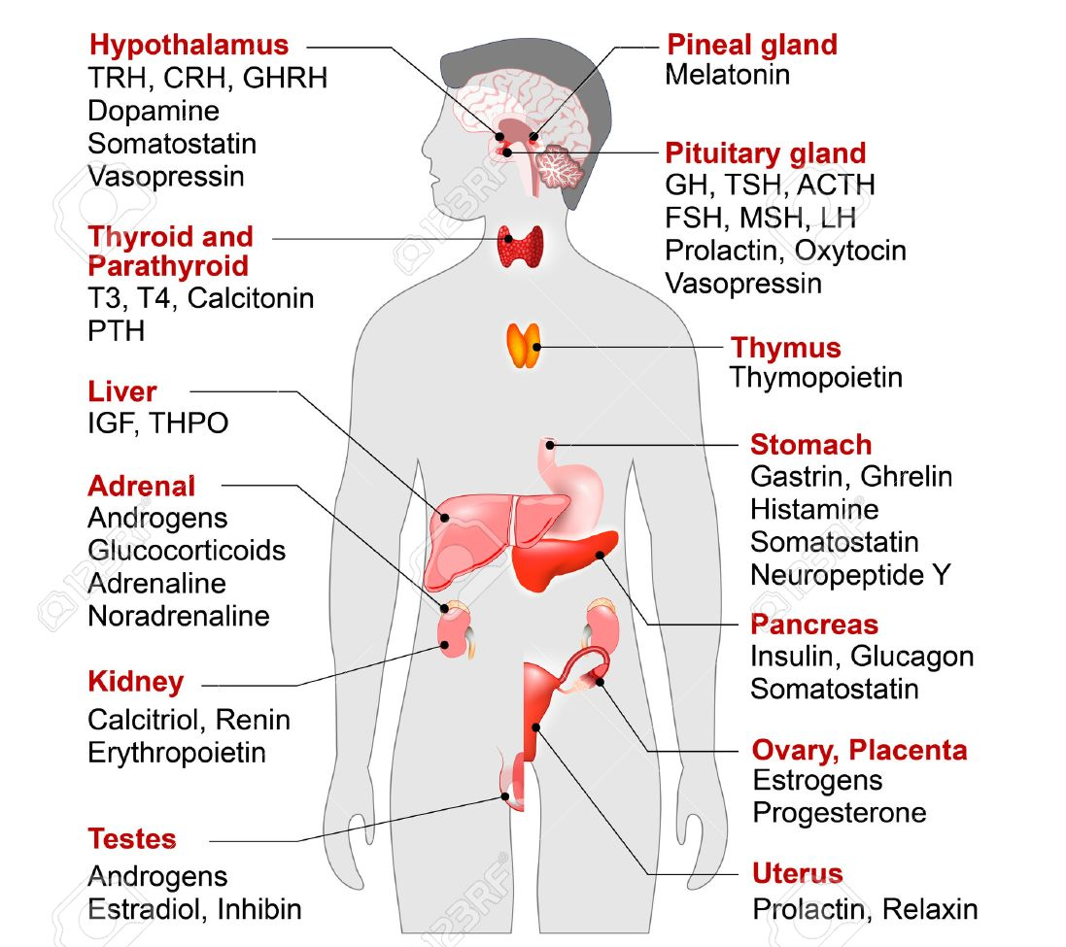
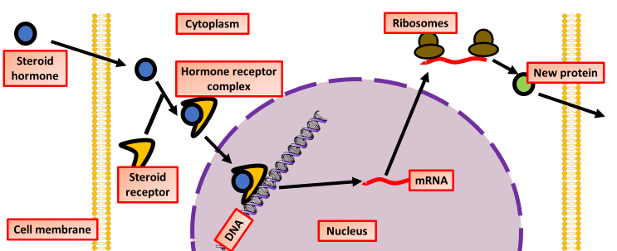
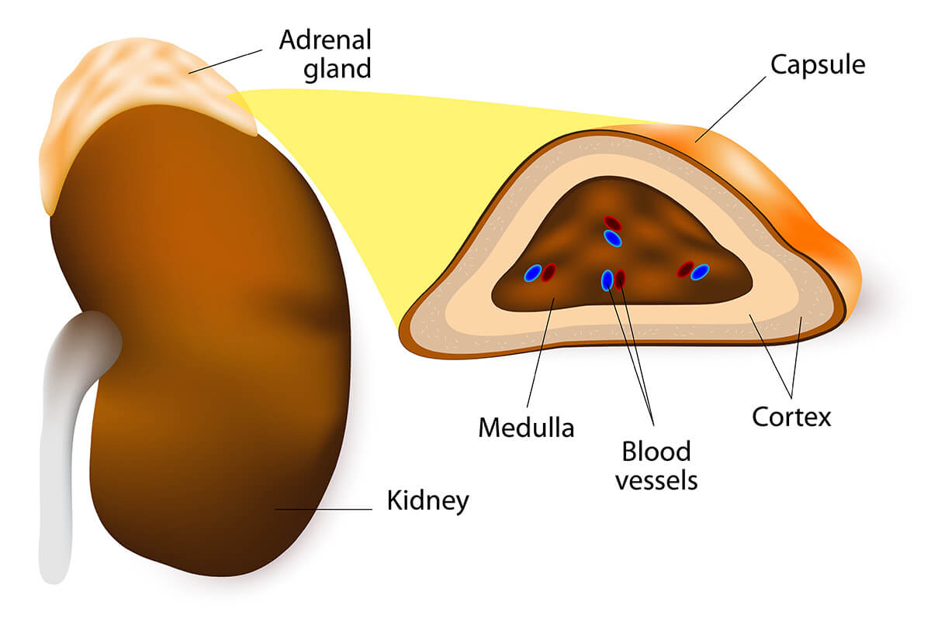
Explain what the endocrine system is
Explain the effects hormones have on cells
Key information to include:
How do hormones enter the cell
How do they increase the transcription of genes
What effect this has on the output of the cell
Key information to include:
What the endocrine system is
What glands are
What hormones are
How glands interact
Negative feedback
Positive feedback
Describe the structure and function of adrenal glands
Explain the effect adrenaline has on body cells
Key information to include:
What the function of the adrenal gland is
Where it is located
The function of the medulla
The function of the cortex
What hormones are produced where
Key information to include:
How adrenaline enters the cell
The effect it has on ATP
The function of cAMP
How glycogen is broken down into glucose

Slide 2
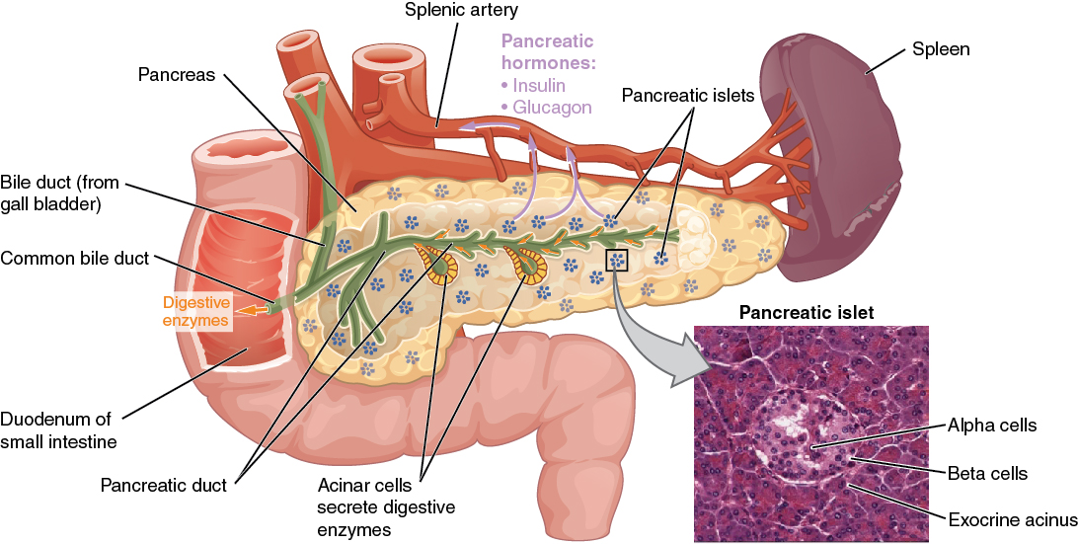
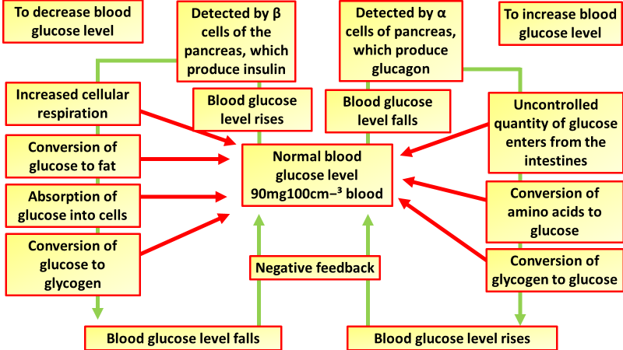
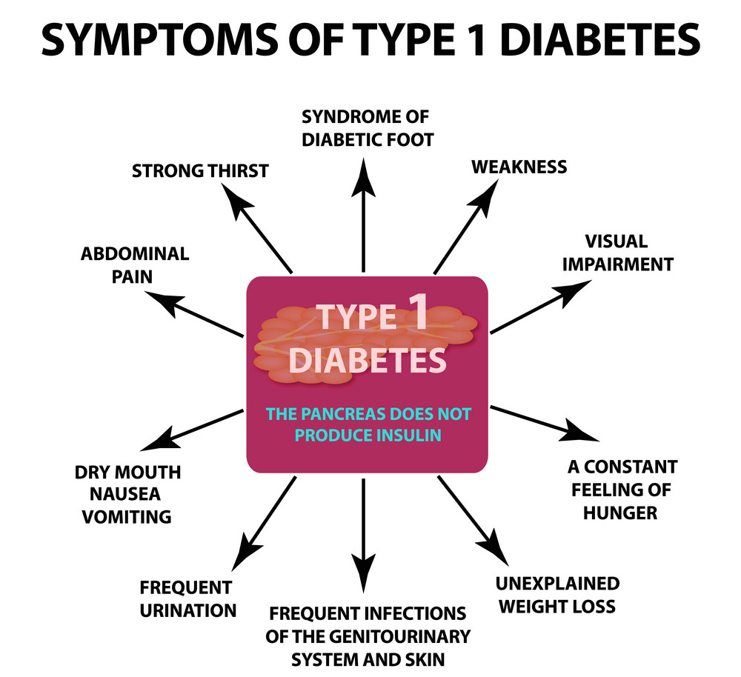
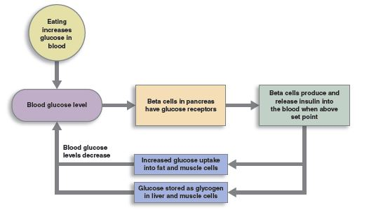
Describe the structure and function of the pancreas
Explain how blood glucose is regulated
Key information to include:
What is the functions of alpha cells
What the function of the beta cells is
What the islets of langahand are
What blood vessels are involved
Key information to include:
What detects blood glucose
What is produced when blood glucose is too high
What is produced when blood glucose is too low
What causes blood glucose to rise or fall
Describe the effect of insulin on cells
Explain how diabetes can be controlled
Key information to include:
Where insulin is produced
The cells it affects
What happens in muscles
The effect on glucose concentration
Key information to include:
Insulin injections
What you eat
Insulin pumps
Exercise
Insulin pills
Stem cell replacement

Slide 3
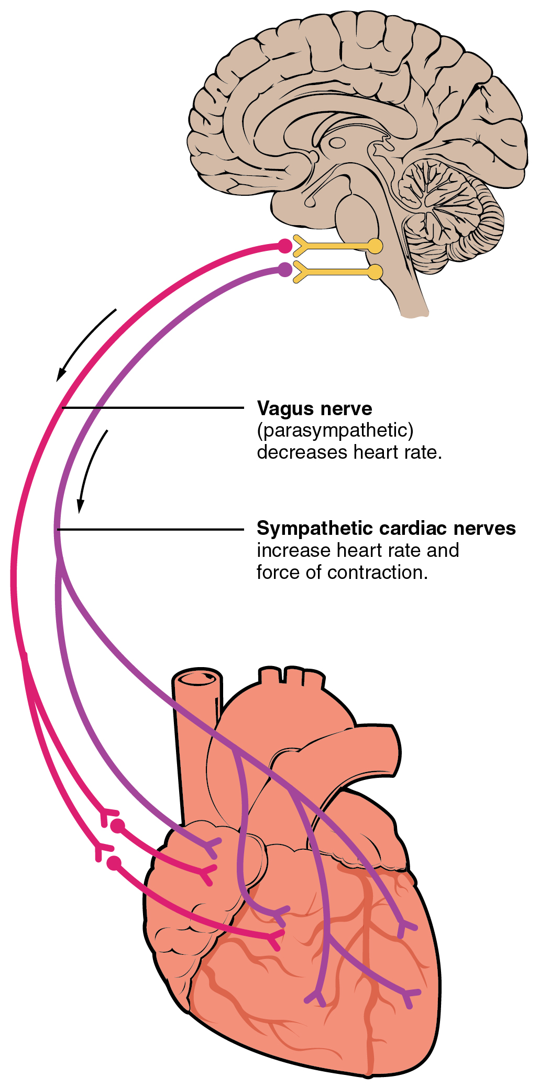
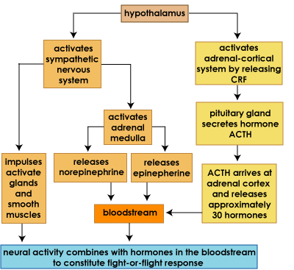
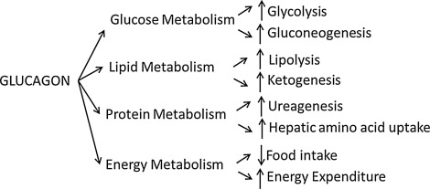
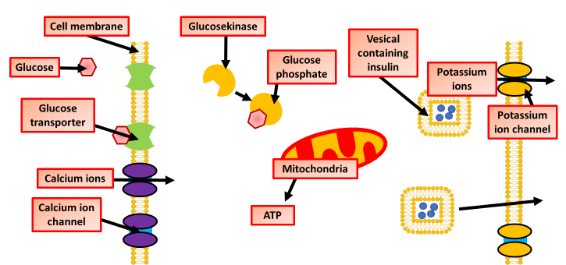
Explain the fight or flight response
Explain how the heart rate is coordinated
Key information to include:
The role of the hypothalamus
The role of the sympathetic nervous system
The role of adrenaline
Key information to include:
The role of baroreceptors
The role of chemoreceptors
The role of the vagus nerve
The role of the sympathetic nervous system
The role of hormones
Describe the effect glucagon has on cells
Describe how and when insulin is produced
Key information to include:
How it affects glucose metabolism
How it affects lipid metabolism
How it affects protein metabolism
How it affects energy
Key information to include:
How glucose is taken into the cell
The role of calcium ions
The role of ATP
The movement of vesicals
The role of potassium ions

Slide 4
Click on the links below for lessons this resource can be used with
TPT lessons on hormones
TES lessons on hormones
Follow this link for a videos running that can be used with students on cells
Youtube video link
Follow me on social media to stay in touch
Keep up to date with my new content:

