Slide 1
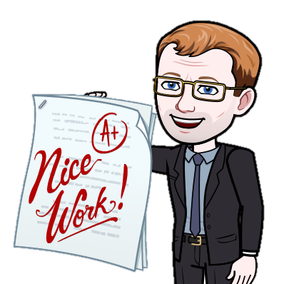
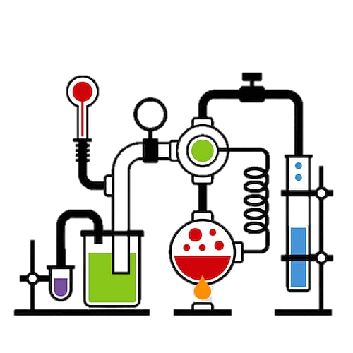
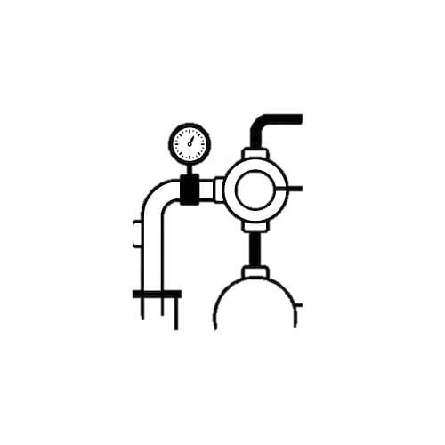
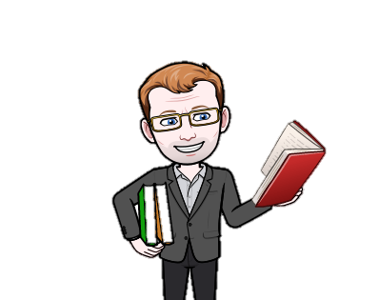
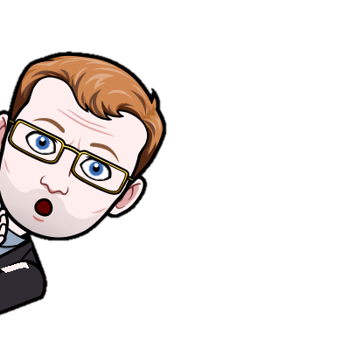
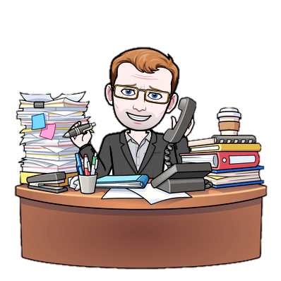
How to revise for exams: Top tips
Make a plan
Decide what you’re going to revise
Construct a detailed revision timetable, including any relevant papers or notes you need to look over
Make a list of what you know and what you don’t
Effective revision does not mean constant revision.
Start early
Take breaks
An anomaly is an observation that differs from expectation
The earlier you start and the more organised you are, the greater your chance of success
A
balanced diet will leave you feeling more focused
Stay calm and positive
Get a good night’s sleep
Eat healthily
If you have a bad day, try to not let it affect how you revise the next day
Exercise gets the blood flowing
Find a method that works for you
to the brain, which helps concentration
There are various revision techniques including flashcards, past papers, mind maps, group work and recording yourself talking and playing it back.
Regular exercise

