Slide 1
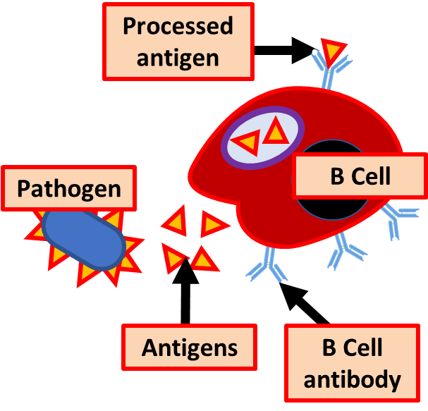
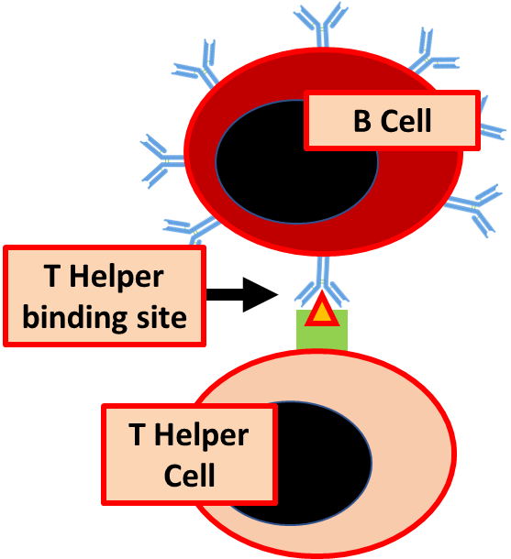
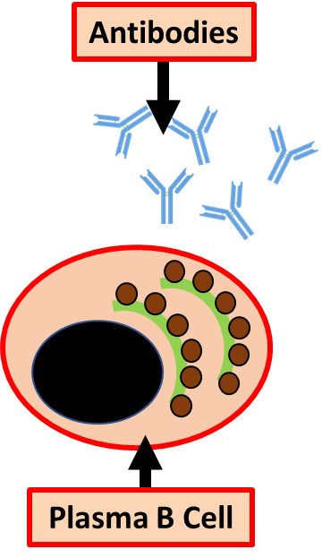
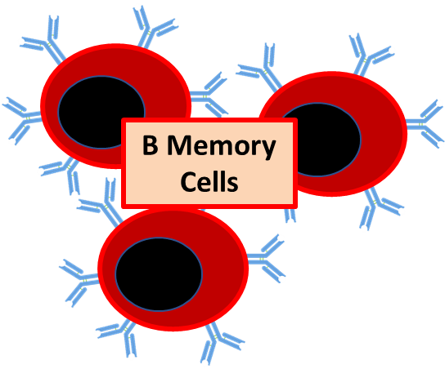
Humoral Immunity Practice Question
Specification Link:
Communicable Diseases: 4.1.1
Highlight key words in the information below:
B cells each have one of millions of distinctive surface antigen-specific receptors that are inherent to the organism’s DNA. For example, naive B cells express antibodies on their cell surface, which can also be called membrane-bound antibodies.
When a naive B cell encounters an antigen that fits or matches its membrane-bound antibody, it quickly divides in order to become either a memory B cell or an effector B cell, which is also called a plasma cell. Antibodies can bind to antigens directly.
The antigen must effectively bind with a naive B cell’s membrane-bound antibody in order to set off differentiation, or the process of becoming one of the new forms of a B cell.
How are antigens processed by specific B cells?
________________________________________________________________________________________________________________________________________________________________________________________________________
What role is played by helper T cells?
________________________________________________________________________________________________________________________________________________________________________________________________________
What is the difference between cell mediated and humoral immunity?
________________________________________________________________________________________________________________________________________________________________________________________________________________________________________________________________________________________________________________________________________________________________________________________________________________________________________________________________________________________________________________________________________
Explain the importance in terms on long term immunity of memory B cells
________________________________________________________________________________________________________________________________________________________________________________________________________________________________________________

Slide 2

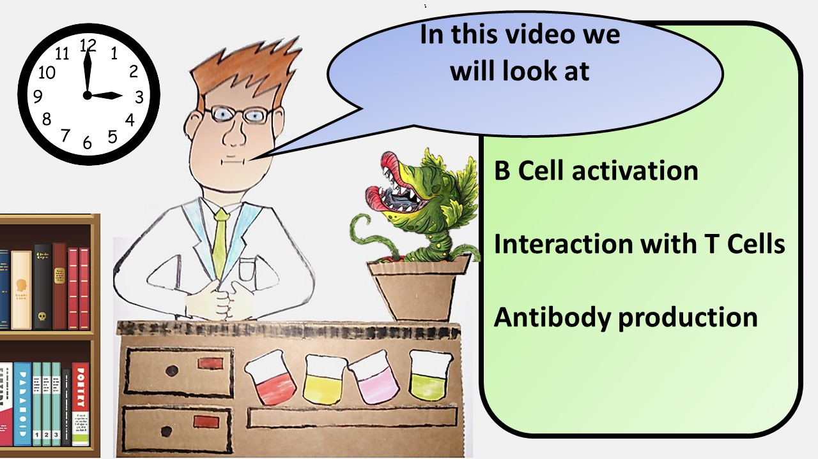


Click here to access my percentage composition youtube videos
Resources that this activity would work well with
Lesson on TES
Lesson on TPT
Follow me on social media to stay in touch
Keep up to date with my new content:

