Slide 1
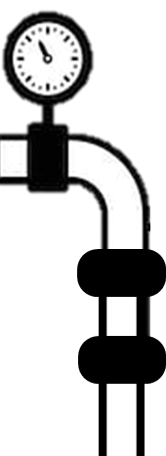

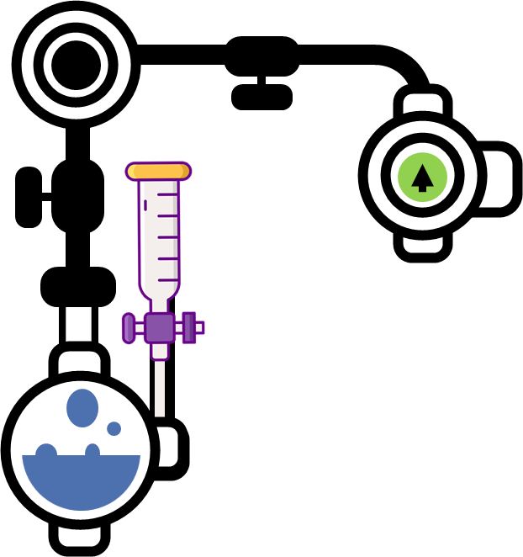

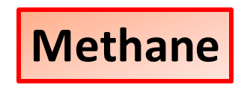
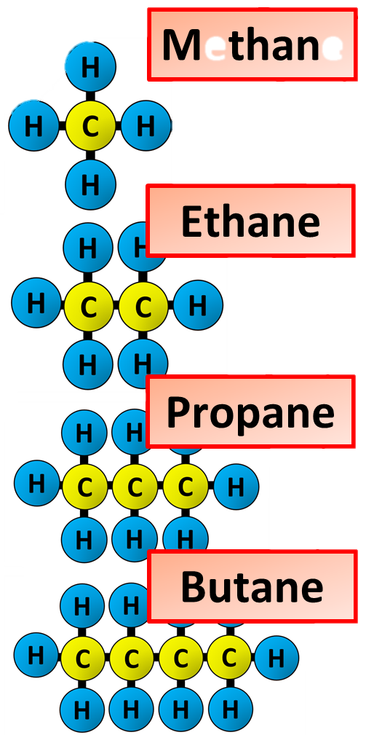
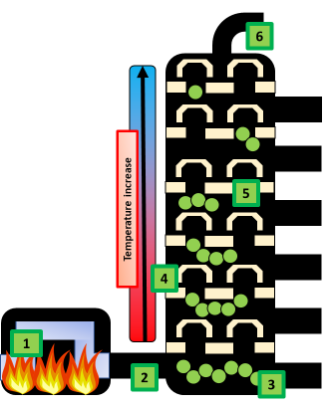
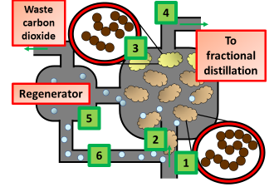
Hydrocarbons Notes
A hydrocarbon is an organic chemical compound composed exclusively of hydrogen and carbon atoms. Hydrocarbons are naturally-occurring compounds and form the basis of crude oil, natural gas, coal, and other important energy sources
Crude oil is a mixture of compounds called hydrocarbons.
Many useful materials can be produced from crude oil.
It can be separated into different fractions using fractional distillation, and some of these can be used as fuels..
Alkanes are saturated hydrocarbons. This means that their carbon atoms are joined to each other by single bonds. This makes them relatively unreactive, apart from their reaction with oxygen in the air - which we call burning or combustion. Like other homologous series, the alkanes show isomerism.
Fractional distillation differs from distillation only in that it separates a mixture into a number of different parts, called fractions. A tall column is fitted above the mixture, with several condensers coming off at different heights. The column is hot at the bottom and cool at the top. Substances with high boiling points condense at the bottom and substances with low boiling points condense at the top. Like distillation, fractional distillation works because the different substances in the mixture have different boiling points.
The crude oil is heated to about 350ºC. All of the crude oil is vaporised.
The vaporised crude oil enters the fractionating column.
It has started to cool. The fraction with the longest molecules (and the highest boiling point) condenses and falls to the bottom of the column.
The remaining crude oil vapours rise up through the bubble caps. The higher up the column the cooler it gets
The remaining longest-chained molecules condense and are removed at the next level as a new fraction.
This process continues until the vapours reach the top of the column where they have cooled to around 30ºC.
Cracking allows large hydrocarbon molecules to be broken down into smaller, more useful hydrocarbon molecules. Fractions containing large hydrocarbon molecules are vaporised and passed over a hot catalyst. This breaks chemical bonds in the molecules, and forms smaller hydrocarbon molecules (some with double bonds)
Long-chain hydrocarbons are heated until they turn into vapour
A catalyst of zeolite crystals is added to lower the temperature needed
The long chain hydrocarbon molecules are broken down
Cracked molecules are pumped into a fractional distillation column
During the reaction the catalyst becomes coated with carbon so is pumped into a regenerator where it is burnt off

Slide 2
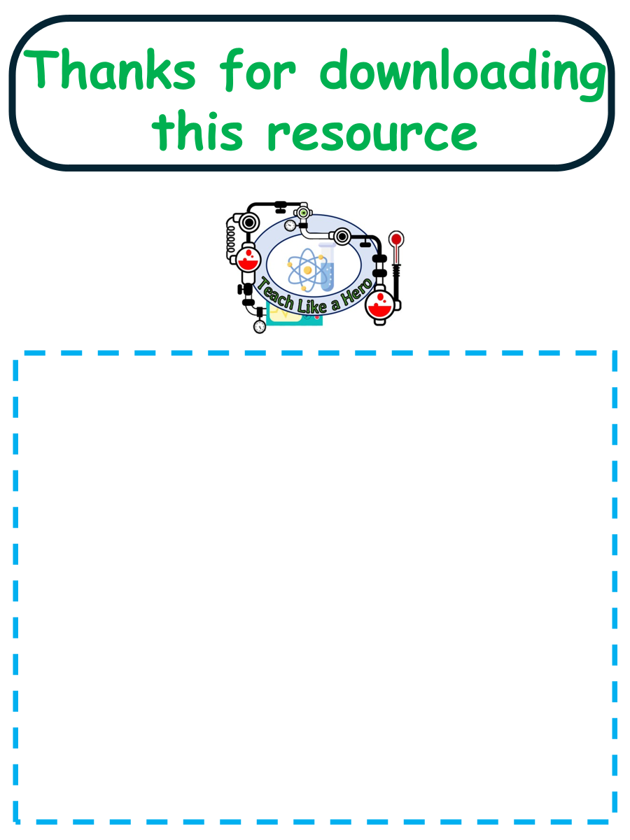
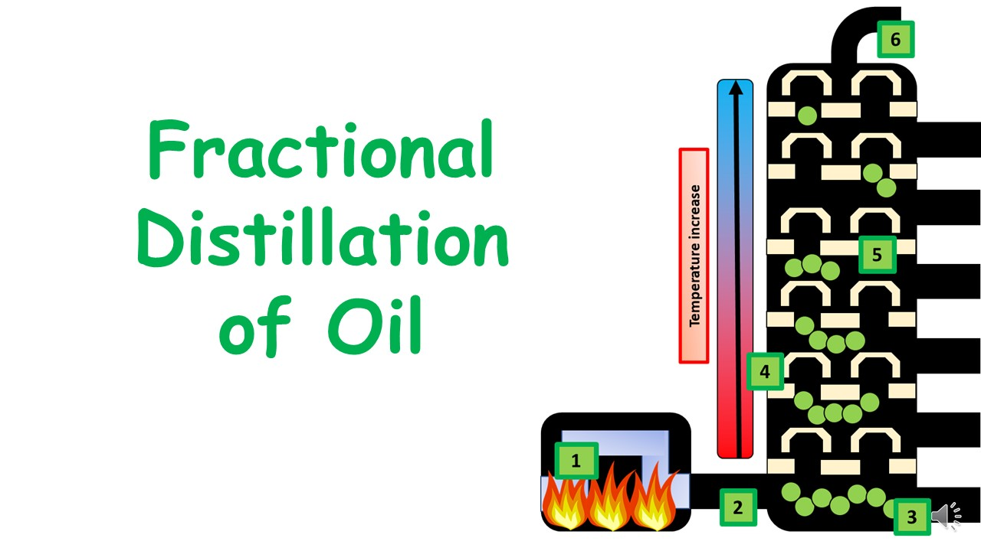


Click here to access my hydrocarbons youtube videos
Resources that this activity would work well with
Lesson on TES
Lessons on TPT
Follow me on social media to stay in touch
Keep up to date with my new content:

