Slide 1
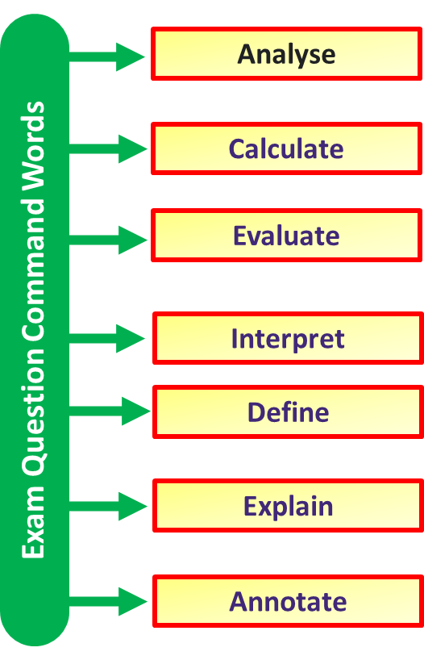
Improving Exam Technique
Key Idea
Read the question
Reread the question
Specification Link:
Science Revision
Method 1: Know the meaning of command words
Command words are the words and phrases used in exams and other assessment tasks that tell you how they should answer the question.
State – Give a simple answer such as a correct term or name.
Describe – Give detail about what happens, where is happens and when is happens. If it is “describe a graph”, give numbers and data from the graph.
Explain – Give detail about how and why it happens. Use specific key terminology within the topic/subject.
Suggest – Come up with an idea based on what you have learnt
Notes:
Print off enough boards for students to use them in pairs

Slide 2
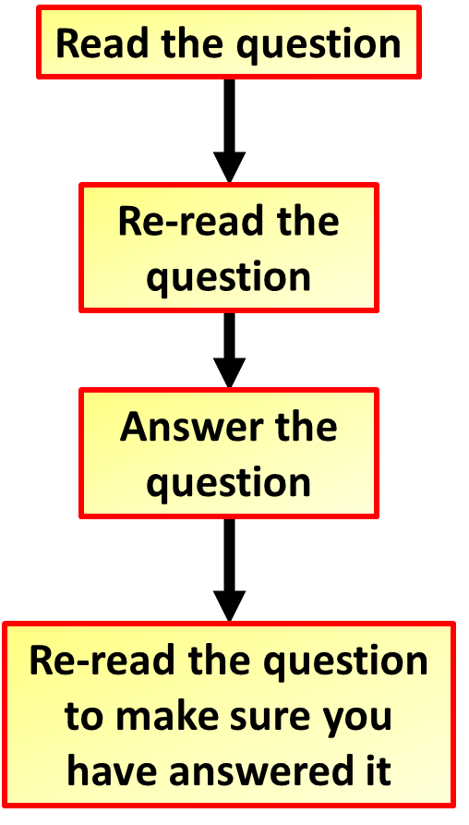
Improving Exam Technique
Key Idea
Read the question
Reread the question
Specification Link:
Science Revision
Method 2: Read the question thoroughly
Read the directions and questions more than once, if necessary. Underline key words. You don't want to re-answer a question
Box – Firstly, students box the command word. This highlights what type of answer the examiner is looking for.
Underline – Then they underline key words, this help jog your memory of the topic.
Glance – Finally they glance over the question again to gain any more information thus allowing you to analyse the question thoroughly and depict what they examiner is asking.
Notes:
Print off enough boards for students to use them in pairs

Slide 3
Improving Exam Technique
Key Idea
Read the question
Reread the question
Specification Link:
Science Revision
Method 3: Don’t miss out on equation question marks
Lots of easy marks are missed in exams when it comes to answering questions that involve equations. Take your time when answering the and remember the following:
Write down the equation you are going to use. If the “standard” form of the equation (e.g. F=ma) needs to be rearranged (e.g. a=F/m) then write down both forms, in case you rearrange the equation incorrectly.
Substitute the quantities from the question into your formula and carry out the calculation.
Write down the answer and don’t forget to use the correct unit.
Notes:
Print off enough boards for students to use them in pairs

Slide 4
Improving Exam Technique
Key Idea
Read the question
Reread the question
Specification Link:
Science Revision
Method 4: Don’t rush graph questions
When drawing a graph make sure you use the majority of the grid space available.
Always think about the features of the graph: what do the axis intercepts, the gradient of the line and the area underneath the line mean
Label each axis with the name of the quantity and its unit
In general:
The independent variable goes on the x-axis
The dependent variable goes on the y-axis
Notes:
Print off enough boards for students to use them in pairs

Slide 5
Improving Exam Technique
Key Idea
Read the question
Reread the question
Specification Link:
Science Revision
Method 5: Long answer questions
Lots of easy marks are missed in exams when it comes to answering long answer questions. You need to remember not to rush and make as many points as marks the question is worth
Try and remember everything you can about what the question is asking before you start answering it
Write in full sentences starting with capital letters and ending with full stops
Check your answer to make sure you have not left anything out
Remember to use key words when appropriate
Notes:
Print off enough boards for students to use them in pairs

