Slide 1
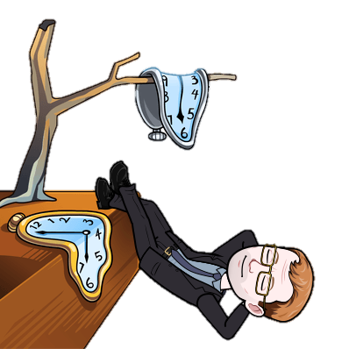
How to become an independent learner
Believe in your intelligent
Don’t be afraid to read outside the course material
Know when to seek help
Never be surprised by due dates
Know where to find your notes and documents
Be willing to try new study techniques
Seek and act on feedback
Give yourself time to reflect
Look for inspiration
Embrace your mistakes
Take risks with your own learning
Plan ahead
Teach someone else
Look for help online
Do your own research
Take time to think

